Slide 1
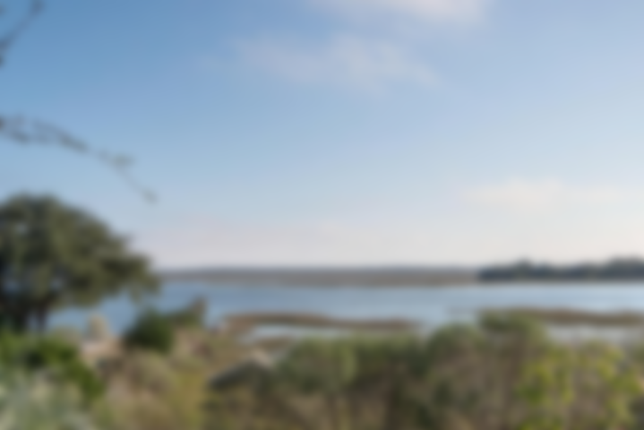
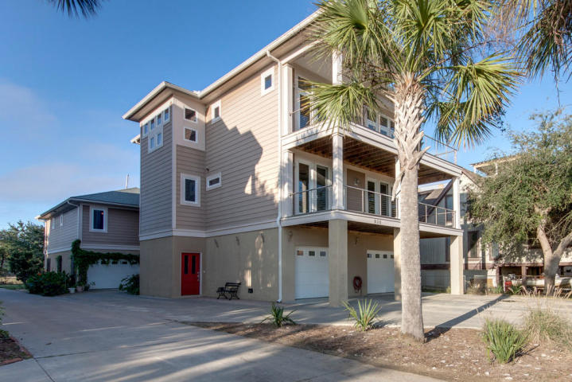
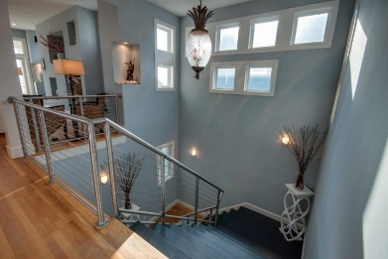
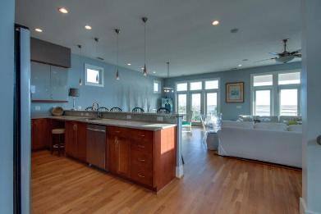
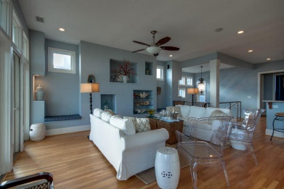
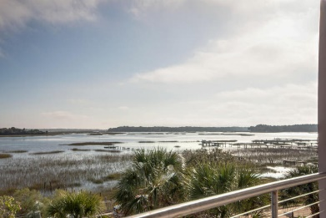
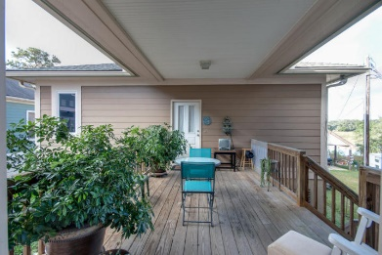
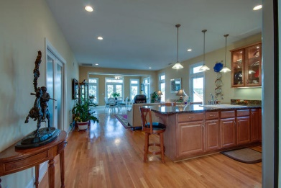
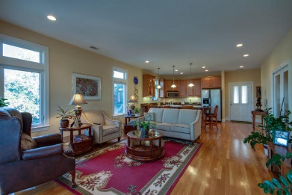
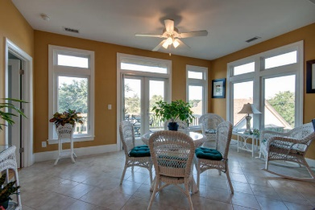


James Island Gem
938 W Oceanview Road
Oceanview Charleston
MLS# 18003157
$940,000
Unique, Private, Beautiful! This is TWO Homes Custom Built Low country waterfront Gem! A Total of 6 Bedrooms and 5 Baths. The Main house in front with Guest House connected by a breezeway in back. Elevator access in front garage. The Guest house (1200 sq. ft) has a creek view and 2 bedrooms and 1 bath Main house has Beautiful EXPANSIVE views of Clark Sound. Main house offers 4 bedrooms and 4 baths, very well done in every aspect, a must see! Very unique property tucked away in a corner of James Island, yet a short trip to Downtown Charleston. Short trip to the Edge of America, Folly Beach. Priced below last appraisal. Please confirm school district and all pertinent information. All info. is to the best of agent and seller's knowledge at listing time.
Jan Miller Cell (843) 345-9719 | Jan.Miller@nvrealtygroup.com
NV Realty Group | 91 Broad St, Ste A | Charleston, SC 29401
janmiller.nvrealtygroup.com

