Slide 1


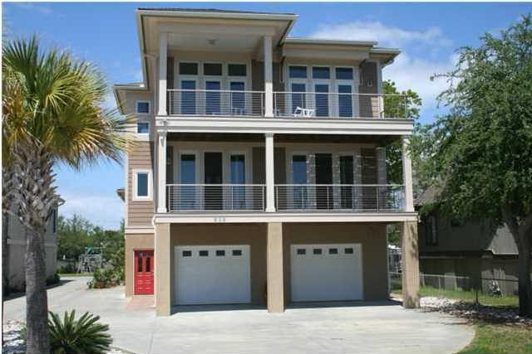
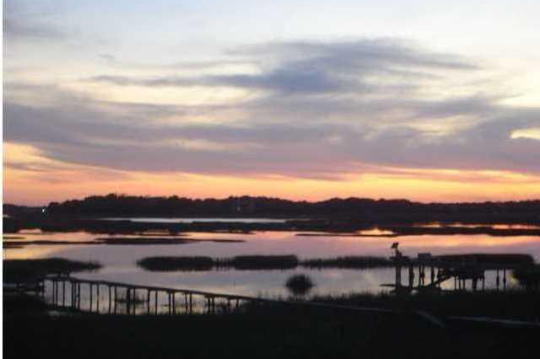
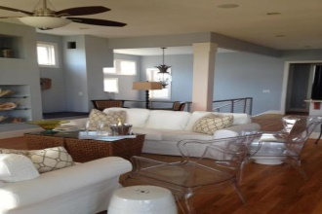
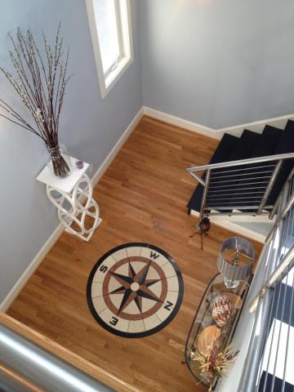
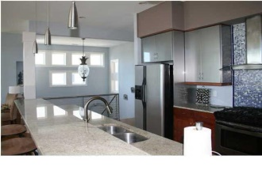
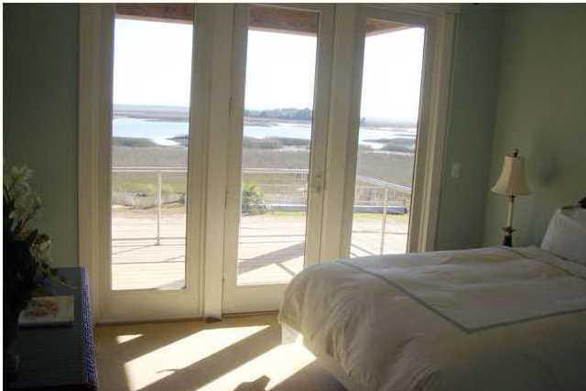
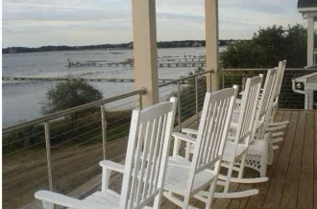
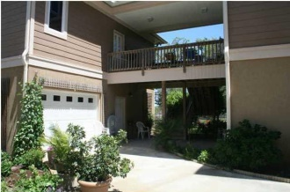


Hidden Gem on James Island with Deep Water and view of Clark Sound
938 W Oceanview Road
Oceanview - Charleston
MLS# 1410947 - $1,165,000
Seller is motivated &
Ready to sell!
This is an Executive Home with a Guest House connected by a breezeway in back.
Beautiful expansive view of Clark Sound.
Very unique property tucked away in a corner of James Island, yet close to access for a quick trip to Downtown and interstate connections.
Short trip to the Edge of America, Folly Beach.
The Main House is fabulous for entertaining and has an Elevator.
Dock permit in hand.
If you saw this house before, the entrance in front has been changed.
The house now has a more proper entrance foyer that is closed off from the garage.
Jan M. Miller, Broker Associate
jan.miller@goldenbearrealty.com
www.GoldenBearRealty.com
Golden Bear Realty | 654 Coleman Blvd, Suite 100 | Mt Pleasant , SC 29464
Cell (843) 345-9719 | Office (855) 352-9088 | Fax (561) 721-3311

