Slide 1
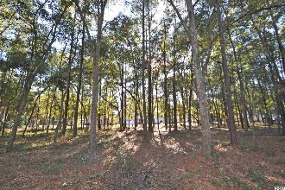
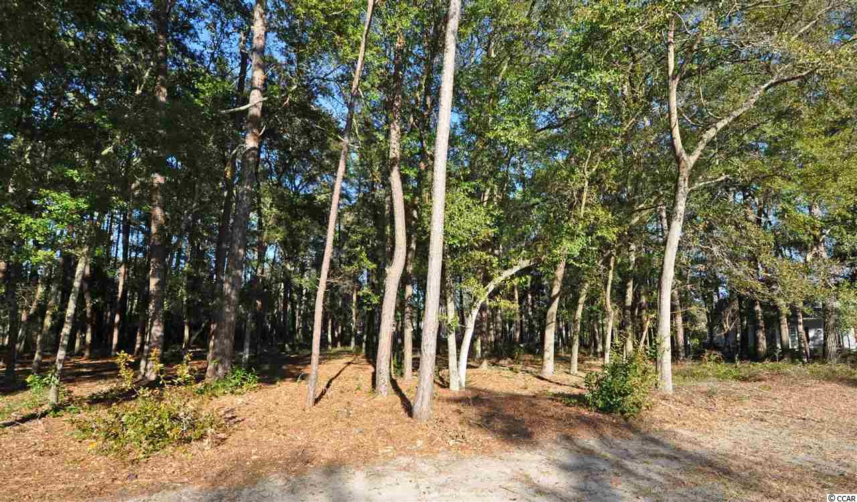
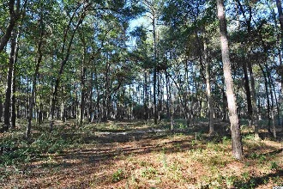
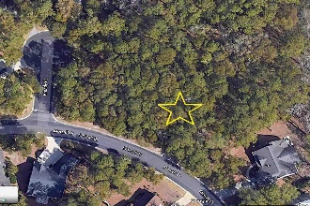
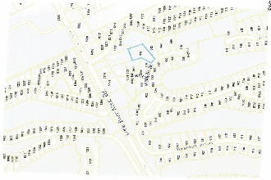
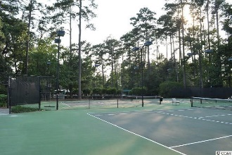
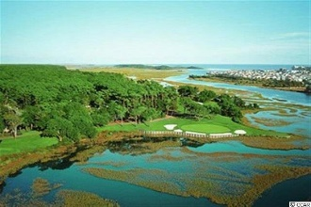
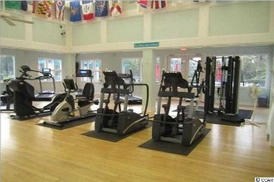
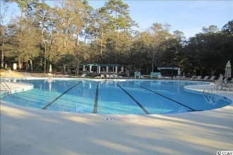
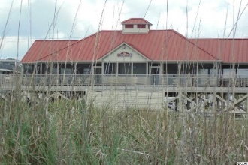


Large - Desirable - Private
938 Morrall Drive
The Bluffs of Tidewater Plantation | North Myrtle Beach, SC 29582
MLS# 2101726 | $99,999
Tidewater Plantation is a golf/Intracoastal Waterway/beach community boasting 24-hour manned, gated security. Lots 804/805 are located directly to the left of 942 Morrall Dr. as one faces this residential home. The preferred Bluffs Section adjoins the Cherry Grove Marsh and peaks at the Atlantic Ocean. The Bluffs represent some of the most spectacular property ever introduced in North Myrtle Beach. Home sites are located on the golf course, salt water marshes, freshwater lakes and interior wooded sites. There is no time frame to build, and the property is NOT in a flood zone! Low HOA fees and taxes as well. Features include the Tidewater Clubhouse Grill/bar, golf shop, driving range, fitness and amenity centers, numerous pools/hot tubs, clay and hard surface tennis courts, pickle ball court, bocce, and horseshoes. These enhancements have created a high standard of luxury living on the Grand Strand. This large, very desirable, approximately .98 ACRE lot is near two pine and hardwood cul de sacs -- affording privacy and low traffic flow. Non golf course lots present fewer restrictions as well, such as a possible option for a pool and/or hot tub as well as possible fencing within DRB guidelines. In addition to golf and being in an ICW community, Tidewater boasts many other rich amenities, including an owners' beach cabana located at 5800 North Ocean Boulevard on the Cherry Grove Beach, named the 11th best in the nation! The beach cabana features open and screened porches, bathrooms, kitchen and enclosed showers. Motorcycles and golf carts are not permitted within the Plantation, but can be placed in the Tidewater storage yard and driven onto public streets. This Tidewater complimentary, gated storage yard with 24 hour video surveillance can also be used for owners' boats, kayaks, jet skis, campers, trailers and recreational vehicles. The on-site, convenient HOA building has rooms for business and other meetings, events and a lending library. There are many clubs and activities year round. In Tidewater, you can do it all, or just relax in the luxurious Tidewater lifestyle. The Bluffs of Tidewater is contiguous along the Cherry Grove Inlet where the Atlantic Ocean meets the marsh. Tidewater itself is on a tree-line road to oceanfront Anne Tilghman Boyce Coastal Reserve, a nature conservancy, including Waties Island, with access for managed recreational use. Tidewater, a historic plantation, is on an elevated peninsula of live oaks and southern pines between the Intracoastal Waterway and the Cherry Grove Inlet to the Atlantic Ocean. The plantation also preserves the unique look of its own origins. It is close to the beach, shopping, entertainment, medical services, outstanding schools and parks and access to major highways. The jewel in the crown of the development is that private owners' beach cabana on the wide, white sands of the Cherry Grove Beach, just a few minutes drive. This charming lot enjoys a lovely, indigenous peaceful environment, along with the excellent reputation of the Tidewater Golf Course, the Pebble Beach of the East. Tidewater Plantation is located in one of the U.S.' top-10 beach towns, safe, popular and still affordable North Myrtle Beach. Welcome to the best of the best at the Beach!
Video Tour: https://www.youtube.com/embed/pfr8WeVOetU
Deborah Collins
843-424-9013
dctidewater@yahoo.com
Connie Ross-Karl
702-306-2643
conniesross@aol.com
NEW WAY PROPERTIES MYRTLE BEACH

