Slide 1
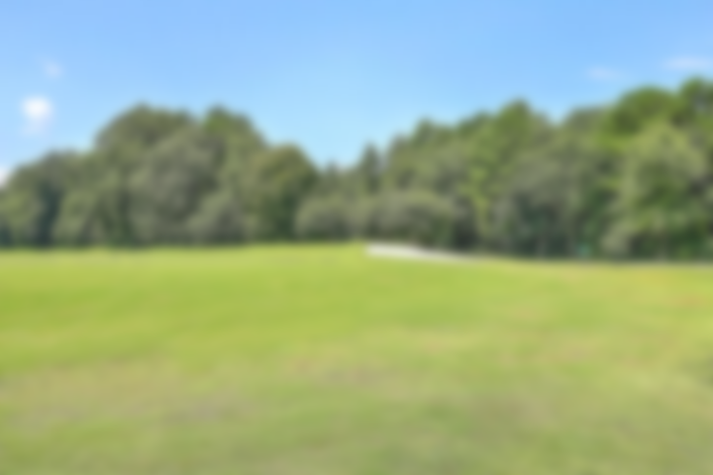
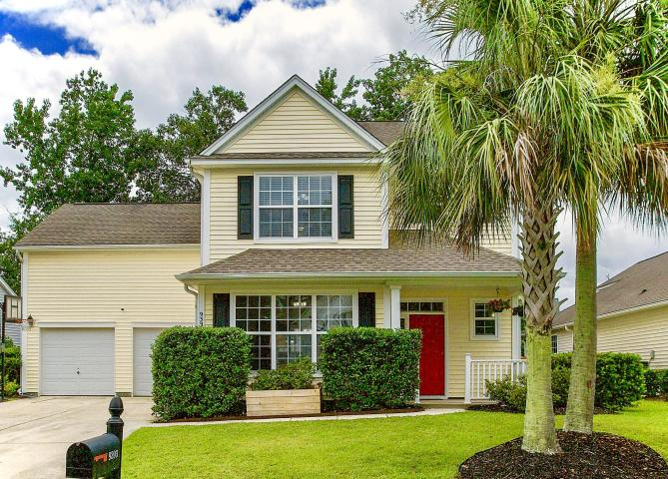
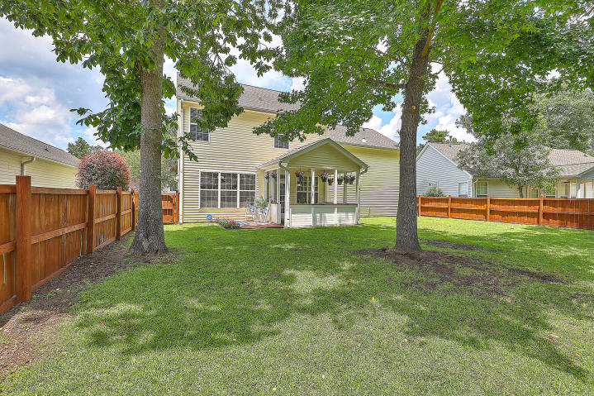
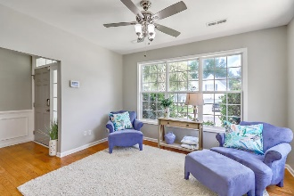
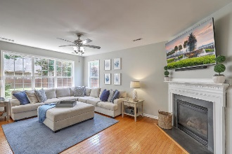
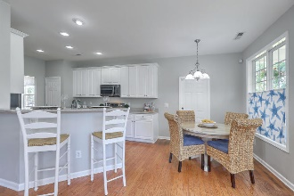
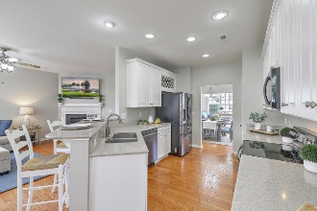
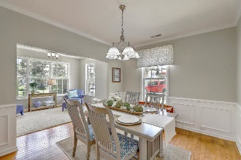
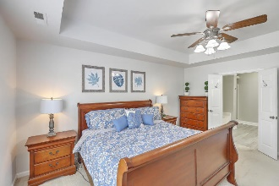
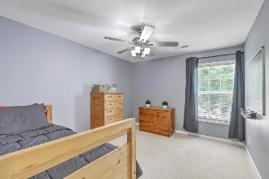
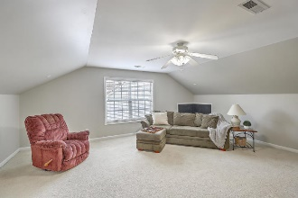
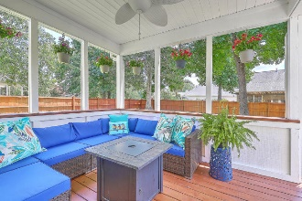
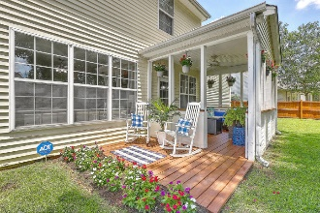
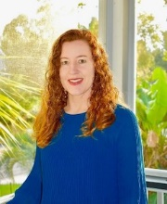

Price Reduced in Wescott Plantation
9393 Ayscough Road
Wescott Plantation | Summerville, SC 29485 | MLS# 20018962 | $317,500
Welcome to this gorgeous, impeccably-maintained, inviting, two-story home located in the highly desirable Wescott Plantation Golf Course Community!! This beautiful, cozy home sits on a beautifully raised, landscaped lot surrounded by azaleas, hydrangeas and palmetto trees, and is located in the award-winning Dorchester District 2 school system. The foyer entrance welcomes you to a freshly painted first floor and leads to a nice size formal living room with large windows and stunning natural light. Living room is open to the large separate dining room with crown molding and chair railing. Updated open kitchen includes 42 inch cabinets, quartz countertops, brand new stainless steel appliances, a breakfast bar, and a pantry. The kitchen opens up to a large family living area with amazing natural light and a corner gas fire place. Beautiful hardwood floors throughout the first floor add to the beauty of the home. A newly built, garden-inspired covered porch and patio overlooks a nice sized and shaded fenced in backyard. Upstairs the master bedroom includes a tray ceiling, ample light, large master closet, and an owner's bath with new ceramic tile floors, dual vanities, garden tub, and separate shower. Also you will find three nice size additional bedrooms; a full bath with ceramic tile. The impressively large 4 th bedroom can also be considered a bonus room and is pre-wired for surround sound! Walking distance to schools, neighborhood pool and parks, wonderful shopping and restaurants puts this home in the perfect area! Close to Mercedes-
Benz Van works, Boeing, Charleston Air Base, Charleston International Airport and other multiple growing businesses. This super clean home has been well cared for by the same owners since it was built. Enjoy the Amenities Center, which includes the large pool, playground, walking/jogging trails and more!!! Golf memberships available to those interested. This house is a must-see!
Virtual Tour: https://www.zillow.com/view-3d-home/22ef2668-2b35-4834-91c9-ec8649d030d0
Lane Gregory
843-737-1541
lanesellscharleston@gmail.com
The Boulevard Company, LLC
806 Johnnie Dodds Blvd Ste 100
Mt Pleasant, SC 29464

