Slide 1
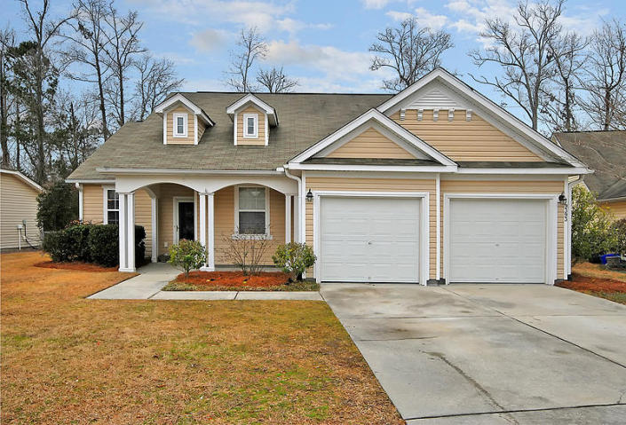
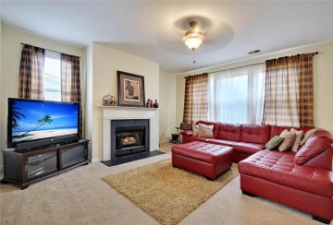
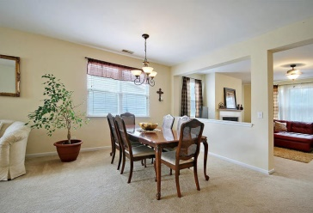
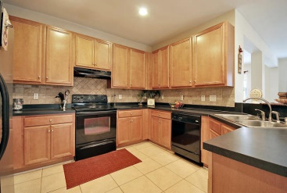
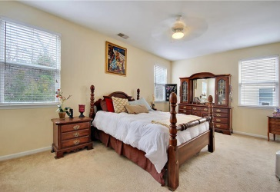
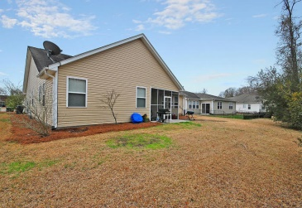


INCREDIBLE OPPORTUNITY!
9393 N Heyward Ct
Wescott Plantation
Summerville
MLS# 15003786
$209,300
Owner is extremely motivated and will consider reasonable offers.
Home is now vacant and easy to show.
This Remarkable Ranch style home is located in an Exclusive Country Club Community, is situated on a quiet tree-lined, cul-de-sac street and is surrounded by a private landscaped golf course lot!
This Amazing home with 9 ft. smooth ceilings offers 3 large bedrooms including a spacious master bedroom suite that offers a holly-wood style bathroom with a popular soaking tub, a surprising stand alone shower and a large walk-in closet, the valuable family room with 9 Ft ceilings offers a classic gas fireplace, the unique living room and dining room are large and will accommodate all your family and friends, the modern Kitchen is perfectly situated and is appointed with beautiful ceramic flooring, crafted 42 inch cabinets and upgraded built-in appliances.
The secret room off the foyer is very flexible and perfect for an office or kids play room. There is a private walk out to the useful oversized screened-in porch and offers private views of the golf course.
"Are You Kidding Me"? Don't miss this once in a life time Opportunity! The homes in The Vistas have irrigation and all lawn maintenance is provided through the regime fee. Age, Sqft, taxes, HOA fees, lot size, schools are all approx. Buyer to Verify.
Bill Everett, Jr
Broker
Office 843-767-7777
Direct 843-693-8539
Fax 843-576-5352
RE/MAX Pro Realty, 9209 University Blvd, Charleston, SC 29406

