Slide 1
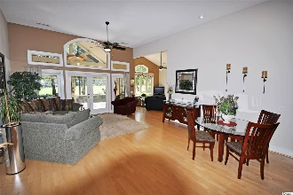
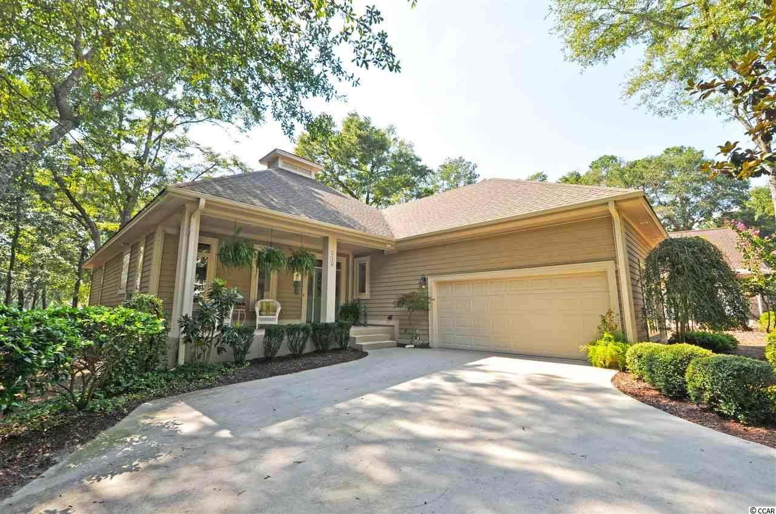
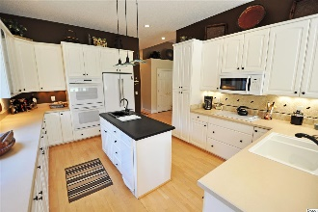
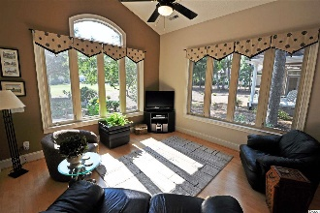
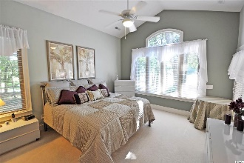
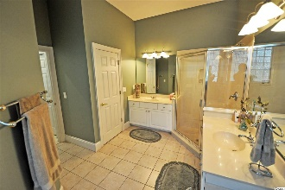
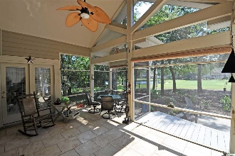
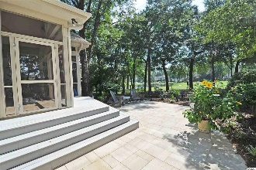
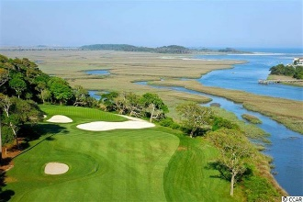
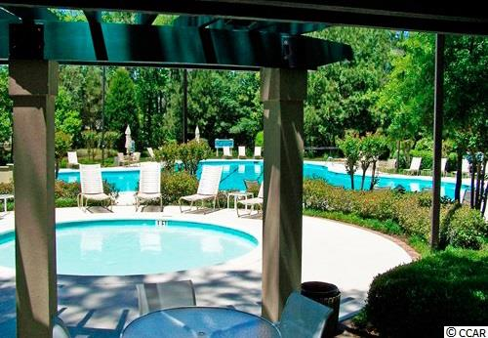
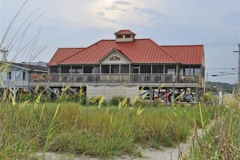


939 Morrall Drive
Tidewater Plantation Resort ~ North Myrtle Beach
MLS# 1719930 ~ $389,900
Fine craftsman-inspired touches in a contemporary, custom-built, open and airy beach house make this ONE-owner home ONE of the most memorable in the prestigious Bluffs of Tidewater Plantation Resort, North Myrtle Beach. It is truly ONE of a kind, too, the only desirable Cape Romaine plan of its type in Tidewater. The hand-picked golf course cul-de-sac lot allows the house to blend naturally into its rustic environment of lake and green and light woods to create a pleasurable, seamless in- and outdoor-lifestyle. Watch egrets, heron and other coastal-Carolina local-favorite birds nesting in the trees or feeding by the lake. And, oh, yes, there is the occasional indigenous golfer sharing the 14th green of the world-class Tidewater Golf Course. Privacy, peace and perfection are free-flowing in an upscale comfortable, easy-living space. Subtle colors and attention to even the most subtle design detail define the 3-split-bedroom, 2½-bath home. Other features include 10 - 12-ft.-high and vaulted ceilings; Carolina room; front and screened back porches with graduated deck and patio; big workable kitchen, with double ovens and convenient breakfast bar; side double-car garage with sink and ease of outside access; laundry with large sink and much more. So see it soon, as it may not be available long! And do take the virtual tour now for a wonderful walk-through at your leisure.
Amenity-rich Tidewater is a 24-hour, manned gated community on a tree-lined road to oceanfront Anne Tilghman Boyce Coastal Reserve, a nature conservancy, including Waities Island, with access for managed recreational use. Tidewater itself is on an elevated peninsula of live oaks and southern pines between the Intracoatal Waterway and the Cherry Grove Inlet to the Atlantic Ocean. The plantation also preserves the singular look of its own historic origins. It is minutes from the beach, shopping, entertainment and access to major highways. The development boasts a private owners' beach cabana on the wide, white sands of the Cherry Grove Beach.
Deborah Collins
843-424-9013
dctidewater@yahoo.com
Connie Ross-Karl
702-306-2643
conniesross@aol.com
NEW WAY PROPERTIES MYRTLE BEACH

