Slide 1
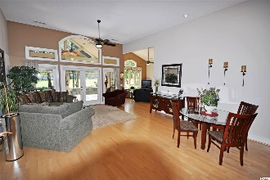
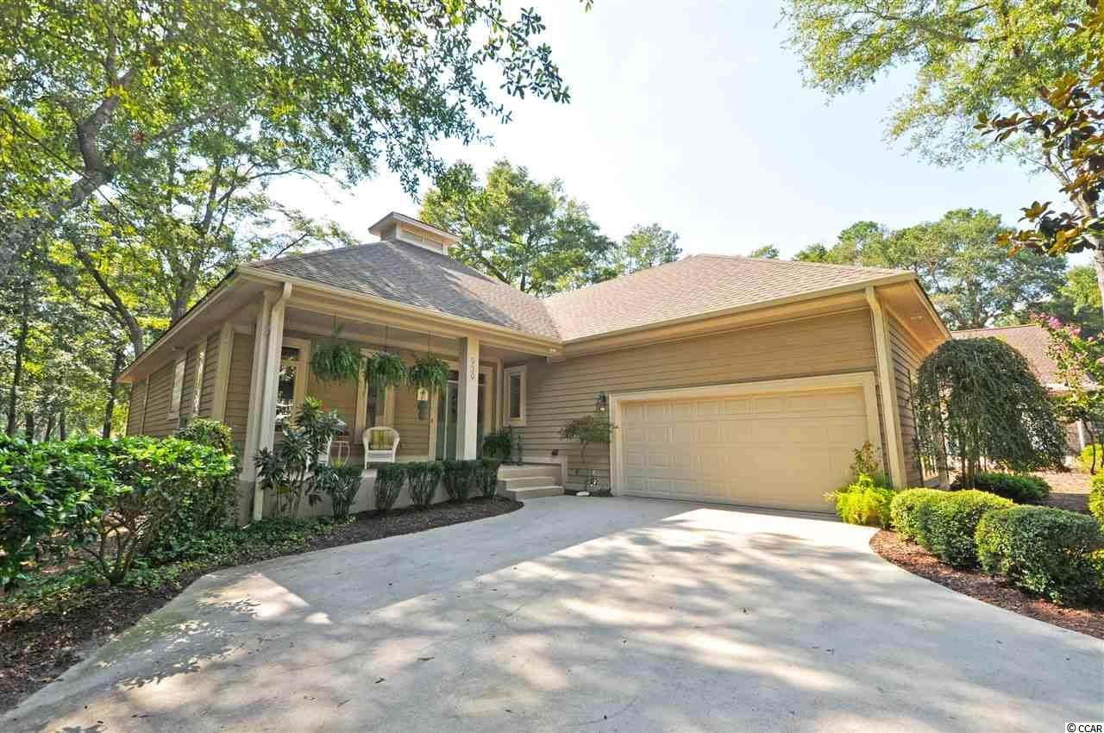
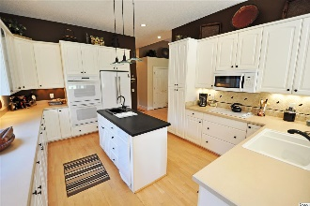
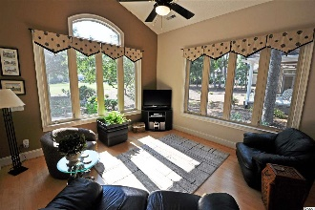
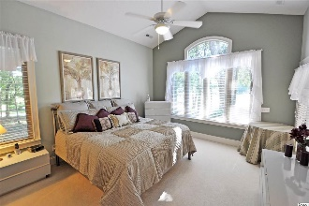
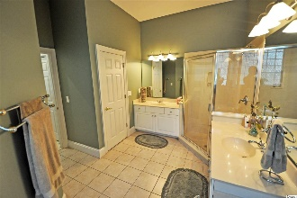
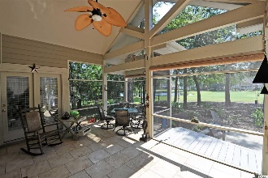
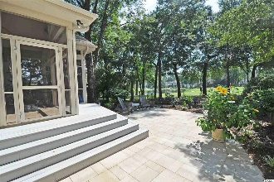
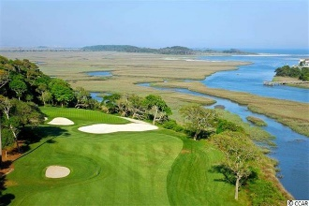
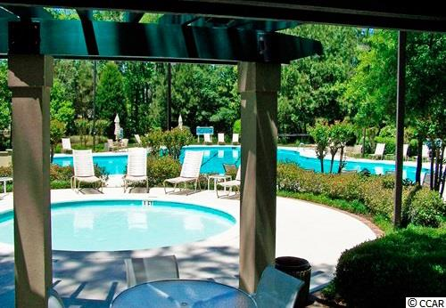
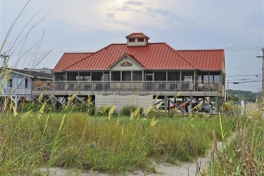


939 Morrall Drive
Tidewater Plantation Resort ~ North Myrtle Beach
MLS# 1920749 ~ $399,900
Fine craftsman-inspired touches in a contemporary, custom-built, open & airy beach house with new upgrades & features make this wonderful home ONE of the most memorable in the prestigious Bluffs of Tidewater Plantation Resort, North Myrtle Beach. It is truly ONE of a kind, too, the only Cape Romaine plan of its type in Tidewater. The hand-picked golf course cul-de-sac lot allows the house to blend naturally into its rustic environment of lake and green and light woods to create a pleasurable, seamless in- and outdoor-lifestyle. Watch egrets, heron and other coastal-Carolina local-favorite birds nesting in the trees or feeding by the lake. And, yes, there is the occasional indigenous golfer sharing the 14th green of the world-class Tidewater Golf Course. Privacy, peace and perfection are free-flowing in an upscale comfortable, easy-living space. Subtle colors and attention to even the most subtle design detail define the 3-split-bedroom, 2½-bath home. Other features include 10 - 12-ft.-high and vaulted ceilings; Carolina room; front and screened back porches with graduated deck and patio; big workable kitchen, with double ovens and convenient breakfast bar; side double-car garage with sink and ease of outside access; laundry with large sink, and much more. So perfectly redone, too, it may not be available long! So take the virtual tour now for a video walk-through at your leisure. Amenity-rich Tidewater is a 24-hour, manned gated community on a tree-lined road to oceanfront Anne Tilghman Boyce Coastal Reserve, a nature conservancy, including Waities Island, with access for managed recreational use. Tidewater itself is on an elevated peninsula of live oaks and southern pines between the Intracoatal Waterway and the Cherry Grove Inlet to the Atlantic Ocean. The plantation also preserves the singular look of its own historic origins. It's minutes from the beach, shopping, entertainment and access to major highways. The development boasts a private owners' beach cabana on the wide, white sands of the Cherry Grove Beach. This home enjoys that pristine, cottage environment. Walk in from the lovely front porch to the entire living room & the open panorama provided by high ceilings and lots of large, interesting windows. Notice the peaked architectural touches through to the screened porch. Natural light abounds, and windows are all insulated. The casual dining area is to the right, close to the expansive kitchen & the guest powder room. And what a kitchen -- large with breakfast bar, patio, access for grilling, work island with sink & second disposal, compactor, pantry & more -- opens directly to the Carolina room. The living area offers singular touches, including new ceramic tile floors and free-flow to all living spaces. The roomy screened-in porch is not only off the living, but the Carolina and master-bed rooms, and provides seasonal relaxation, dining, entertainment and always the view! The master has size, comfort, two walk-in closets, en suite with double-sink vanity, separate water closet and walk-in shower. There are two other big bedrooms and a guest full bath; one bedroom is being used as an office. Storage is plentiful. Front entry has a nice double-door closet. The over-sized 2-car garage has pull-down steps to a full-floored attic. Entry from the garage leads to the laundry room and on to baths, guest room and kitchen. Well cared for, value, comfort and location, this Tidewater house on nearly a third-acre is the perfect choice for a contemporary, easy-living beach home – ONE of its kind! Tidewater amenities at low HOA fees include that oceanfront beach cabana. Bluffs residents enjoy the use of 3 pools/hot tubs. Other amenities include driving range, golf shop, clubhouse with bar and dining overlooking the 18th hole, clay & hard-surface tennis courts, pickle ball, fitness center, bocce courts, amenity center/more. There is even a gated storage yard. Tidewater Plantation truly reflects a "way of life." Welcome home! Schedule a Private Showing.
Deborah Collins
843-424-9013
dctidewater@yahoo.com
Connie Ross-Karl
702-306-2643
conniesross@aol.com
NEW WAY PROPERTIES MYRTLE BEACH

