Slide 1
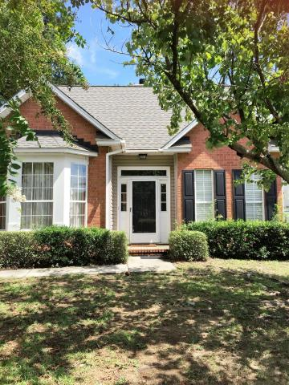
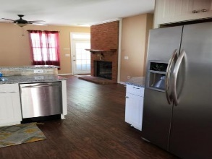
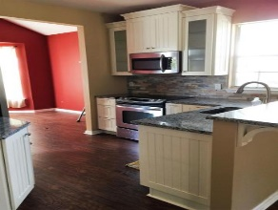
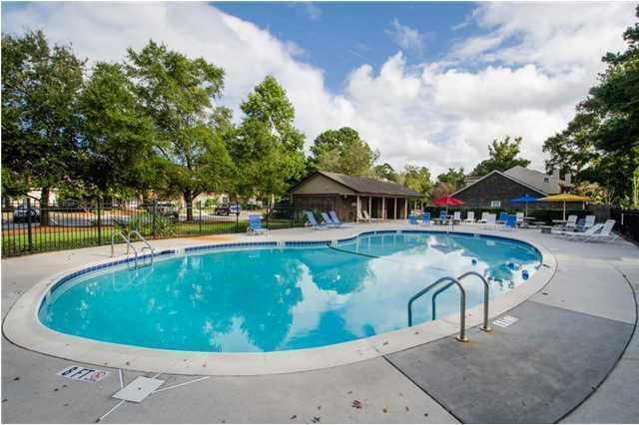
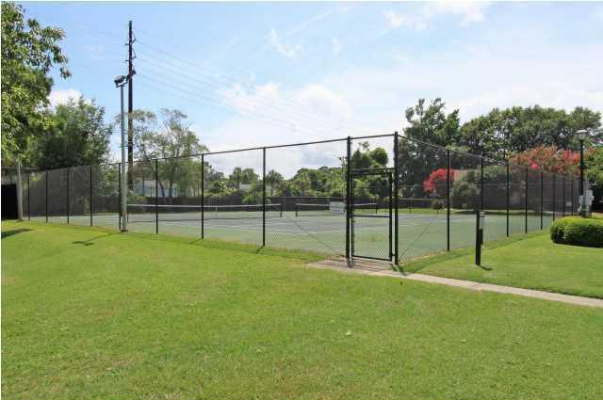


Reduced!
Move In Ready!
Open House Saturday 12-3 Refreshments Provided
939 Provincial Circle
Patriots Province :: Mount Pleasant :: MLS# 15023583 :: $349,900
This super convenient, charming low maintenance home is just steps from the Ravenel Bridge, moments to Shem Creek and minutes to Sullivan's Island in desirable Mount Pleasant. This home features a spacious and open floor plan with nine foot ceilings on the main level, fireplace in the family room, separate dining room with vaulted ceiling, full laundry room, half bath and a master suite with large walk-in closet on the first level. The second floor features two more bedrooms each with surprisingly generous closets. Detached garage is tucked away behind the home in the private backyard. Enjoy virtually maintenance-free living. HOA dues cover yard maintenance and exterior maintenance. UPDATED KITCHEN! $$1000.00 painting allowance with acceptable offer.
Donna Evans
REALTOR, ABR, CRS, EPRO, GRI
Office - (843) 972-2400 | Mobile - (843) 568-3948
donna@comeliveincharleston.com | www.comeliveincharleston.com
RE/MAX Advanced Realty | 311 Johnnie Dodds Blvd | Mt Pleasant, SC 29464

