Slide 1
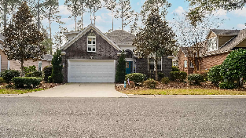
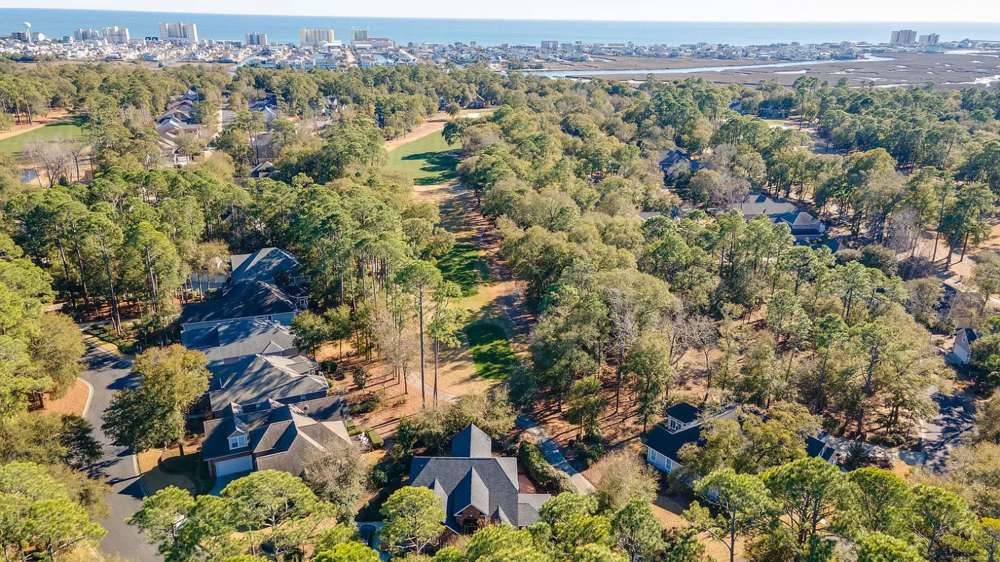
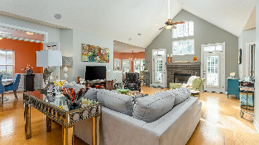
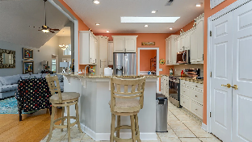
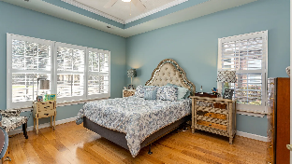
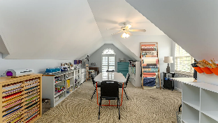
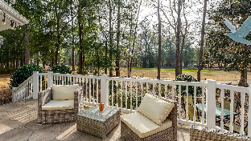
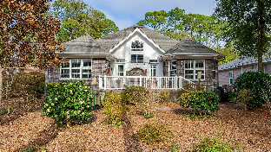
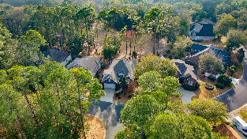
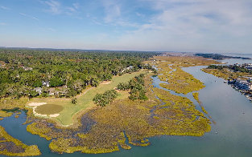
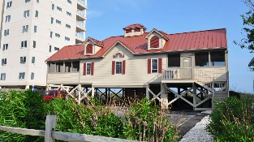



Welcome to the the Best of the Beach!
939 Heshbon Drive
The Bluffs of Tidewater Plantation | N Myrtle Beach | MLS# 2303659 | $559,000
Unexpected! This well-priced custom-built home (plans available) offers the surprise of a beautiful neighborhood and wonderful golf-course location -- on the 11th hole of world-class Tidewater Golf Course, named the best in the nation in 2022 – and of its all-brick construction! Stunning, also across from a serene peninsula amid lush treed cul-de-sacs, much privacy and natural surroundings. Very walk able and invites bike-riding, too...Then come in through the brick front porch and formal entry-foyer to the panorama of soft Caribbean colors in the great main living space of the living room with fireplace and lovely vaulted cathedral ceilings, formal dining room featuring wainscoting, and fabulous kitchen with all-new stainless steel appliances and rich granite counter tops showcasing counter-depth drawers. It is fun flex space for ease of decor and function. Plus, it lives contiguously to the inviting back porch, brick, of courser, and to the picture-perfect setting of backyard relaxation, dining and golf-course scenery. Inside on the main level are three spacious bedrooms and two and a half baths. The master en suite with whirlpool tub looks out on the golf view, as well, and is very private and pretty. Two other bedrooms share a bath and are in the preferred split-bedroom floor plan. Marvel at the eye-catching plantation shutters throughout and to the striking over-sized living space on that main level. A laundry/utility room with handy mud sink connects the kitchen to the garage (sink in garage, too). Another surprise of the BIG bonus room upstairs, another large full bath and a huge area in the attic set aside for storage. More storage is in the double-car garage. Important to note are the newer roof installed in January 2020 with 15-year warranty and the Bryant 4-zone HVAC system with air purifier. In addition to golf & being in an ICW community near the beach, Tidewater boasts many other rich, upscale amenities, including owners' beach cabana on the Cherry Grove Beach named the 11th best in the nation, pools & spas, clay & hard-surface tennis courts, pickle ball, bocce, horseshoes, amenities center, fitness center, driving range and putting green, 24-hour gated manned security, and clubhouse with bar & restaurants. There is even a complimentary gated storage yard for boats, campers, recreational vehicles and the like. The on-site, convenient HOA building has rooms for business and other meetings and events and a lending library. There are many clubs and activities year round. In Tidewater, you can do it all, or just relax in the luxurious Tidewater lifestyle. The Bluffs of Tidewater is contiguous along the Cherry Grove Inlet where the Atlantic Ocean rolls into the marsh. This home, therefore, is highly sought after by the investor or primary or vacation home owner who desires to acquire an extraordinary golf/ICW/beach property at today's market price. Tidewater itself is on a tree-lined road to oceanfront Anne Tilghman Boyce Coastal Reserve, a nature conservancy, including Waties Island, with access for managed recreational use. Tidewater, a historic plantation, is on an elevated peninsula of live oaks and southern pines between the Intracoatal Waterway and the Cherry Grove Inlet to the Atlantic Ocean. The plantation also preserves the unique look of its own origins. It is close to the beach, shopping, entertainment, medical services, outstanding schools and parks and access to major highways. The jewel in the crown of the development is that private owners' beach cabana on the wide, white sands of the Cherry Grove Beach, just a few minutes drive. This charming, livable and cheerful home also enjoys a compelling price and low HOAs and taxes along with the excellent reputation of the Tidewater Golf Course. Tidewater Plantation, in one of the U.S.'s top-5 beach towns, North Myrtle Beach, truly reflects a "way of life." Do not let this versatile, immaculate all-brick home get away. Welcome to the the Best of the Beach!
Video Tour: https://youtu.be/_Rz_HXlRlwk | Virtual Tour: https://my.matterport.com/show/?m=DJhgBFw5gLH
Connie Ross-Karl
702-306-2643
conniesross@aol.com
Ronnie Nichols
Realtor / BIC
ronnienichols8@aol.com
NEW WAY PROPERTIES MYRTLE BEACH

