Slide 1
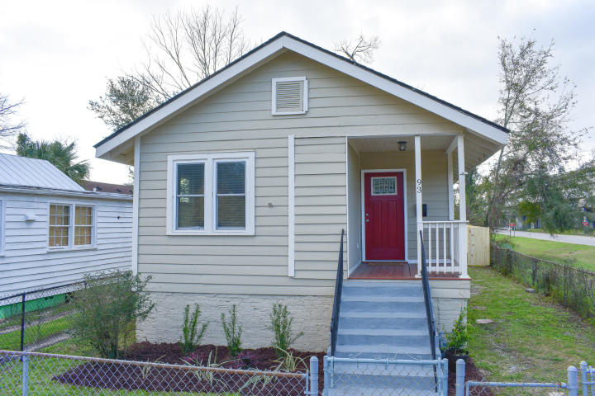
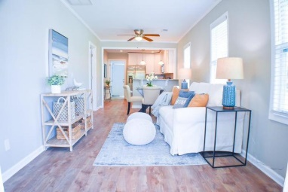
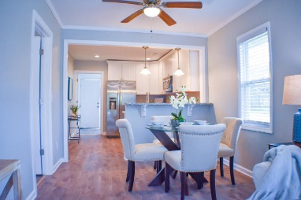
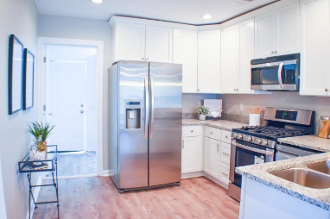
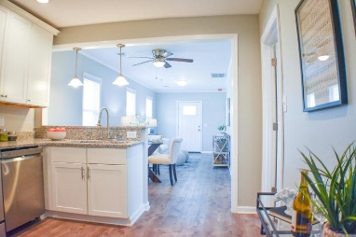
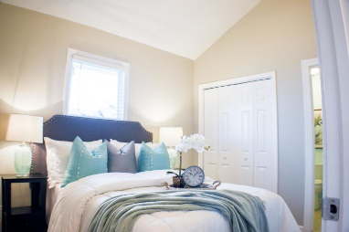
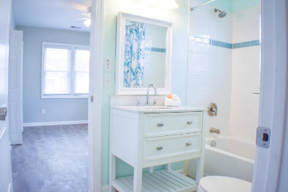
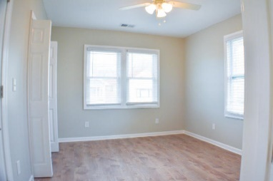
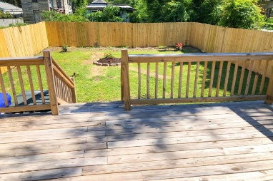

Name Your Price…All Offers Considered!
Completely Renovated ~ Come Take A Look
Starbucks card to first 10 agents
93 Romney Street
Romney Village
Charleston, SC 29403
MLS# 20005780
Home has been completely renovated and is ready to move in. New range dishwasher and microwave. Tankless water heater. and garbage disposal. three bedrooms, two baths, laundry room and very nice deck on rear of home, NOT TO MENTION LOCATION, LOCATION LOCATION. Close to interstate, and all major Hwys. Mt. Pleasant, North Charleston and Folly Beach. Home located In the heart of downtown Charleston. Great for sightseeing by driving, biking and walking.
Come take a look. You will be glad you did.
Geraldine Sands
(843) 224-1911
gw.sands67@gmail.com
AgentOwned Charleston Group | 902 Savannah Hwy | Charleston, SC 29407-7802

