Slide 1
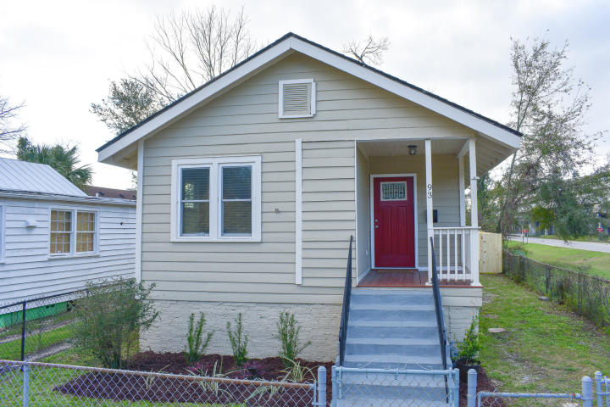
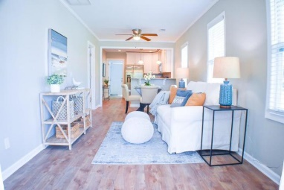
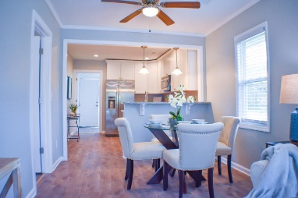
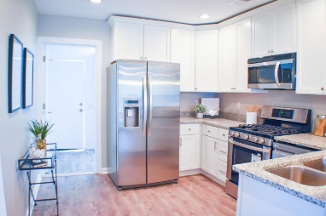
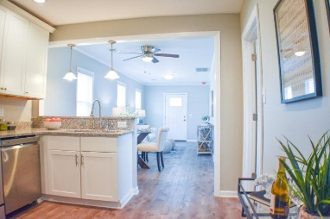
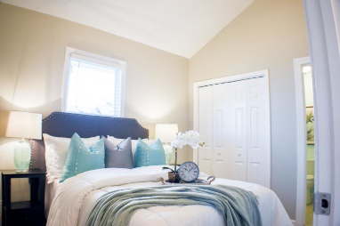
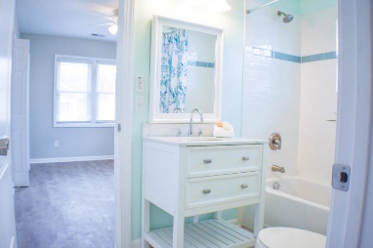
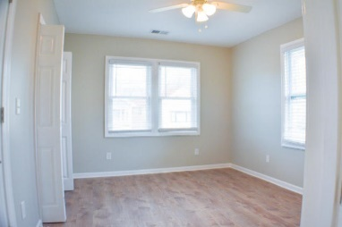
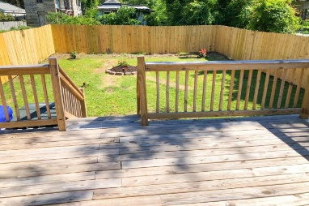

Completely Renovated Home Downtown.
Name Your Price…All Offers Considered!
Starbucks card to first 10 agents
93 Romney Street
Romney Village
Charleston, SC 29403
MLS# 20005780
Looking to downsize?
Enjoy walking?
Want to be close to stores and restaurants?
Come and see.
Make an offer and get ready to enjoy a great change in life style.
Geraldine Sands
(843) 224-1911
gw.sands67@gmail.com
AgentOwned Charleston Group | 902 Savannah Hwy | Charleston, SC 29407-7802

