Slide 1
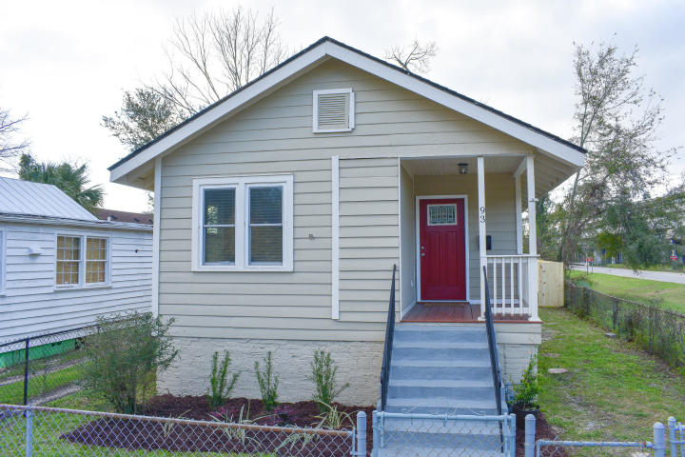
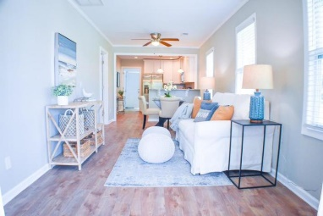
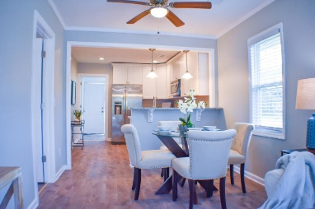
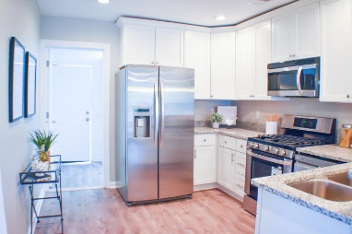
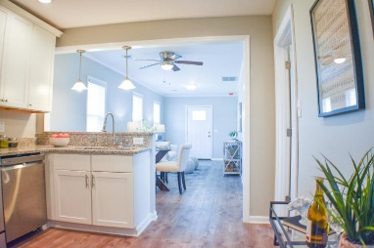
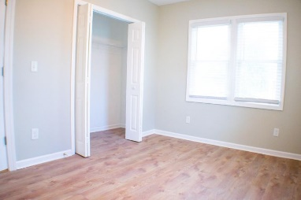
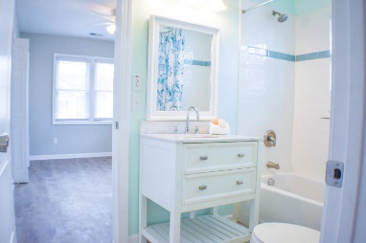
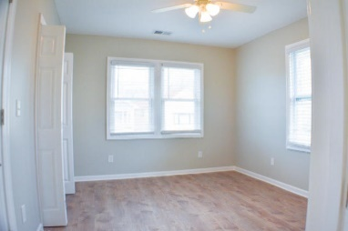
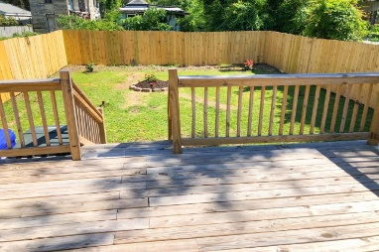

Completely Renovated Home Downtown $10,000 REDUCTION ENJOY A 6 MONTH LEASE BEFORE YOU CLOSE!
Starbucks card to first 10 agents
93 Romney Street
Romney Village
Charleston, SC 29403
MLS# 20005780
$359,900
Home has been completely renovated and is ready to move in. New range dishwasher and microwave. Tankless water heater. and garbage disposal. three bedrooms, two baths, laundry room and very nice deck on rear of home, NOT TO MENTION LOCATION, LOCATION LOCATION:. Close to interstate, and all major Hwys. Mt. Pleasant, North Charleston and Folly Beach. Home located In the heart of downtown Charleston. Great for sightseeing by driving, biking and walking. Come take a look. You will be glad you did.
NOW YOU CAN RENT FOR 6 MONTHS BEFORE BUYING. SEE AGENT FOR DETAILS.
Geraldine Sands
(843) 224-1911
gw.sands67@gmail.com
AgentOwned Charleston Group | 902 Savannah Hwy | Charleston, SC 29407-7802

