Slide 1
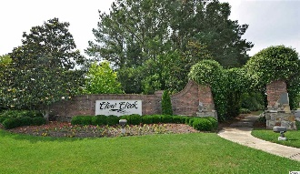
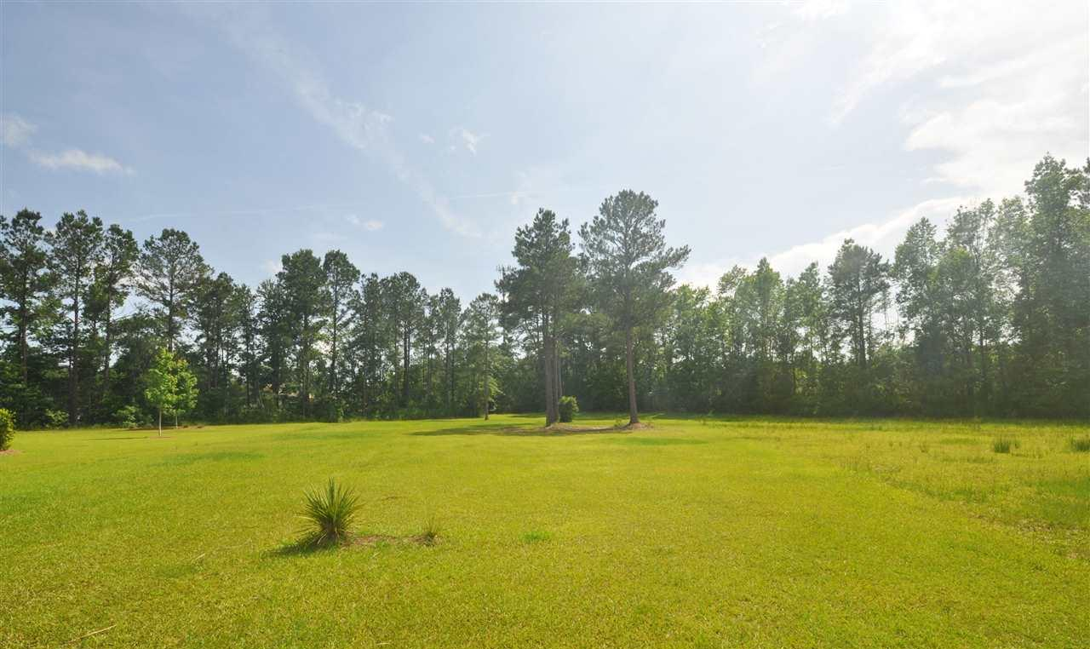
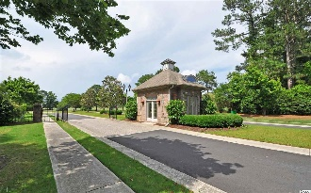
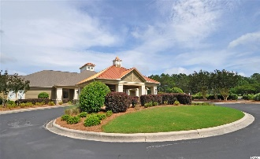
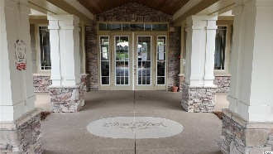
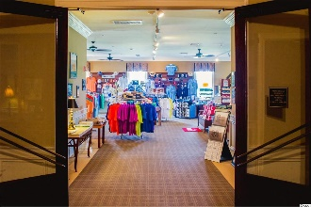
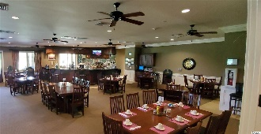
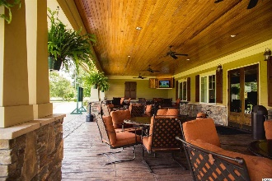
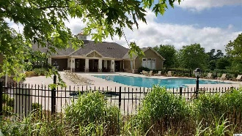
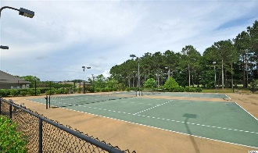
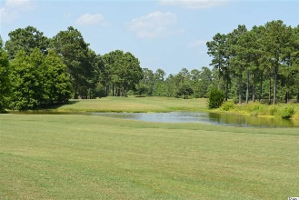


Ready For Your Dream Home
9442 Old Salem Way
Crow Creek ~ Calabash, NC 28467
MLS# 2011185 ~ $44,900
There is just something special about Crow Creek that sets it apart from other luxury golf/beach residential resorts. (Take the virtual tour herein of the pretty drive to this secluded cul-de-sac lot overlooking a lovely lake and request the photo slide show of the communities' many enjoyable amenities.) For starters, there is a world-class golf course located in the quaint fishing village of Calabash, NC: Crow Creek Golf Club is an 18-hole public course designed by architect Rick Robbins. Residents have a discounted rate without being a member! Since opening in 2000, the course has touted its reputation for being one of the most immaculately maintained along the East Coast. The tifsport bermuda fairways and V8 bent-grass greens, along with the challenging and fun layout, make Crow Creek a preferred stop for visiting golfers, as well as a top locals' favorite. There's a full-service pro shop, driving range & putting green, plus an upscale, impressive 14,000' clubhouse with Low Country architecture and amenities, inclusive of a wonderful casual restaurant offering a complete breakfast and lunch menu -- and it's open all day. The facility itself is designed to handle events of all types, including wedding parties, meetings, and community gatherings, and is staffed and equipped to handle groups large and small. As a resident, whether you’re grabbing a quick lunch or snack at the turn, sitting down for a comfortable meal, or planning a party, the restaurant facility and staff are available. You really rarely have to leave this beautiful environment of rolling hills, unique manicured landscape design and rich amenities at low, low HOAs. But, if you do, a choice of signature restaurants, area sight-seeing, shopping and thrift trails, wineries and some of the best beaches in the U.S. await you, only minutes away. Some say Sunset Beach may be the "World's Best." As the southern-most Brunswick Islands beach, Sunset Beach, was recently included on National Geographic's list of 21 Best Beaches In The World. If it's sweeping views of seemingly endless sand and peaceful serenity you're longing for, put this beach at the top of your list. Uninterrupted by boardwalks or high-rises, the wide stretch of beach separating the surf and the marsh is perfect for biking or collecting shells, while reconnecting with the natural world and one another during this time of pandemic uncertainty. Or choose South Carolina's Cherry Grove Beach, another of the nation's best, in the city of North Myrtle Beach, also nearby, for entertainment, shopping and family attractions. Crow Creek has something for everyone and has ease of assess to all major roads and highways, schools and medical facilities. Crow Creek is divided into two neighborhoods. The first is the single family homes that are located on the west side of Hickman Road. The other area hosts the spacious condos located on the east side of Hickman Road. Crow Creek is also very affordable considering its premier location and full offering of amenities, including three pools (one indoor), tennis, fitness center, walking trails and sidewalks, community clubs and special events and residents' center. Those who own condos enjoy their own bountiful amenities. This nearly three-quarter acre lot was selected for its seclusion in the neighborhood, size, interesting shape for designing the perfect home, front view of the lake, privacy and spacious surroundings. This extraordinary location welcomes even the most discriminating buyers to build their dream home. And, Builders, take note, the greatly reduced price and low resale inventory in the area prompts wonderful opportunity for speculation or custom builds. Investors, this lot may be irresistible, too! So take a trip to Southern Brunswick County today from either North or South Carolina; Crow Creek is close to Wilmington and to The Grand Strand of Myrtle Beach; but it's miles away in ambience, charm and the best of the golf/beach lifestyle. Welcome home!
Deborah Collins
843-424-9013
dctidewater@yahoo.com
Connie Ross-Karl
702-306-2643
conniesross@aol.com
NEW WAY PROPERTIES MYRTLE BEACH

