Slide 1
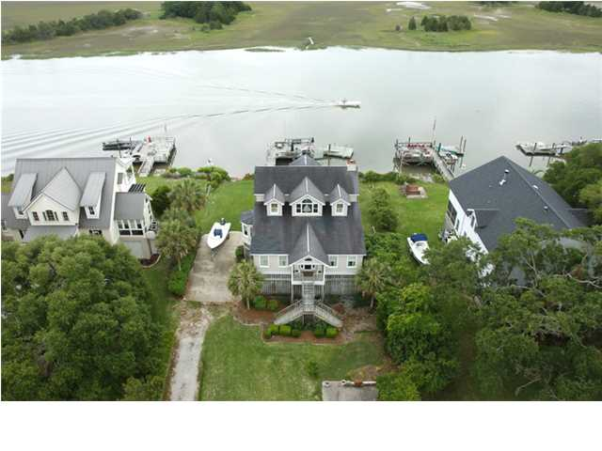
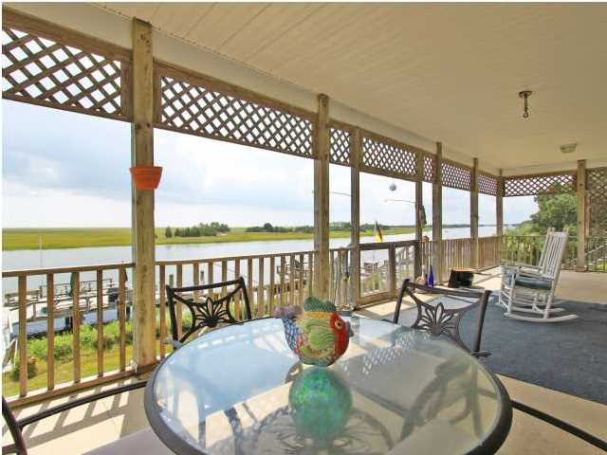
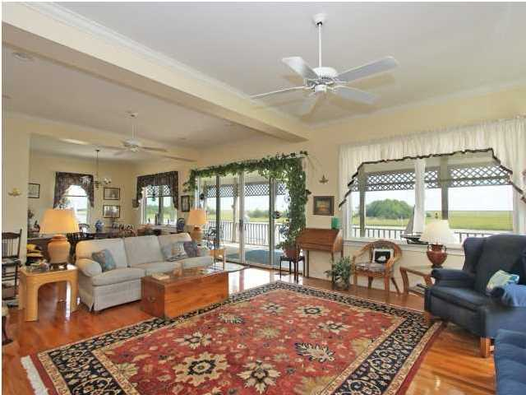
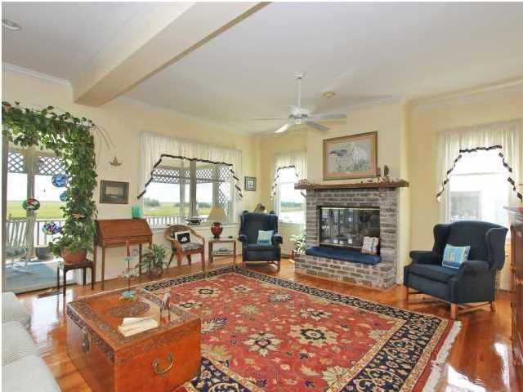
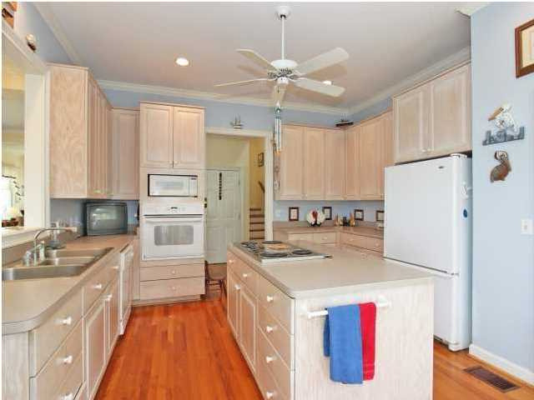
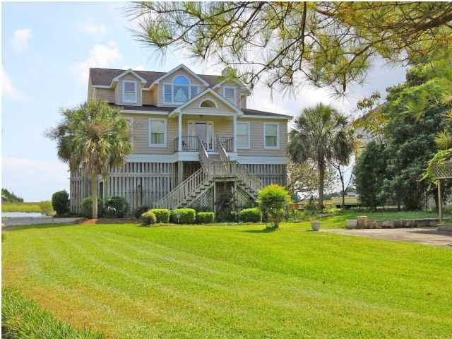
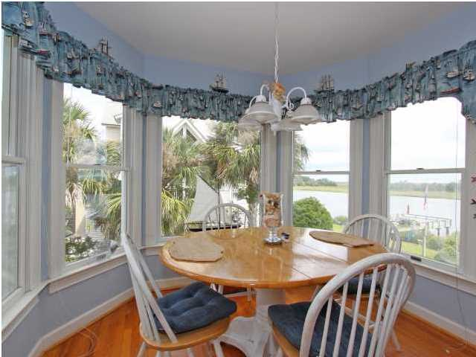
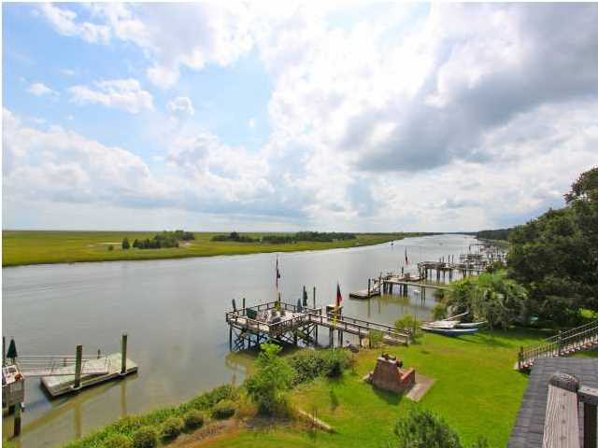
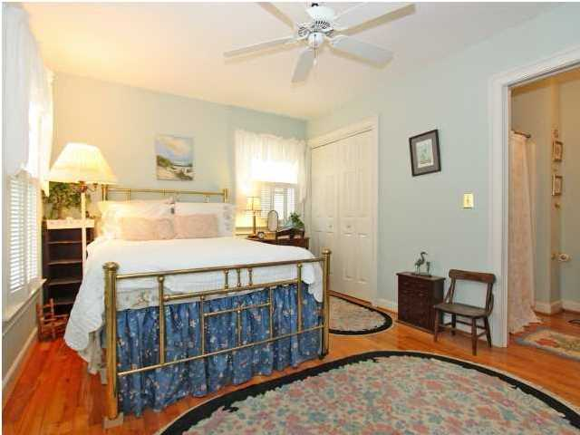
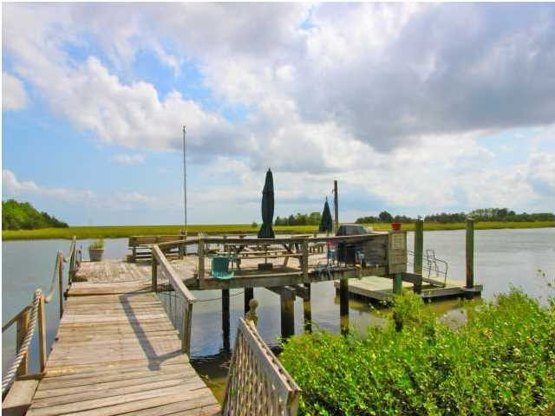

Deep Water!
945 Shellmore Ln ~ McClellanville ~ MLS# 1408611 ~ $825,000
Ready to be impressed? Then you need look no further. Located on the Intracoastal Waterway, this lovely waterfront home has amazing views and is a boater's paradise. In the heart of historic McClellanville sits the 945 Shellmore Lane. This home is a dream come true for water lovers as you are just steps from your floating dock and pier head located on true deep water. Whether you are enjoying a glass of sweet tea while admiring the stunning vistas, or headed out for a boat ride, this waterfront home is the essence of South Carolina's Lowcountry. With an great floor plan and loads of features, there is nothing this home doesn't have! Throughout much of the home you'll find wonderful hardwood floors. The kitchen is spacious and well-appointed, and it's the perfect spot for a novice cook or an experienced chef. Even the dining area has expansive views of the water. There's certainly no shortage of sweeping views with the many large and inviting open-air porches that overlook the Intracoastal Waterway. Located halfway between Charleston and Myrtle Beach, this home provides the perfect location and serves well as either a primary or a vacation residence. This is an once-in-a-lifetime opportunity to buy a piece of paradise at an incredible price. Don't miss your opportunity to act on this Southern treasure!
Call or email for details: (843) 642-3546 or ben@mattoneillteam.com

