Slide 1
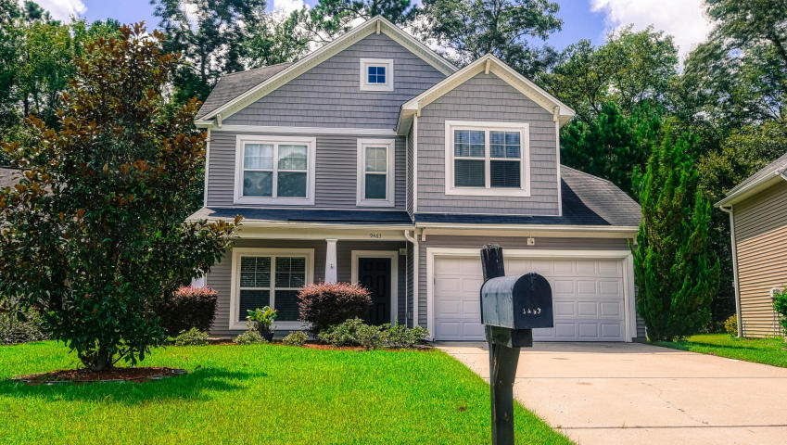
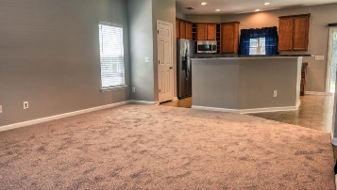
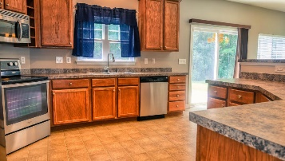
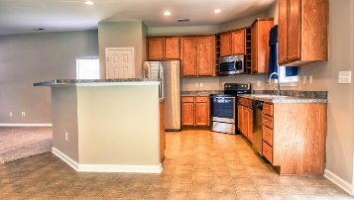
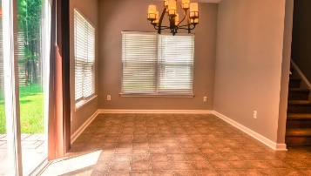
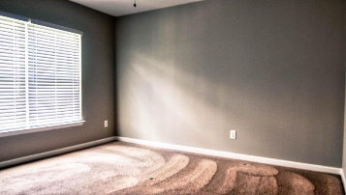
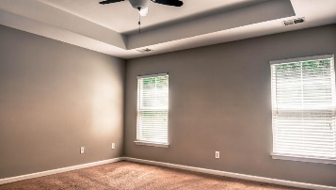
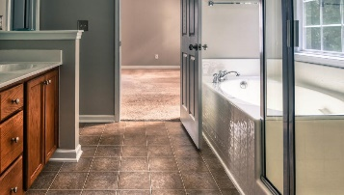
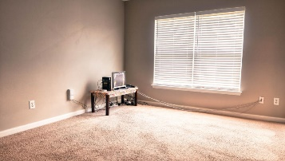
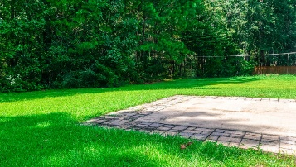
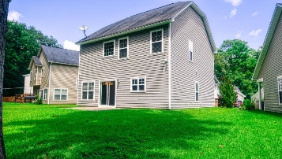


9463 Netted Charm Court Paddock Pointe ~ Ladson, SC 29456 MLS# 19026204 ~ $237,500
Open House Lunch ~ Friday, Oct 3 from 11 - 1
Handyman Special… Bring your hard hats!
New Price!
Price Reduced!
An affordable 3 bedroom home, on a great lot that backs to protected wetlands and convenient to everything. Some might say it doesn't exist but here it is and it's move-in-ready. Close to the Air Base, Boeing, Mercedes Benz shopping and restaurants, this home features an open floor plan. The kitchen would delight any chef with it's large amount of cabinet space, stainless steel appliances 42'' upper cabinets and wine racks. All three bedrooms are located upstairs along with the laundry room. The master features a tray ceiling and ceiling fan. Homes in Paddock Pointe do not stay on the market long. Come see this home today.
Steven Ginsberg, ABR, EPRO
(843) 860-7782 sginsberg1@gmail.com | www.steveginsberg.com
Realty ONE Group Coastal | 654 Coleman Bvld Suite 100 | Mt. Pleasant, SC 29464

