Slide 1
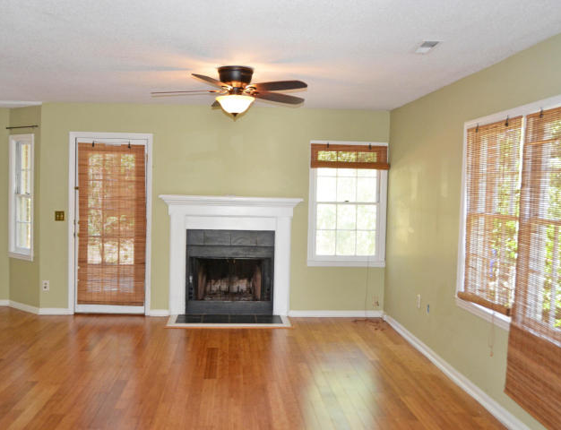
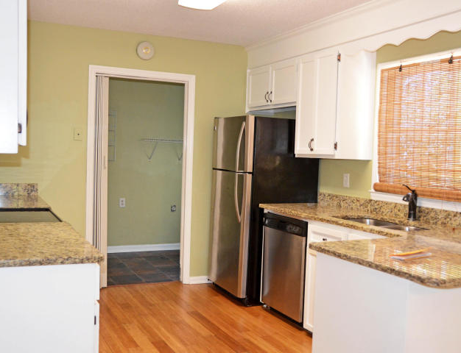
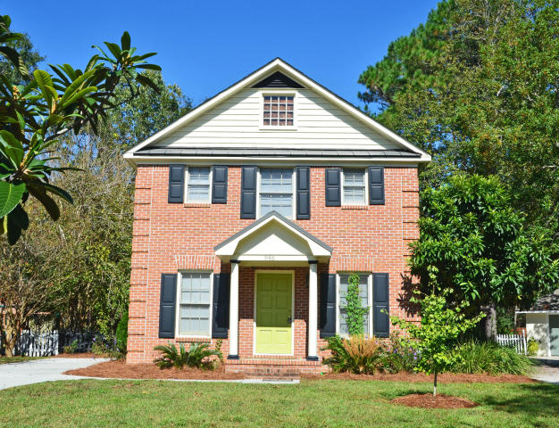
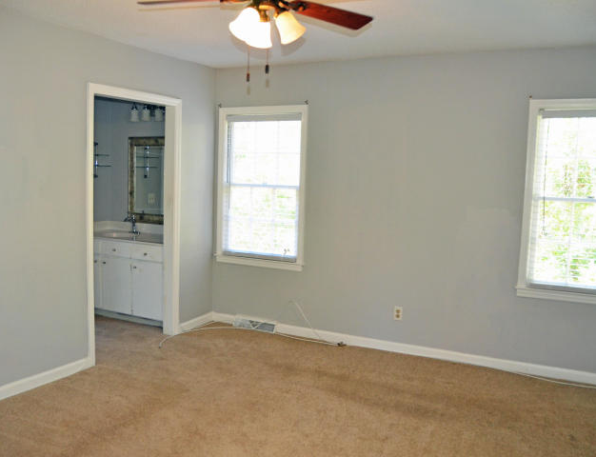
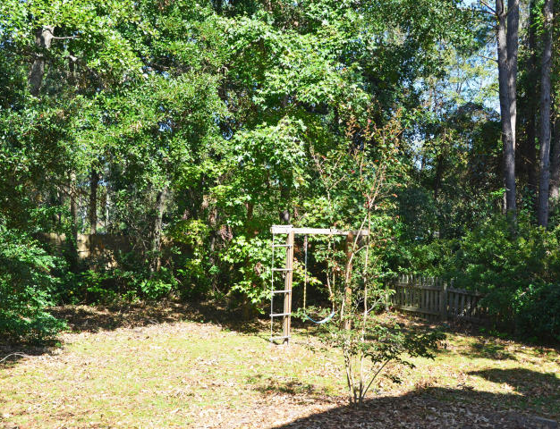
Best Deal in Mount Pleasant Just Got Better!
946 Governors Court
Snee Farm ~ MLS# 16025347
Now $375,000
Located in the New Charlestowne section of Snee Farm. Remodeled in 2014, painted through out, new granite counters, bamboo floors down stairs. New lighting, hardware, tile and counters in baths. New carpet upstairs. New privacy fence and back patio. New driveway in 2015 and new roof in 2016. Home warranty included. Vacant and easy to show. Owner is agent.
Bonnie Miller
843.884.3901 O ~ 843.693.2647 M
bcm.olddom@gmail.com
Old Dominion, REALTORS · 890 Johnnie Dodds Blvd · Mt Pleasant, SC 29464

