Slide 1
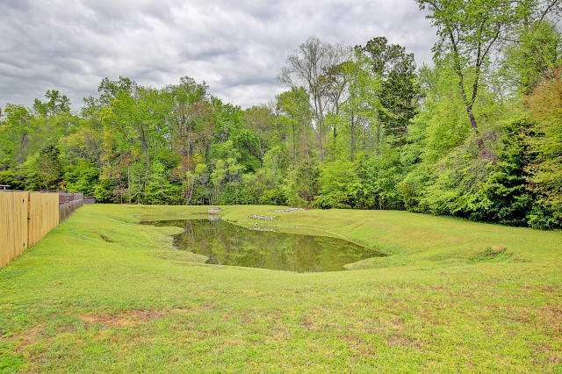
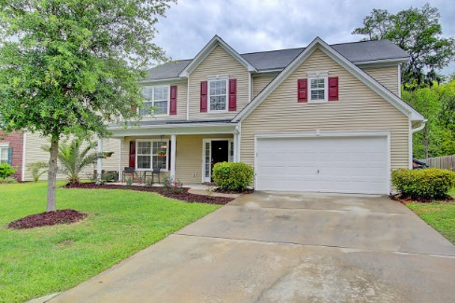
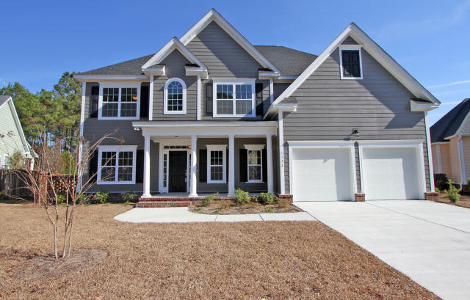
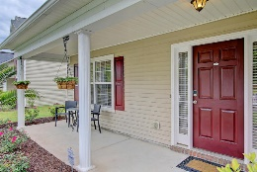
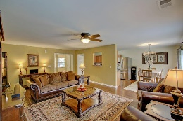
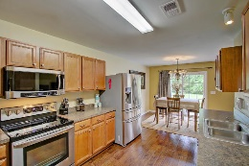
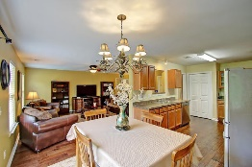
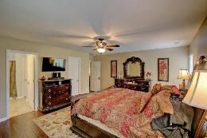
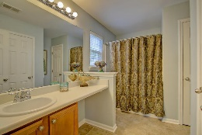
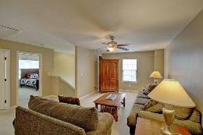
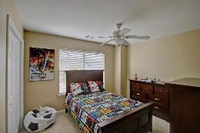
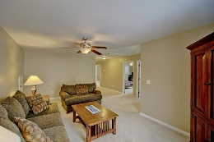
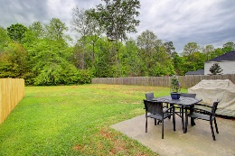
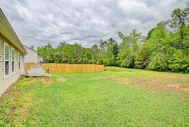


JUST REDUCED * ALMOST 3000SF * MASTER DOWN
9472 Falling Embers Lane
Paddock Pointe
Ladson, SC 29456
MLS# 16010016
$235,000
Paddock Point is a serene neighborhood enclave - away from busy, noisy highways - in a local country setting & close to a nice neighboring Equestrian Center.
You'll find an abundance of green space surrounding the neighborhood & even a neighborhood play park. This home is on one of the largest homesites overlooking a natural area w/lagoon views. Also floor plan is open & spacious.
Extra wide hallways with Master suite on the main level
Upstairs is a large open lounging/TV/homework space and 4 good sized BRs plus 2 full baths
Special features include: glass front cabinets, modern appliances in kitchen, tons of counter space, HYBRID H20 HEATER, tile kitchen & baths, GORGEOUS WOOD FLOORS & lots of storage!
One of the nicest homes under $250K--a great home for ALL!
Ask your agent to set up your viewing today!
Sheila Romanosky
(843) 224-0242
sromanosky@carolinaone.com

