Slide 1
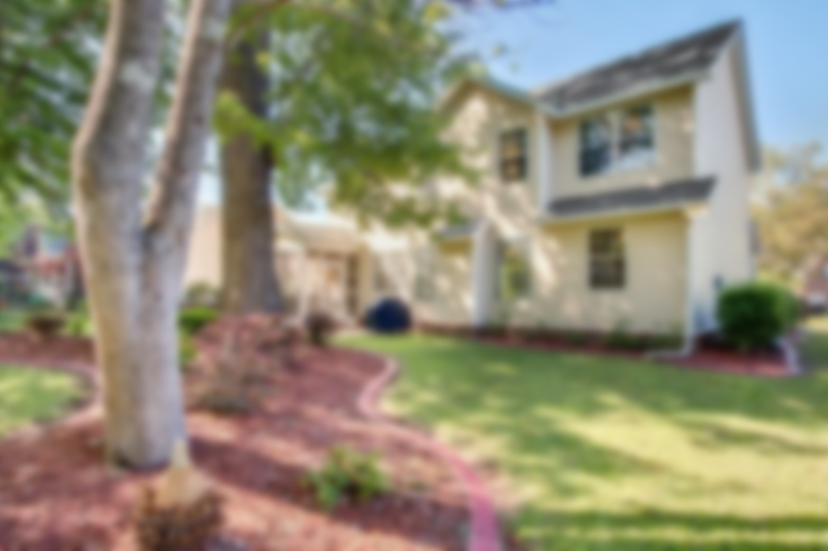
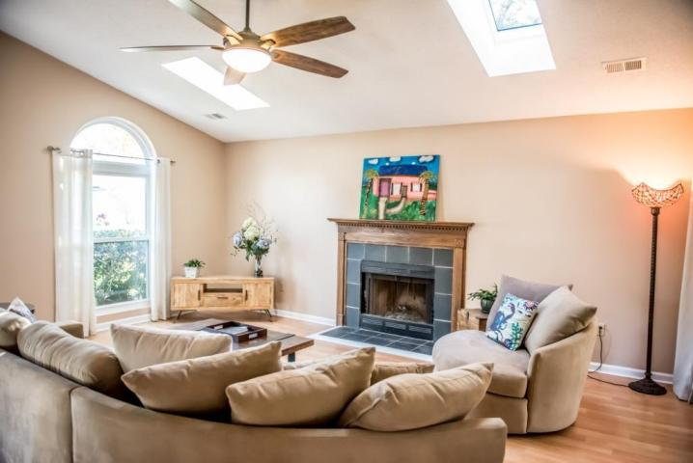
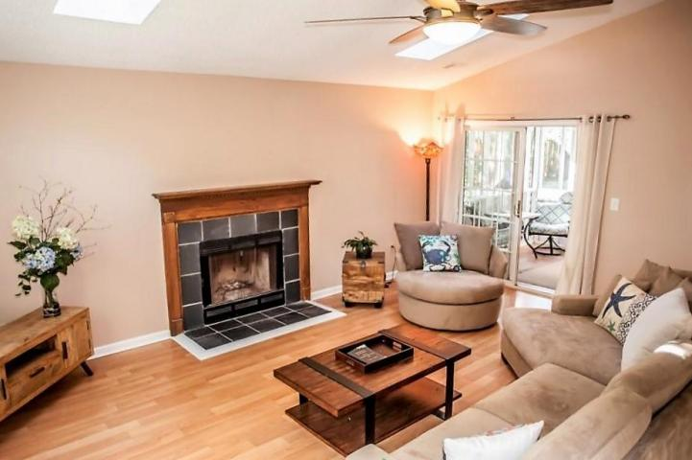
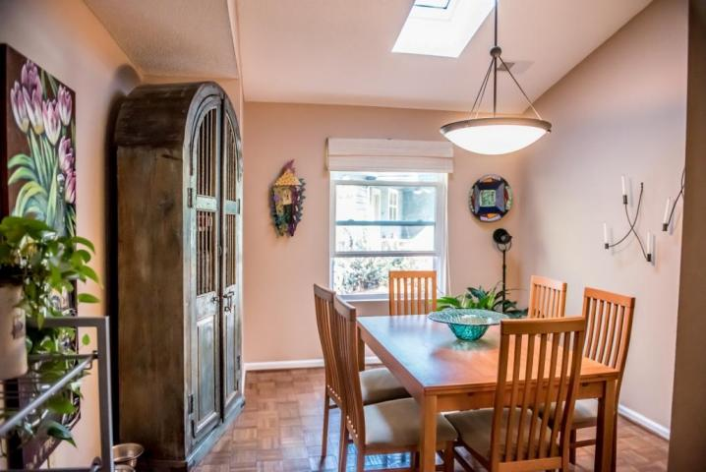
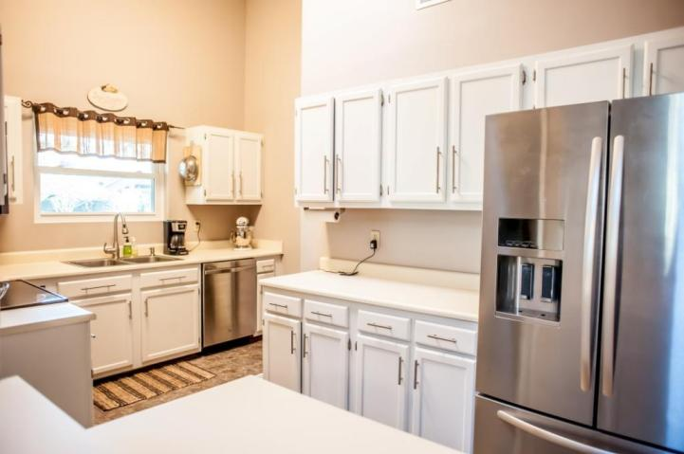
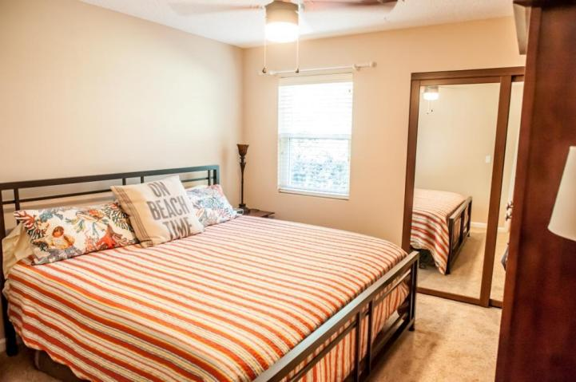
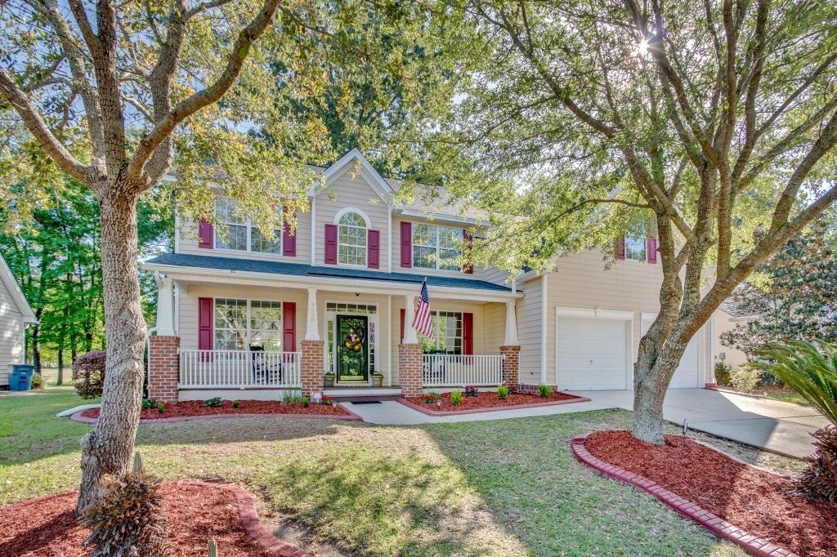
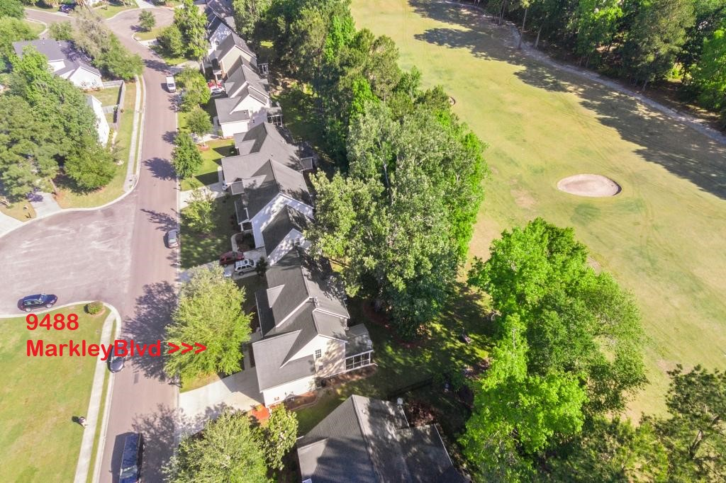
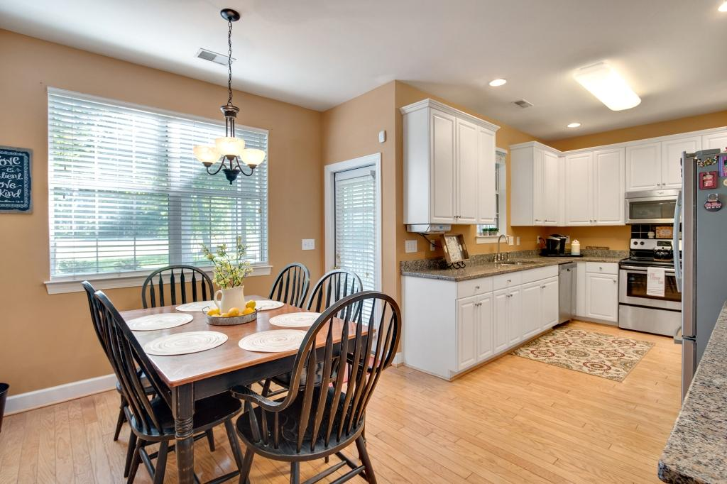
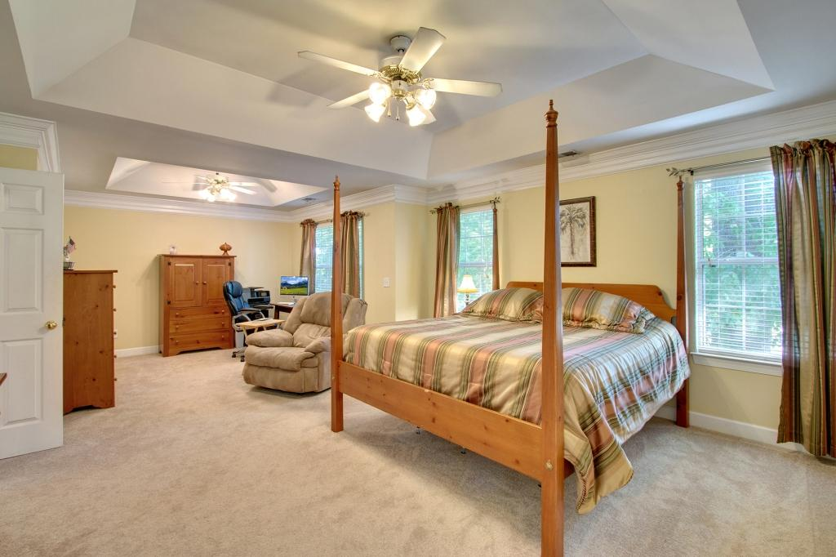
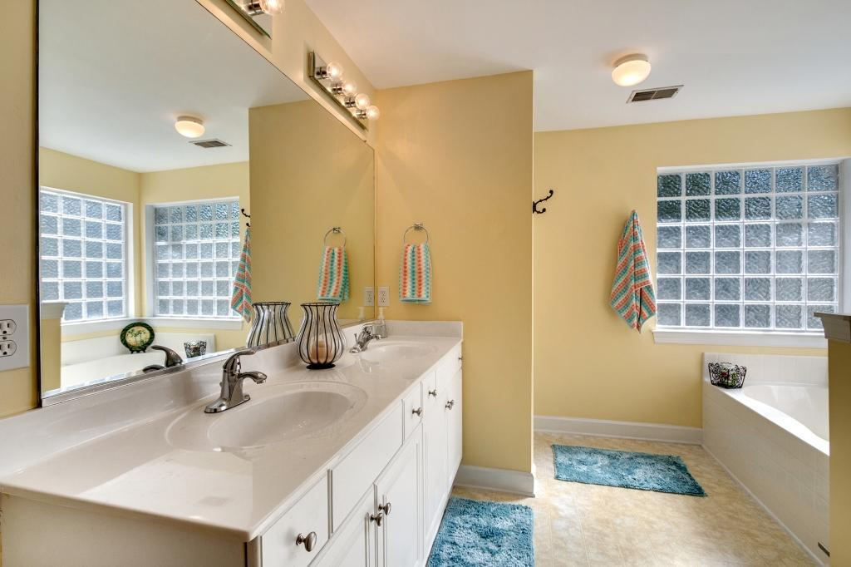
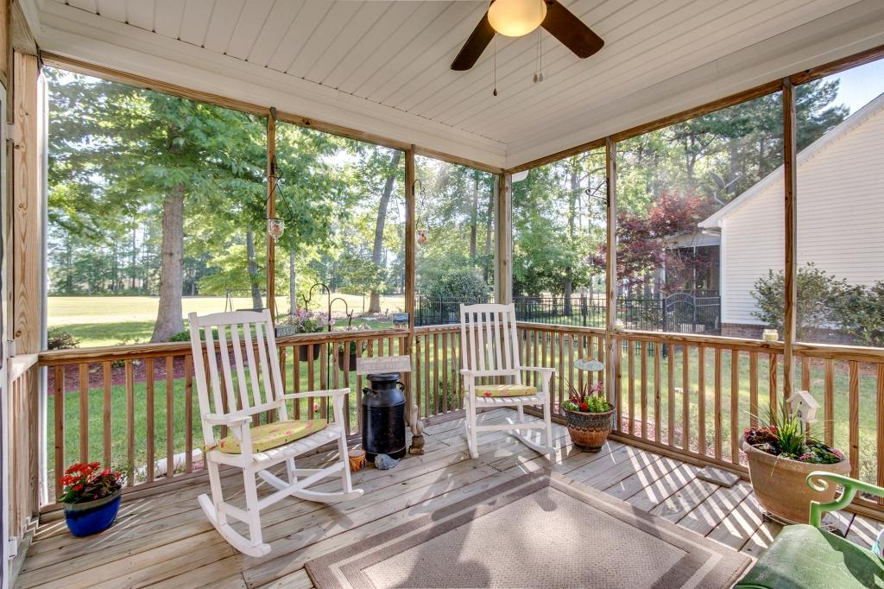
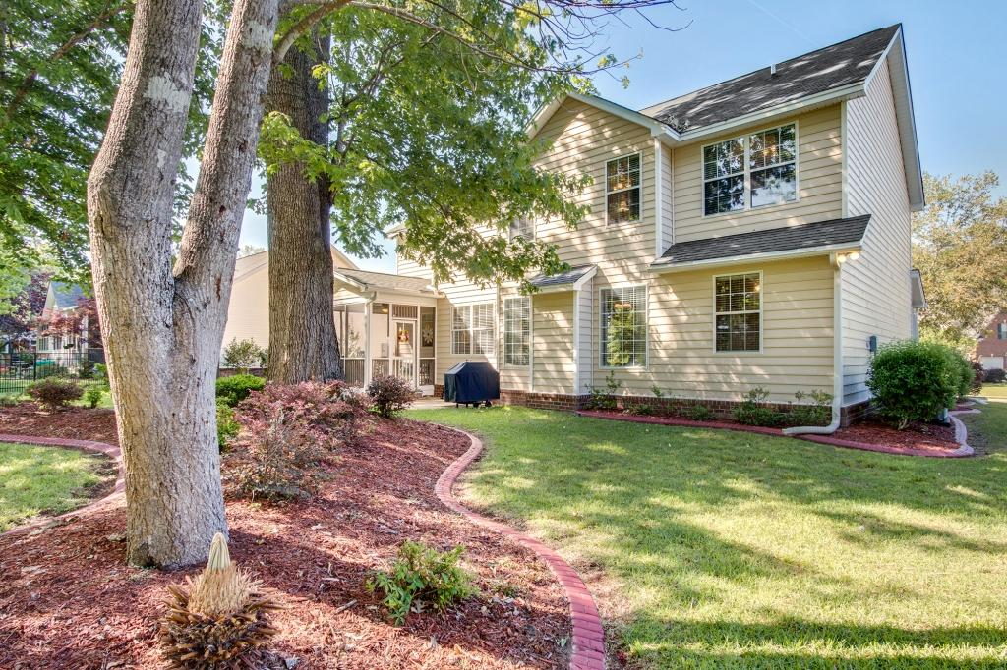
Impeccably Maintained Golf Course Home
9488 Markley Boulevard
Wescott Plantation ~ Summerville, SC 29485 ~ MLS# 18012674 ~ $325,000
From the moment you walk up, it is clear this one owner home is in pristine condition! The elevated lot is situated on the Black Robin Tee at Wescott golf course. Great views from the breakfast area, living room, master bedroom and screened porch! A two story foyer separates the dining room and front office. Large windows line the living room and foyer for plenty of natural light! Recent updates to the kitchen include granite and ss appliances. A downstairs bedroom and full bath are located off the living room. Beautiful Hardwoods downstairs and new carpet upstairs. The upstairs master suite includes an adjacent space for nursery or den and the walk in closest is finished with shelving and drawers. En suite is a spacious retreat with jetted tub and long double vanity. There are a total of five bedrooms plus a FROG. Abundant storage throughout, including a pantry and mud room off the kitchen. The sellers treat the private screened porch and patio as a second living area and the large lot has mature landscaping and shade trees. They have loved the home and neighborhood and but are ready to downsize. In addition to the two car garage, the driveway offers four additional parking spots, and boats may be parked in the driveway. Located a short bike or golf cart ride to the community pool, Fort Dorchester Elementary School, Harris Teeter, Lowes and other retail. Palmetto Commerce Parkway is three miles away, and Wescott is part of the acclaimed Dorchester II School District.
Behren Kittrell
(843) 870-3549
behrenk@scflatfeerealty.com
CharlestonFlatFeeRealEstate.com
Charleston Flat Fee Real Estate
2024 Covey Lane
Charleston, SC 29412

