Slide 1
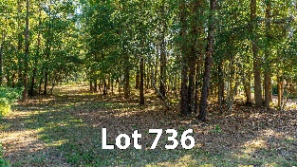
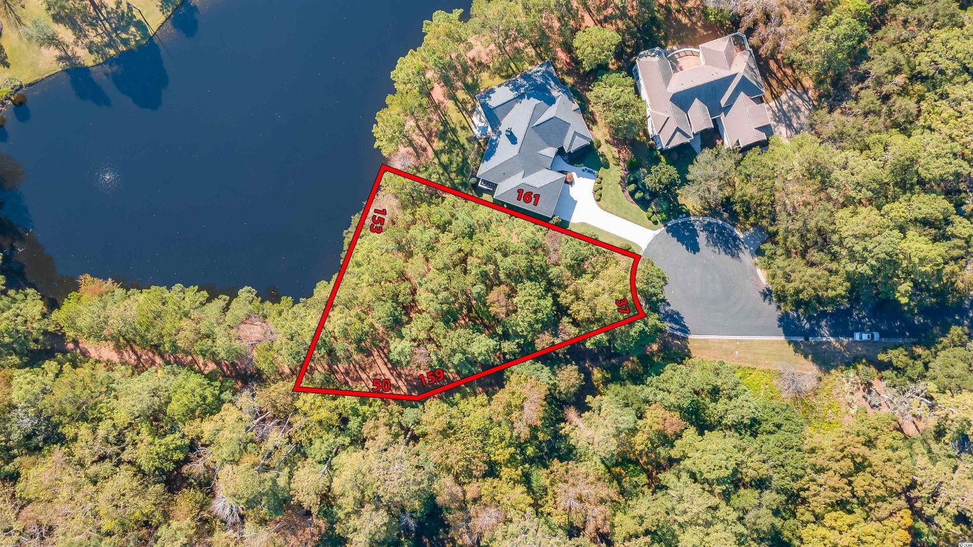
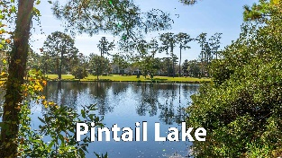
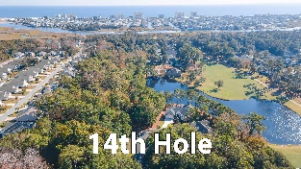
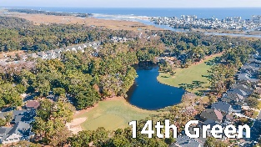
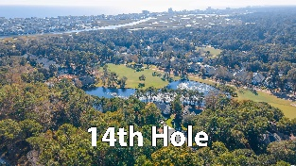
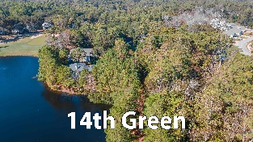
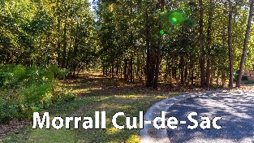
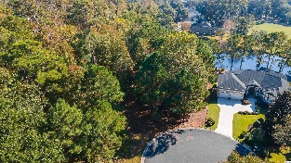
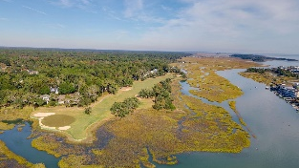
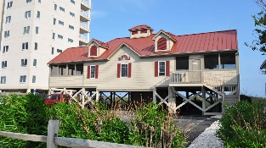



142 FT. OF PICTURESQUE NATURAL LAKEFRONT ON THE 14TH HOLE
949 Morrall Dr
Tidewater Plantation | North Myrtle Beach SC 29582 | MLS# 2224052 | $179,000
IMPRESSIVE, SINGULAR, NEARLY HALF-ACRE, SECLUDED LOT ON A PRIVATE CUL-DE-SAC AND A NATURAL, FREAH-WATER LAKE IN THE PREFERRED BLUFFS OF TIDEWATER PLANTATION RESORT! PERSONAL TOURS OF TIDEWATER AVAILABLE. Tidewater Plantation is a GATED golf/Intracoastal Waterway/beach community. The Bluffs Section adjoins the Cherry Grove Marsh and peaks at the Atlantic Ocean. This lot is situated on a pine and hardwood cul-de-sac, bordering the 14th hole of world-class Tidewater Golf Course, named recently as the best in South Carolina, with its picturesque, signature natural lake front and to buffered land with privacy. This large remarkable lot has many possibilities for enhanced enjoyment, including about 142 feet of mesmerizing lake front featuring abundant wildlife and much SECLUSION AND AMAZING PRIVACY, too! Long-term rentals only are allowed on the Bluffs side; so, at this compelling price, exciting building options and low HOAs and taxes, this amazing, rare residential lot is an excellent investment as well as being desirable for building a vacation or permanent home. No flooding ever! There is no time frame to build. Tidewater-approved contractor list available. Approximately 1/2-acre lot: This is a 17,424 sq. ft. lot with a depth of up to about 209 ft. THE BLUFFS OF TIDEWATER IS BEING RAPIDLY BUILT OUT. You must view! THIS MAY BE THE LAST TRURLY LUXURY LAKE LOT AVAILABLE, AND IT IS STUNNING. In addition to golf and being in an ICW community, Tidewater boasts many other rich, upscale amenities, including owners' beach cabana on the Cherry Grove Beach named the 11th best in the nation, pools & spas, clay & hard-surface tennis courts, pickle ball, bocce, horseshoes, amenities center, fitness center, driving range and putting green, 24-hour gated manned security, and clubhouse with bar & restaurants. There is even a complimentary gated storage yard for boats, campers, recreational vehicles and the like. The on-site, convenient HOA building has rooms for business and other meetings and events and a lending library. There are many clubs and activities year round. In Tidewater, you can do it all, or just relax in the luxurious Tidewater lifestyle. The Bluffs of Tidewater is contiguous along the Cherry Grove Inlet where the Atlantic Ocean rolls into the marsh. This lot, therefore, is highly sought after by the builder, investor or soon-to-be home-owner who desire to acquire an extraordinary golf/ICW/beach property at today's market prices to be built later. Tidewater itself is on a tree-lined road to oceanfront Anne Tilghman Boyce Coastal Reserve, a nature conservancy, including Waties Island, with access for managed recreational use. Tidewater, a historic plantation, is on an elevated peninsula of live oaks and southern pines between the Intracoatal Waterway and the Cherry Grove Inlet to the Atlantic Ocean. The plantation also preserves the unique look of its own origins. It is close to the beach, shopping, entertainment, medical services, outstanding schools and parks and access to major highways. The jewel in the crown of the development is that private owners' beach cabana on the wide, white sands of the Cherry Grove Beach, just a few minutes drive. This charming lot enjoys a lovely, indigenous peaceful environment, along with the excellent reputation of the Tidewater Golf Course, the Pebble Beach of the East. Tidewater Plantation, in one of the U.S.'s top-5 beach towns, North Myrtle Beach, truly reflects a "way of life." Do not let this singular lot get away. Welcome to the the best of the beach in the Bluffs of Tidewater Resort.
Video Tour: https://youtu.be/y7njoXYAdss
Connie Ross-Karl
702-306-2643
conniesross@aol.com
Ronnie Nichols
Realtor / BIC
ronnienichols8@aol.com
NEW WAY PROPERTIES MYRTLE BEACH

