Slide 1
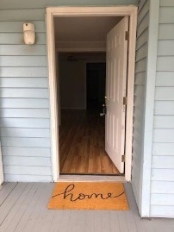
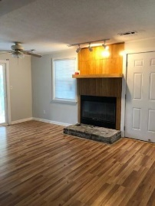
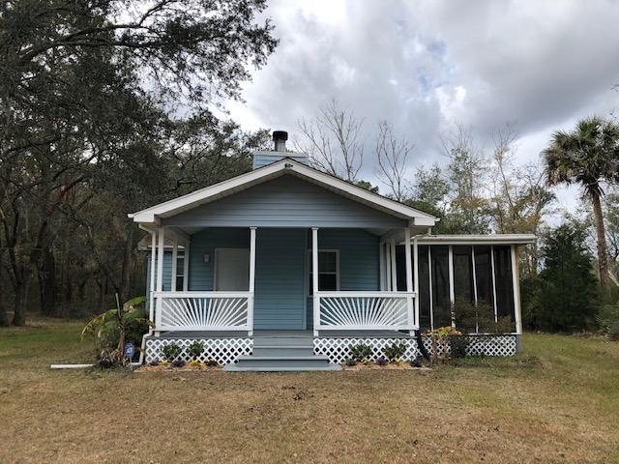
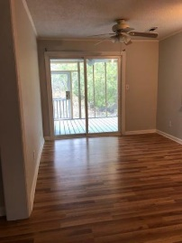
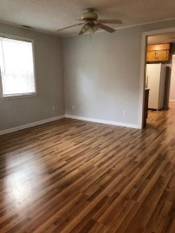
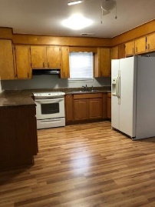
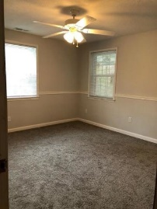
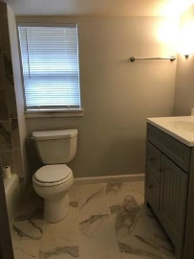
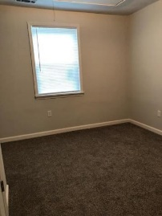
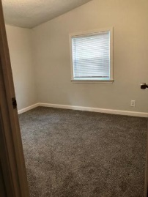
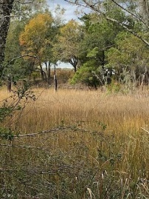
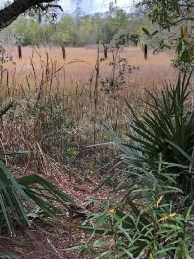
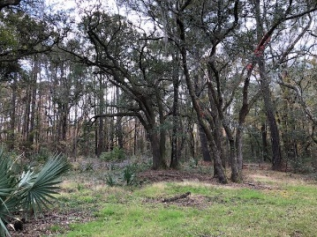


950 Brownswood Road
Pt Hickory Hill | Johns Island, SC 29455 | MLS# 19033602 | $259,900
Just Listed!!
RARE OPPORTUNITY and PRICED TO SELL for this updated and renovated home sitting on almost an acre(.84) on a tidal creek w/access to the Stono River! Nature at its best with beautiful large oak trees throughout the property providing tranquility and privacy. Many updates to include Architectural Shingle Roof-2016, HVAC incl. Ductwork-2016, Low-e Insulated Windows and Sliding Glass Door to Screen Porch-2017, Pex Plumbing-2016, Wiring updated-2016, Carpet and Laminate-2019, Freshly painted, Sump Pump-2017, New Vapor Barrier and Lighting in crawl space-11/2019. Roof has rubberized/ice shield adhesive under the shingles for added durability.
Beth Mandell
M 803-463-7734 | O 843-871-2121
bmandell@century21properties.com
www.bestcarolinahomedeals.com
Century 21 Properties Plus of Summerville | 118 W Richardson Ave | Summerville, SC 29483

