Slide 1
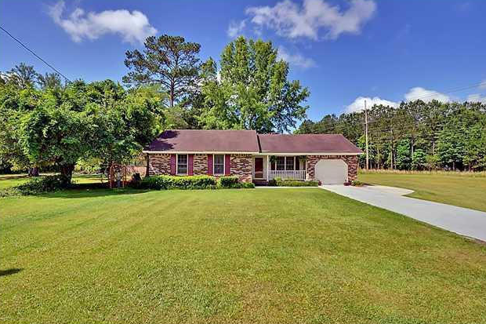
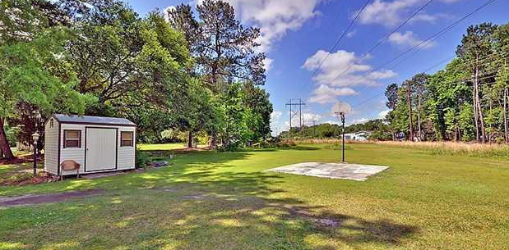


Start your own business here!!
951 St James Avenue
Summerville, SC 29483 | MLS# 15002156 | $225,000
Zoned Commercial and Residential. You can live/work on this property. Many options for this .68 acres property. A car lot, a business office, a work shop, a bakery, a daycare. Or start from scratch and build what you want. So many opportunity and the location is a no brainer. On a main road easily accessed from Hwy 176 and 17A. There is so much you could do with this space you must come check it out for yourself. Get this property before its gone.
Carmilla Brown, REALTOR Office - (843) 416-2000
Mobile - (843) 926-2007 crbrownrealestate@gmail.com
http://yourcharlestonnewhome.realtyincharleston.com
Keller Williams Realty 496 Bramson Ct Ste 200 Mt. Pleasant, SC 29464

