Slide 1
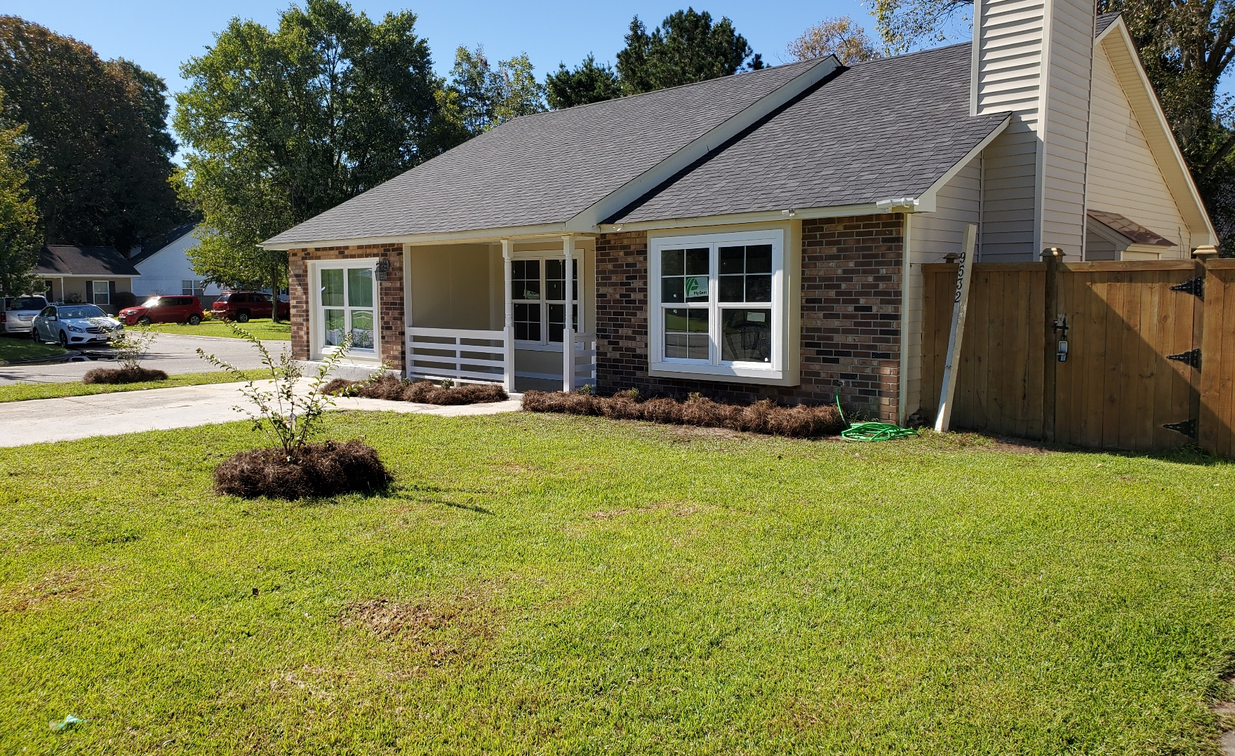
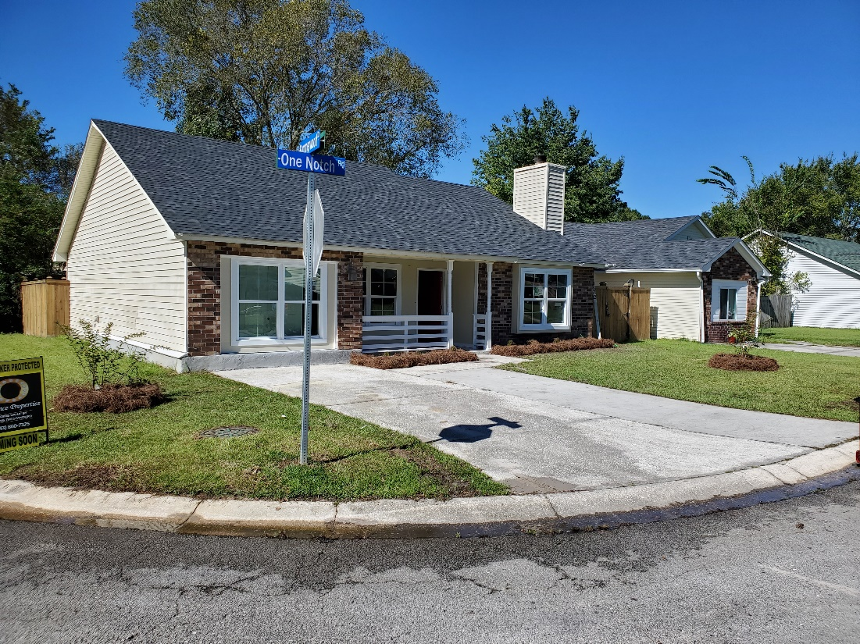
Coming
Really
Soon!!
9532 One Notch Road
Summerwood :: Ladson, SC
For Sale By Owner $250,000
Buyer’s Agent Protected
New Roof (2-years old)
New A/C Unit (2-years old)
1,454 SF
Granite Countertops
LTV (Luxury Vinyl Tile) Flooring
Wedge Wall Framing
Stainless Steel Appliances to Follow
Completely Remodeled and Renovated Home
For more information or to schedule a showing, contact
Rodney :: 843-860-7325 :: info@lockwoodoutdoor.com

