Slide 1
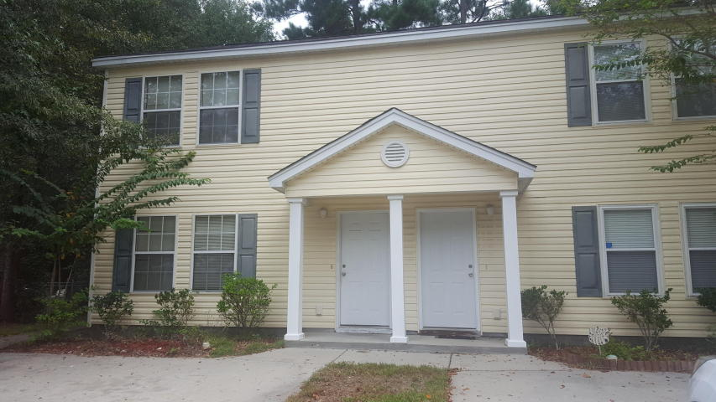
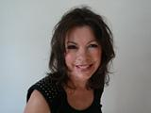

Great Investment!
9535 S Cardinal Drive
Avenue of Oaks ~ Ladson, SC 29456 ~ MLS# 17025061 ~ $125,000
NICE TOWNHOUSE IN A CUL-DE-SAC, READY FOR OCCUPANCY.
THREE BEDROOMS, WITH TWO UPSTAIRS AND ONE DOWN.
2 FULL BATHS
LIVING/DINING ROOM COMBO
NEW CARPET AND NEW BLINDS
GOOD LOCATION TO BOEING,BOSCH, AFB AND SHOPPING
IN ONE OF THE TOP RATED SCHOOL DISTRICTS, DORCHESTER 2.
GREAT FOR INVESTMENT!
Marilyn Stewart, Realtor
Realtor of Distinction
843-297-4098 M
843-416-2200 F
marilyn@charlestonsells.com
Keller Williams Realty
496 Bramson Ct Ste 200
Mt. Pleasant, SC 29464

