Slide 1
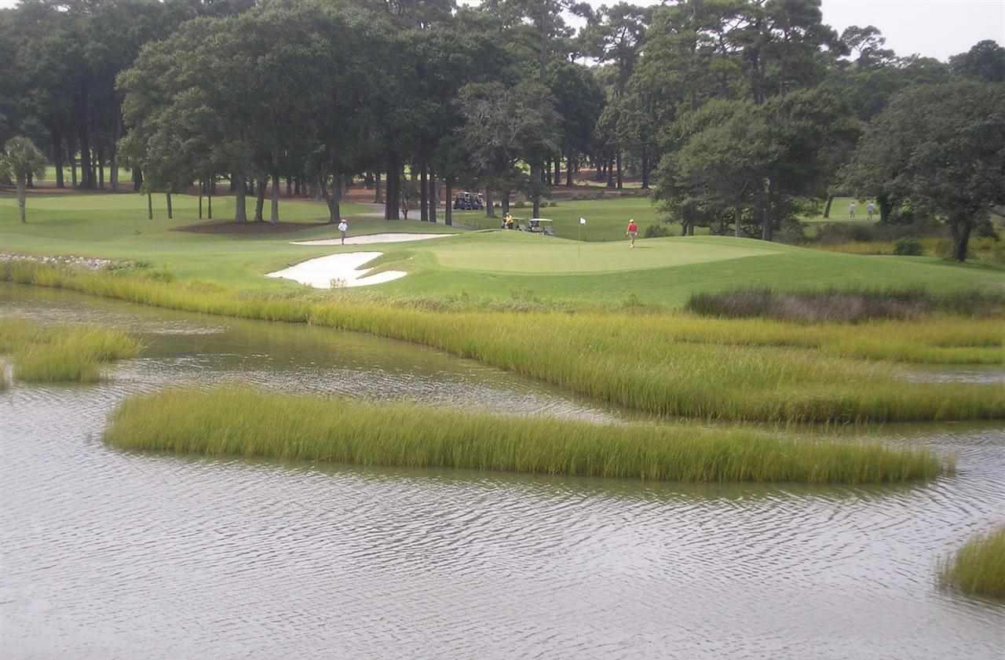
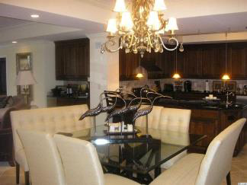
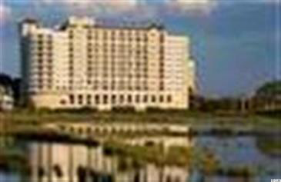
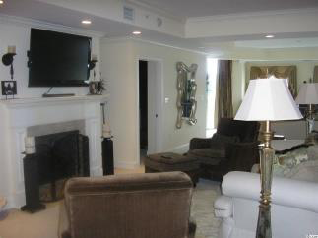
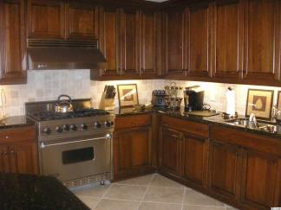
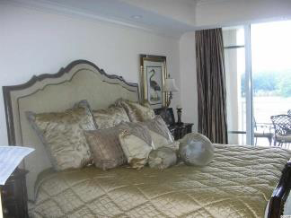
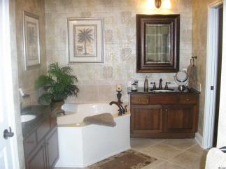

$3,000 Buyer’s Agent Bonus with an accepted contract by August 30, 2014.
9547 Edgerton Drive #102
The Pointe
Myrtle Beach, SC 29572
MLS# 1316827
Reduced to $519,900
This beautiful, fully furnished 3BR / 3½ BA private luxury residence has dual balconies which overlook the Atlantic Ocean and Dunes Golf and Beach Club. Located on the 1st floor which gives you easy access to amenities such as the owners lounge with billiards room, full Viking kitchen and HDTV, fitness center and indoor heated pool which are also located on the first floor level. 2700 SF with spacious living area with natural gas fireplace and wet bar, open kitchen and dining area. Appointments include a gourmet kitchen with granite counters, Viking stainless appliances, including a natural gas range and custom cabinets. Master suite has balcony and Jacuzzi tub. Separate laundry room with washer and dryer. Roof top sun terrace for those gorgeous days you just want to relax and bask in the sun and enjoy the view.
**MOTIVATED SELLERS, BRING ALL OFFERS!!**
M.A. Peedin | builderpeedin@wmconnect.com | 843-385-3931
Wilkinson & Associates ERA Powered, 9652 North Kings Highway, Myrtle Beach, SC, 29572

