Slide 1
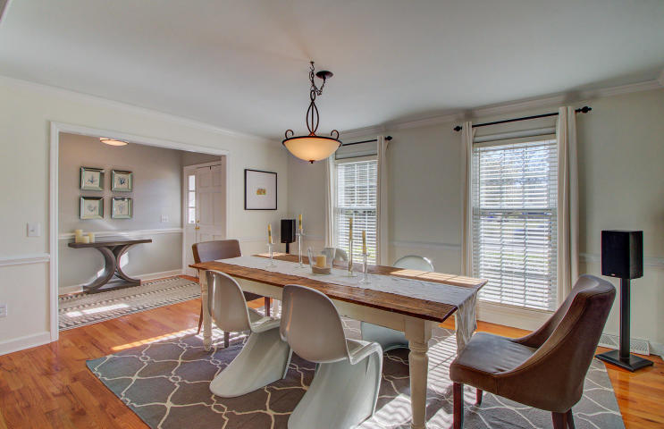
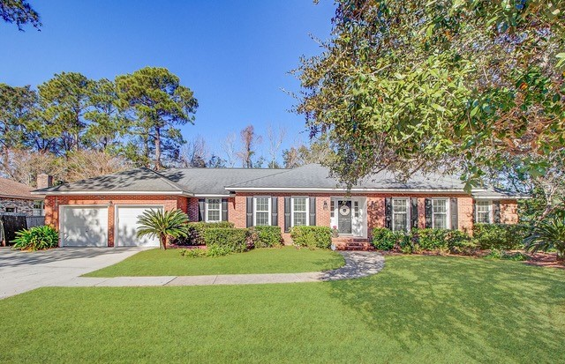
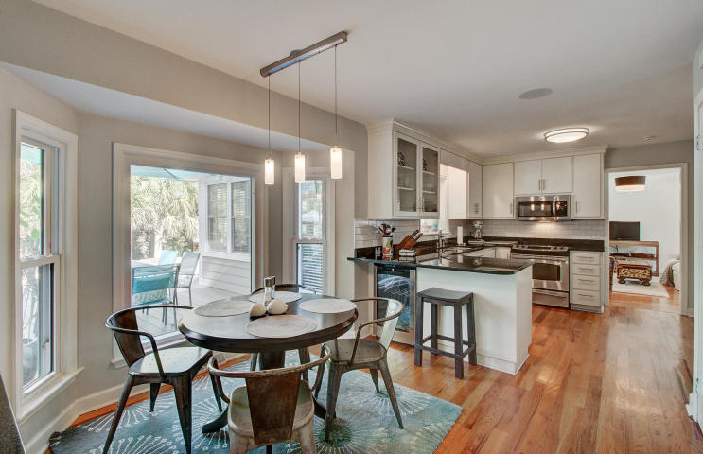
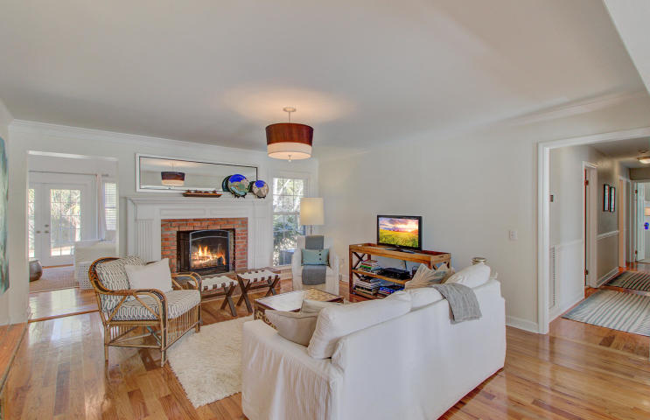
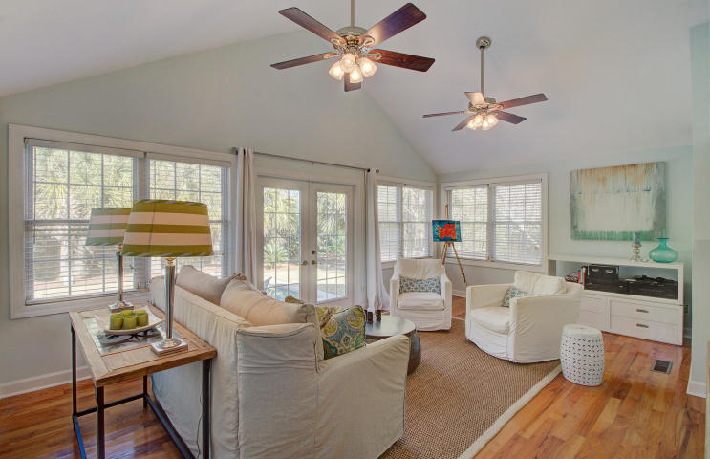
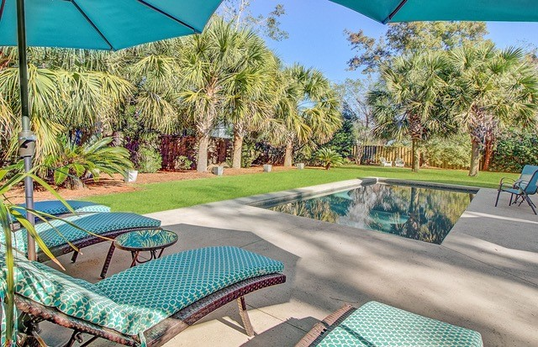
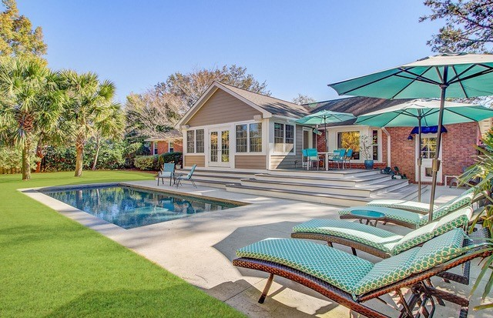


JUST LISTED! The Ultimate Lifestyle Awaits You In Mount Pleasant, SC
956 Cummings Circle
Cooper Estates
Mount Pleasant, SC 29464
MLS# 20000695 | $765,000
The ultimate lifestyle awaits at 956 Cummings Circle. The total package- that is what you have found! If you have been searching for a home in an amazing location where you can simply unpack and start enjoying life, then your search is over. This one level brick beauty is nestled away on a quiet street in the coveted community of Cooper Estates, a neighborhood full of charm and natural beauty yet conveniently located. Lovingly maintained and enhanced through the years, you will be equally impressed with the yard as you are the home! A back yard paradise has been created to include a stunning in-ground gunite pool (saltwater) with Pebble Tech surfacing. Fresh landscaping with accent lighting adds to the beauty of this back yard oasis which is ultra private making this property a true stand out! This one level home can be described as tastefully finished throughout. Upon entry, you will feel warm and welcomed in the lovely foyer with views of the open and airy dining room and family room with wood burning fireplace. The eat in kitchen has been updated and is finished with granite counters, a new tile backsplash, and stainless steel appliances. Enjoy the incredibly inviting sunroom overlooking the pool and yard. Recently french doors were added to this room in addition to Trex style decking that wraps around the exterior providing an outdoor dining space and entry to the back yard paradise. This will be a favorite room for sure! The layout of the home is fantastic. Having a designated office, there is no need to sacrifice one of the three bedrooms if you work from home. The master bedroom is located on the rear of the home and has a freshly renovated master bath. The finishes are elegant and include beautiful quartz counters and porcelain tile flooring. The tile shower has an attractive frameless enclosure. This master suite has multiple closets. Two guest rooms are on the front of the home. Smartly designed, there is a powder room in addition to a full guest bath in the hall. The design of this home also incorporates a walk up attic for abundant storage and a separate laundry room off the kitchen. Warm wood flooring throughout most of the main living spaces and fresh interior paint make a nice impression. The current owners replaced the HVAC system in 2019. Residents who are members of the Cooper Estates Civic Club can enjoy the benefit of a community boat launch on Shem Creek, a covered shelter, and ample parking. Water enthusiasts will appreciate the parking pad beside the two car garage where they can store their boat or kayaks! From this home you can walk to Shem Creek Park, the popular waterfront dining establishments along Shem Creek, and Trader Joe's. Numerous shops, restaurants, and businesses are nearby on Johnnie Dodds Boulevard and Coleman Boulevard adding to the many benefits of living here. Beach enthusiasts will be thrilled to live ten minutes from Sullivan's Island and it is only a ten minute drive to Historic Downtown Charleston. This is the house that has it all- move in ready, gorgeous pool in the private yard, and proximity to beaches, Downtown, Shem Creek Park, and desirable shopping and dining! Be sure to check out the property video and the 3D walk through tour and schedule your showing to make this opportunity your dream come true! Be sure to take in the details that make this house a home.
Ellen O'Neil
Broker/Owner, ABR, e-PRO, CNE
Charleston Realtor of Distinction
(843) 300-8530
www.EllenONeilProperties.com

