Slide 1
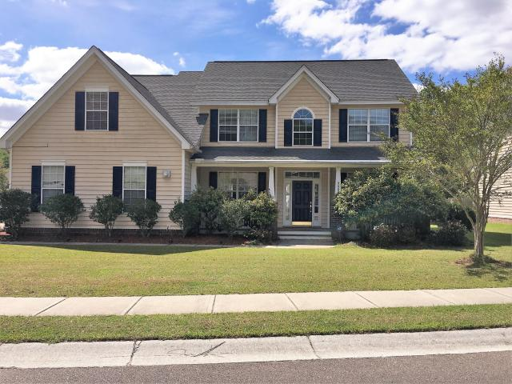
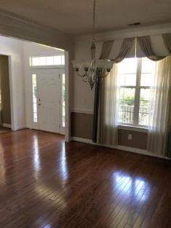
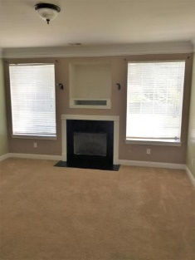
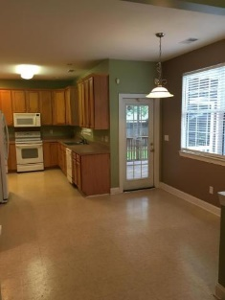
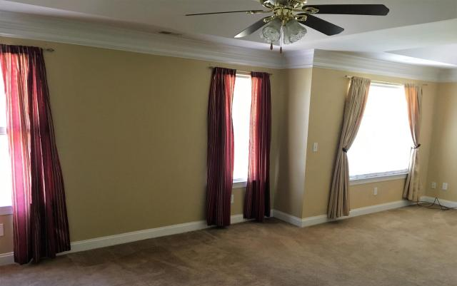
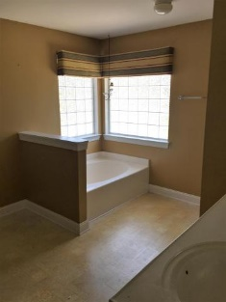
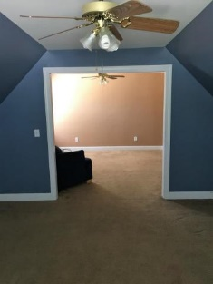
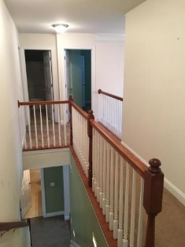
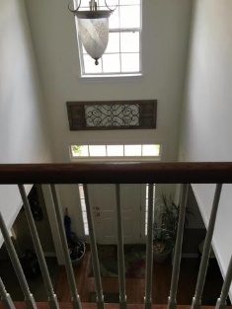
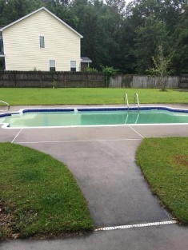
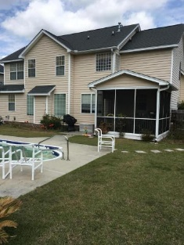
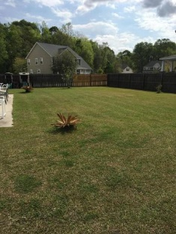


Wonderful Home …Easy Living
9583 Markley Boulevard
Wescott Plantation · Summerville MLS# 17010251 · $306,900
5 Bedrooms · 3 baths · 2,854 sqft
Gorgeous Home 5 Bedrooms and 3 full Baths. Great neighborhood in the highly desired subsection "The Preserve" in Wescott. This home features formal living room and dining room, Hardwood floors through foyer and dining room. Spacious Family Room, Study/Guest Bedroom downstairs. Upstairs is a lovely master bedroom with sitting room, Master Bath with Garden Tub, Separate shower, dual vanity and large walk in closet. 3 additional nicely sized bedrooms upstairs and one has its own sitting area. Don't need 5 bedrooms, 5th bedroom would make a perfect office and has room enough for a spacious exercise room. You will enjoy your large back yard with in-ground pool and screened porch. Perfect for Barbecues and entertaining. Everything you need is nearby, dining, shopping,a pedestrian path for walking, running, or biking. Golf Course and Club membership available. Schedule a viewing today.
James Hopkins
Office - (843) 871-9133
Mobile - (843) 708-5930
rxhop@aol.com
AgentOwned Premiere Group
1800 Trolley Rd
Summerville, SC 29485
Real Estate ● Mortgage Insurance ● Business Brokerage

