Slide 1
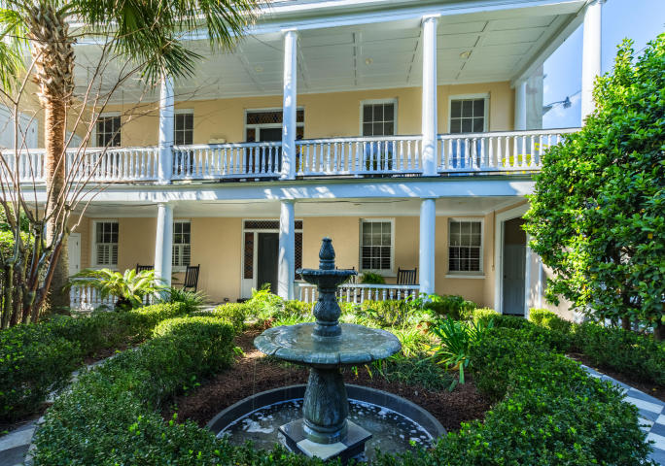
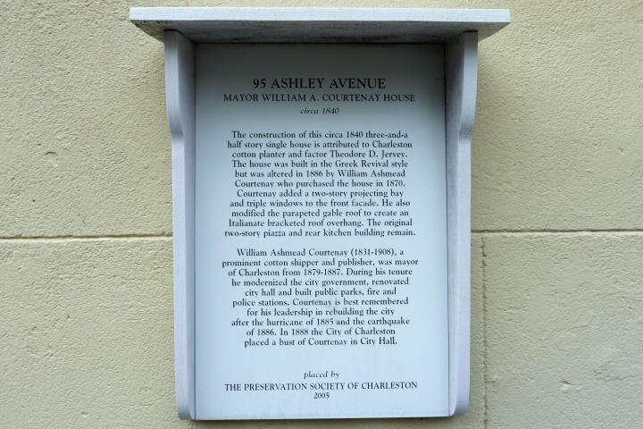
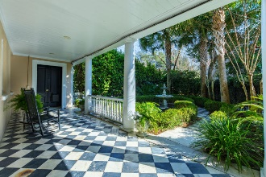
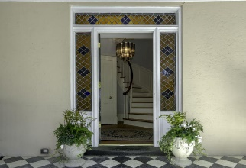
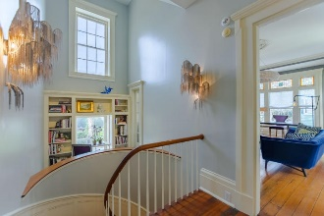
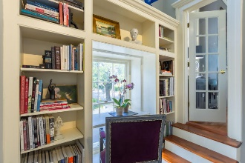
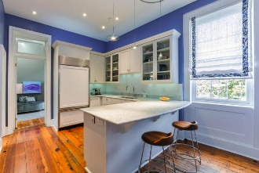

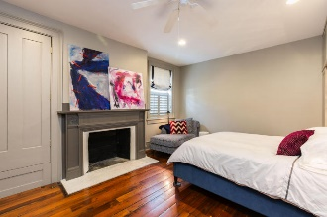
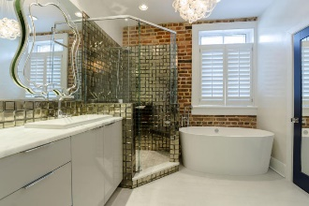
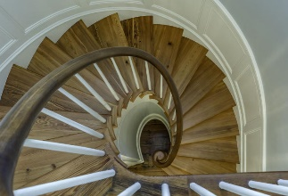
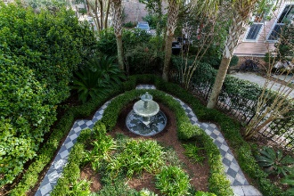
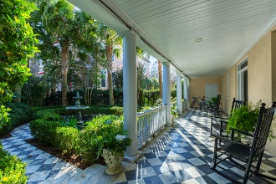

95 Ashley Avenue A/B
Harleston Village ~ Charleston ~ MLS# 17002892 ~ $1,575,000
City Living At Its Best!
This move-in-ready historic home was the house of Charleston Mayor, William A. Courtenay. This spacious 3000 sq. ft. home has 4 bedrooms and 3 bathrooms. Each room is filled with natural streaming light and has over 12 ft. ceilings. As you open the front door from the street you are awakened by a beautifully landscaped courtyard with the serene sound of running water that flows from the fountain. Upon entering the home you are greeted by a gracious porch that overlooks the courtyard. Once in the home you are embraced by the stained glass door. To your right is a vast bedroom/family room with an en-suite.
Down the hallway you will find the handsome master bedroom with a splendid en-suite and an abundance of storage. On the first floor you also have a third bedroom that is currently being used as an art studio and a well located laundry area with a laundry sink.
At the top of the staircase, is the delightful office area and another stained glass door that leads to the 2nd porch.
To your left is the grand, exquisite living room. Straight ahead is the generous dining room that leads into the gourmet style kitchen with marble counter-tops. The fourth bedroom is located on the 2nd floor. The porch off the dining room allows for glorious outside dining and unending enjoyment.
This home embodies Charleston living at its best; with 4 fireplaces, 2 off street parking spots, an elevator, 2 entrances & 2 large porches. All the new additions to the house are, spa-like master bath with ToTo toilet/bidet, tank-less hot water heater, custom built storage cabinets & bookshelves, plantation shutters, high end appliances, magnificent light fixtures, LED lights, built in reading lights, upgraded security lights & dehumidifier in crawl space. There are wooden floors throughout the living space and your own private downtown courtyard/garden; A Charming Move-in-Ready Home To Be Had...in walking distance to Colonial Park.
Please note that most of the designer furniture can be purchased for an additional $100,000 with the exception of the iron rocking chair, the art work, and the items located in the two art studios.
Carolyn Dubrofsky
843-324-9645 M
cdubrofsky@comcast.net
The MarshallWalker.com Group
582 Rutledge Ave
Charleston, SC 29403

