Slide 1
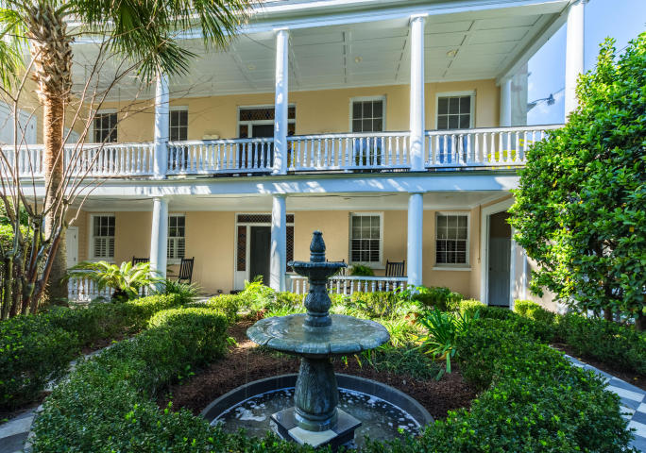
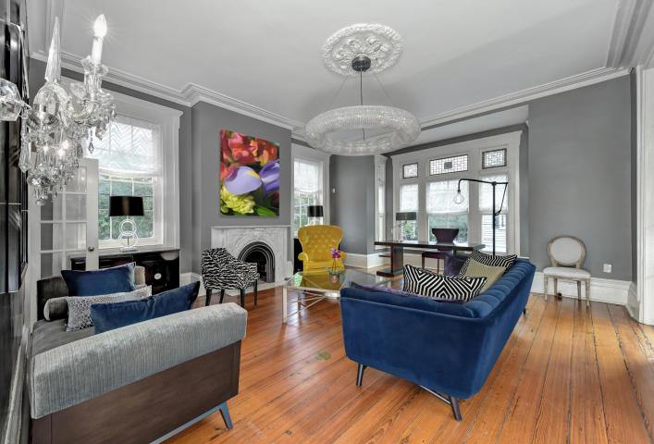
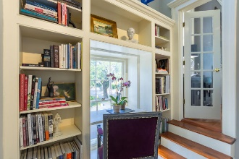
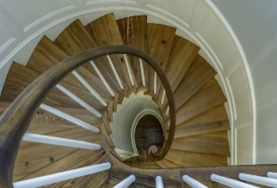
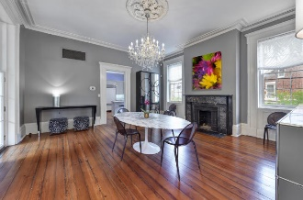
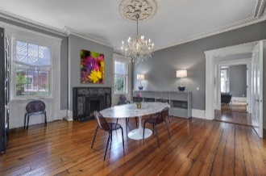
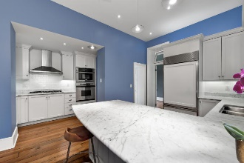

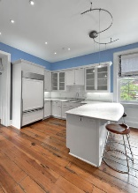
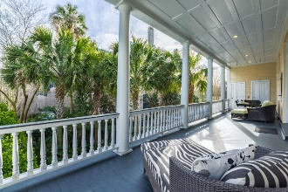
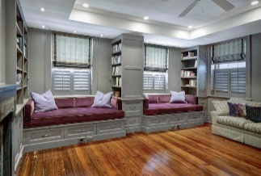
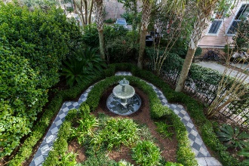
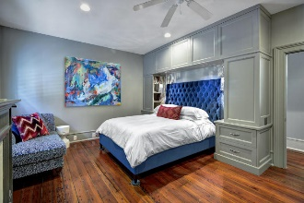

95 Ashley Avenue A/B
Harleston Village ~ Charleston ~ MLS# 17002892 ~ $1,296,000
Your Opportunity To Purchase Downtown Charleston
This rare downtown gem is move in ready; with 2 off street parking spots, 4 bedrooms, 3 baths, an elevator and expansive built in storage; this home is just blocks from Colonial Lake.
This jewel of a home makes a great primary home, 2nd home or a fabulous investment rental. Once inside everyone can savor the sounds of the soothing fountain from the gorgeous private courtyard or one can delight in the solitude of the lovely 2nd floor piazza.
This unique corner location plus the gorgeous bay window fills this elegant home with light and seclusion at the same time. Every detail was considered from extraordinary artistic lighting to premium energy efficient appliances, while preserving all the allure of a historic 1840’s home.
Priced below fair market value, priced to sell!
Carolyn Dubrofsky
843-324-9645 M
cdubrofsky@comcast.net
The MarshallWalker.com Group
582 Rutledge Ave
Charleston, SC 29403

