Slide 1
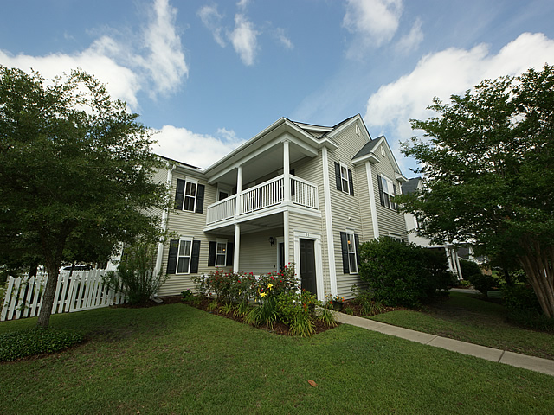
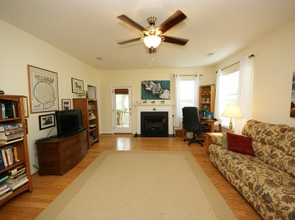
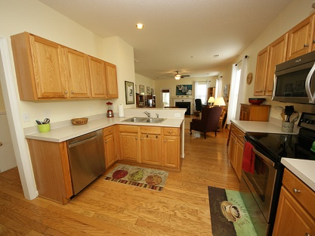
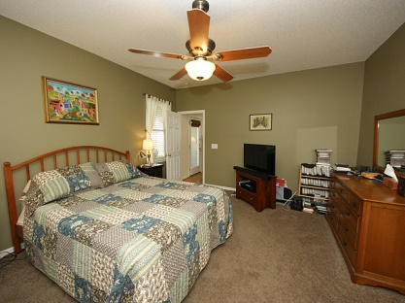
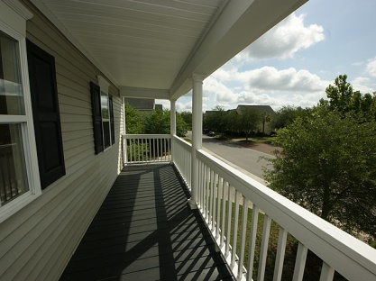
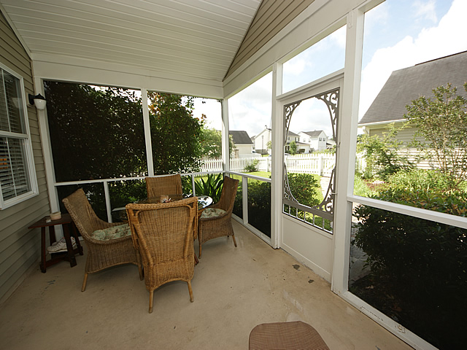
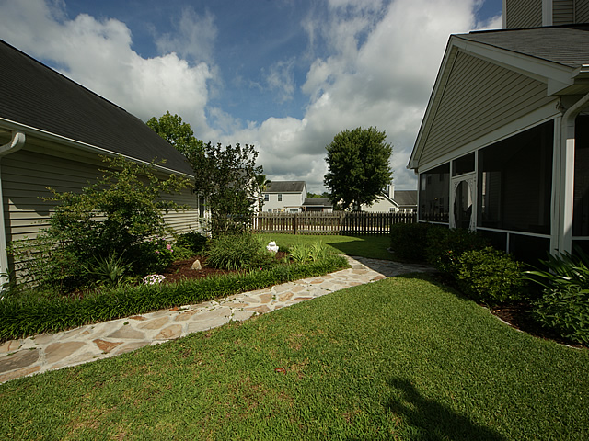

95 Creekside Dr
Bridges of Summerville
Summerville, SC
MLS# 1411117 $226,900
2,512 Sq Ft - 4 Bedroom - 3½ Bath
New Listing!
Classic Charleston Single Style Home. located in the Very Desirable “Carriage Park” Area in the Bridges of Summerville. Over 2500+ Sq.Ft. of Living Space to include 4-Full Bedrooms, 3.5 / Baths, a Super Loft area, Front Porches up & down, a Nice Size Screen Porch, a Detached 2/Car Garage and a white picket fenced side and back yard. This home is loaded with extra designer features and cosmetic upgrades and most of the interior has just been freshly painted in neutral colors. Enter the home into a Two Story Foyer which includes an upper plant shelf, Entry Closet, Adjacent Powder Room and Hardwood Floors which extend throughout the first floor excluding the Master Bedroom Suite and Laundry area. There are nine foot ceilings and Real Wood Blinds throughout. The Formal Dining has double front windows and 3/transom style windows providing plenty of light. The Eat-In Kitchen is has Beautiful Oak Cabinets, lots of Counter Space and includes a Nice Snack Bar for casual dining, a Pantry, Flat Top Stove, and Built-In Microwave. The Kitchen opens directly into the Family Room with a Fireplace, a Ceiling Fan, and a glass panel door leading to the Screen Porch. There is also a Laundry Room on the first floor. This home also features a Large First Floor Master Suite with ceiling fan, Large Bath with Double Vanity Sinks, a Soaking Tub, Separate Shower and a large Walk-In Closet. The 2nd Floor has a large Loft Area which could be used as a Media Room or Man Cave. The Loft area also provides access to the Upper Front Porch. There are 3 Nice Size Bedrooms, 2 of which are separated by a Jack & Jill Bathroom and a 3rd Full Bath that is convenience to the Loft and 3rd Bedroom. This home is situated in the award winning Dorchester 2 School District. The Bridges of Summerville offers Play Parks and Community Swimming Pool and is located just minutes from the Summerville Medical Center, Churches, Schools, Shopping, Historic Downtown Summerville, I26-Freeway, Boeing and the Air Base.
Bill Milo
Mobile: 843-412-0052
Bill@southernshoresre.com
Southern Shores Real Estate
1050 St. Andrews Blvd
Charleston, SC 29407

