Slide 1
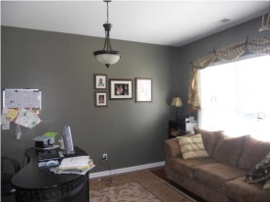
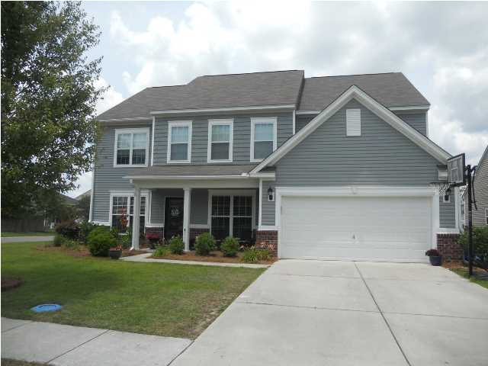
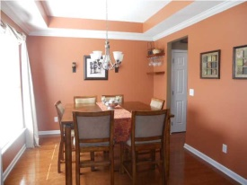
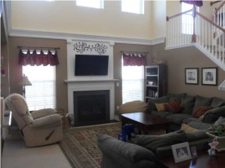
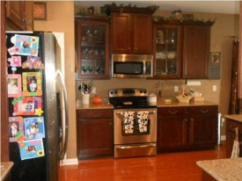
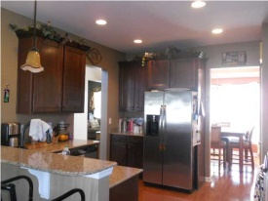
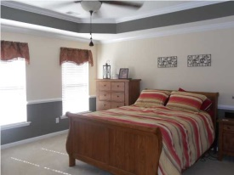

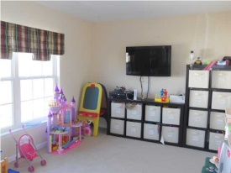

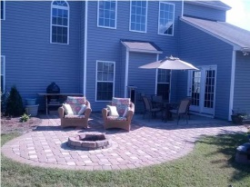
$1,500 Agent Bonus!
9601 N Carousel Cir
Wescott Plantation
Summerville, SC 29485
Open House & Lunch
TODAY @ Noon
MLS# 1412820 | $284,900
4 Bed / 3 Bath
This stunning home was professionally decorated and shows like a model home. Features include beautiful wood floors in the great room, kitchen, breakfast area, formal dining, media room and spacious foyer. This home is complimented with crown molding, tray ceilings, upgraded fixtures and has been tastefully painted in each room. The well designed kitchen has 42" cabinets accented with glass doors and upgraded hardware. Granite, under mount sink, and trendy light fixtures over the breakfast bar tops it all off. Staircase leads up to a loft and an impeccable master suite complete with tray ceiling, crown molding and ceiling fan. The large master bath features a garden tub, separate shower with upgraded fixtures as well. The yard is enclosed with a picket fence and the home owners have increased the patio space from the sun room by adding decorative pavers and a cozy fire pit for relaxing and entertaining in the back yard. Play park and community pool are in walking distance and golf club membership is available for the public golf course in Wescott.
Connie White
C: 843-532-3356
conniesyouragent@gmail.com
Omni Carolina Real Estate
126 Eston Dr
Goose Creek, SC 29445

