Slide 1
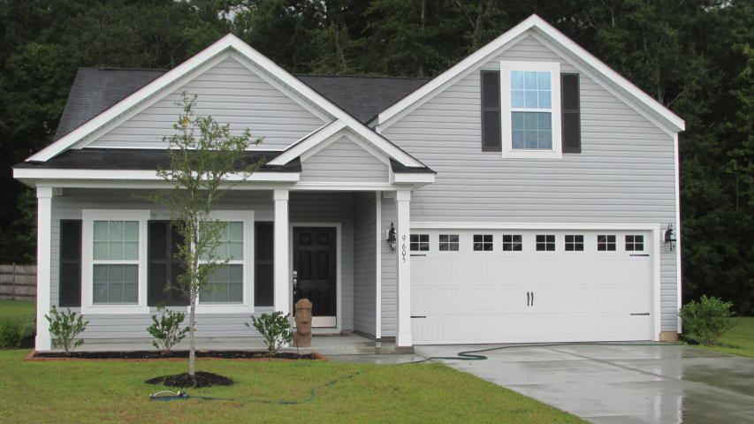
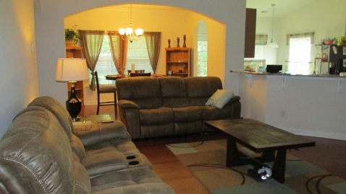
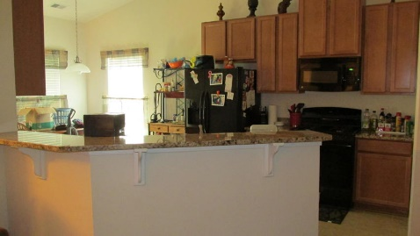
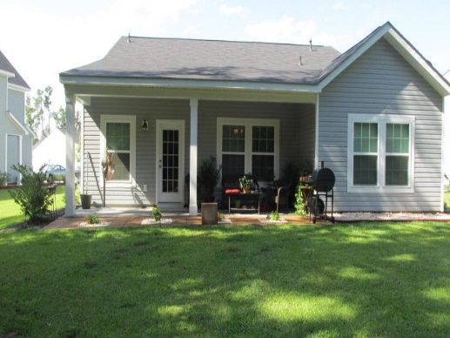
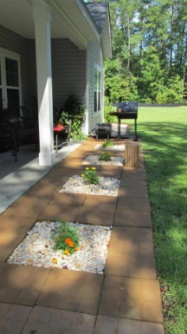
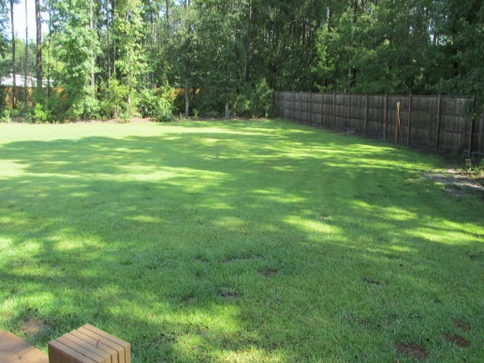
Huge Yard…Close To Everything!
9605 Spencer Woods Rd
Spencer Creek Woods
Ladson, SC 29456
MLS# 15022369
$214,900
4 Bedroom | 2 Baths
New Lower $$$ for Lennar's most popular floor plan on HUGE 1/3 acre lot, this beautiful ranch offers large open plan, soaring ceilings, beautiful curved archways throughout, gleaming hardwood floors in entry, living & dining rooms; ceramic tile floor in kitchen and baths. Large open kitchen with gas stove, granite counters, 42'' cabinets, separate eating area and large pantry adjacent to laundry. Beautiful formal dining room. Private master suite features trey ceiling, full bath with dual sinks, soaking tub, separate shower and private water closet, & huge closet! Two additional bedrooms & full bath complete the main level. Bonus/4th BR is over garage. Wonderful covered patio on back with additional 6x22 patio for grilling, overlooks huge backyard that is partially fenced along one side. Nice tree line to one side of the home offers shade to part of the yard. This is one of the largest lots in Spencer Creek Woods. Really feels like country, with a super convenient location close to everything!
Darlene Bollettino
Real Estate Agent
Miler Properties
Office: 843-821-1111
Cell: 843-209-8955
dbollo84@yahoo.com www.milerproperties.com

