Slide 1
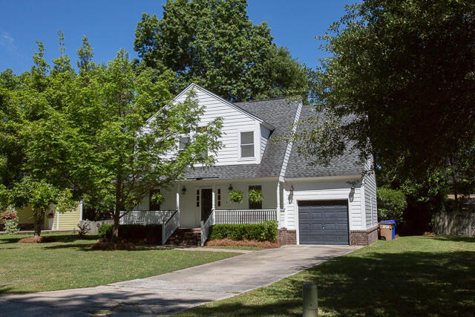
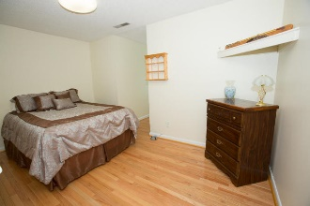
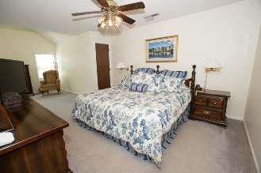
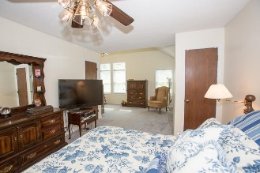
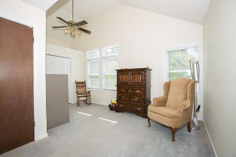
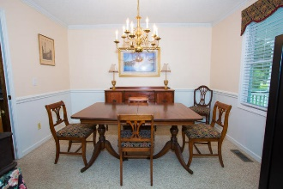
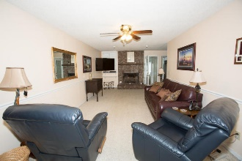
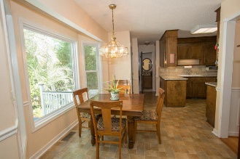
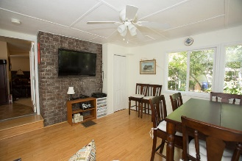
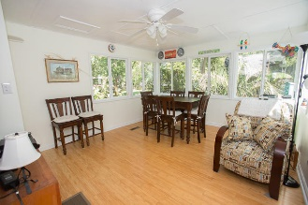
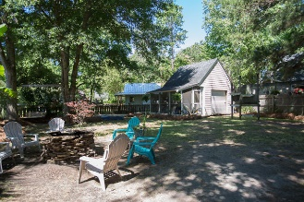


Open House
Saturday, July 9 12:00 - 4:00
***PRICE REDUCED***
960 Mooring Drive
Bayfield Manor · Charleston · MLS# 16012179 · $404,900
Michael Dew
O (843) 870-7000
M (843) 870-7000
michaeledew@gmail.com
www.michaeldewrealestate.com
Beautiful, well maintained 3 bedroom 2.5 bath located in highly sought after area of James Island. Bayfield Manor is nestled between Lawton Harbor and Harbor Woods. Eat in kitchen with granite counter tops. Lovely great room with gas or wood burning fireplace. Formal dining. Florida room. Room above the garage. Plenty of space!!! Back deck with gas line for grill overlooking large back yard. There is also a 16x14 shed for additional storage. Hardiplank exterior installed 2010. Freshly painted. New high impact windows installed 2008. High efficiency Heil variable speed HVAC installed downstairs in 2016 with wi fi t-stat. All new duct work and insulation. X flood zone. Must see! Convenient to schools, downtown shopping and Folly Beach!!!
AgentOwned Charleston Group
902 Savannah Hwy
Charleston, SC 29407
Real Estate ● Mortgage
Insurance ● Business Brokerage

