Slide 1
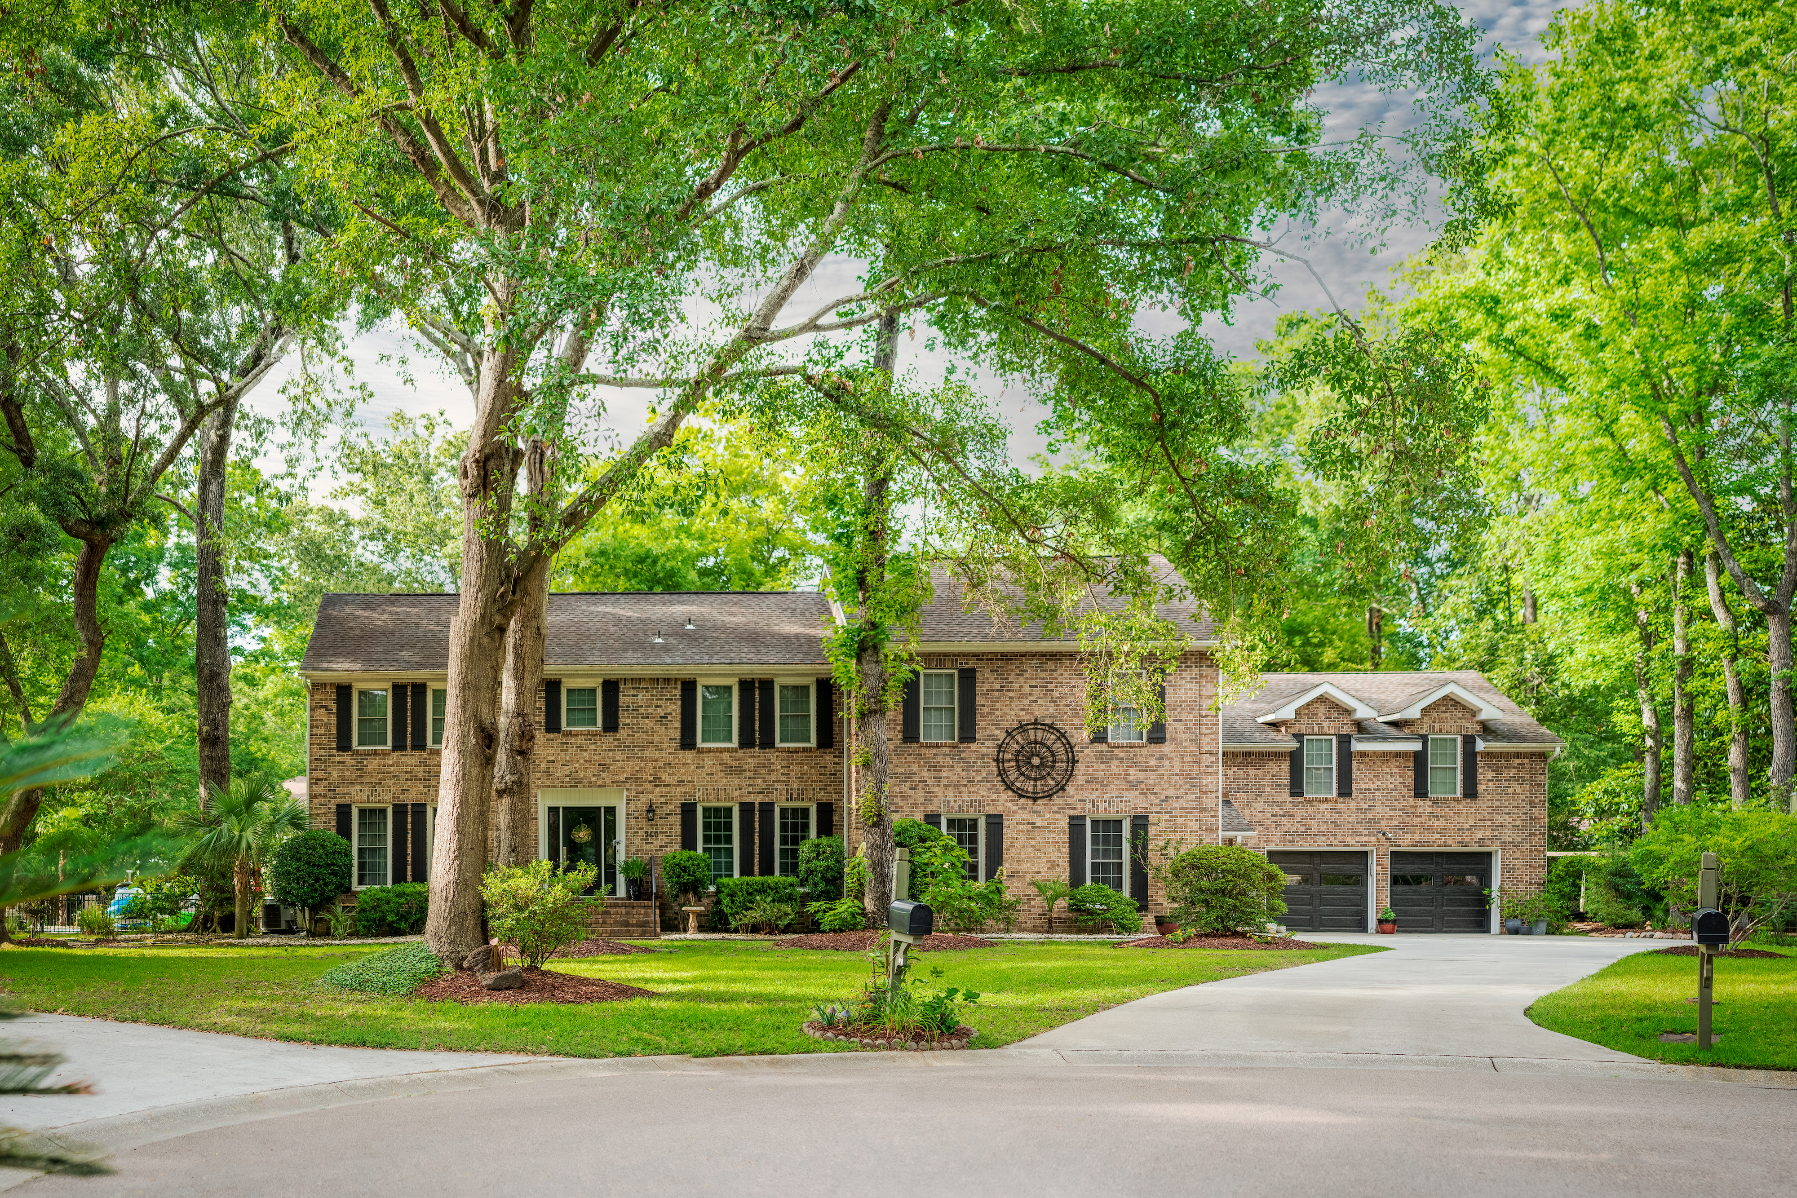
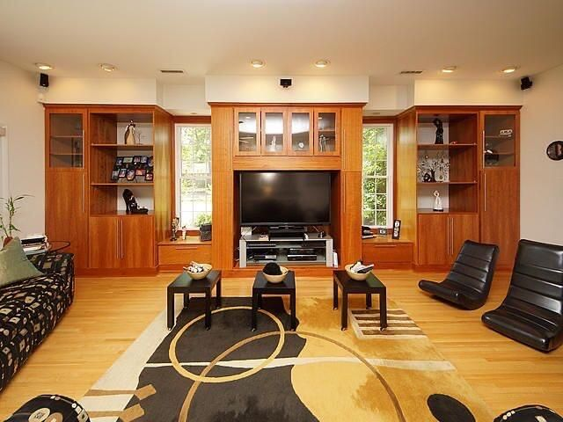
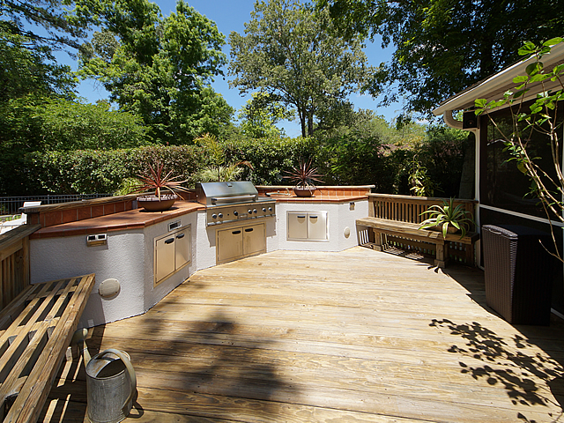
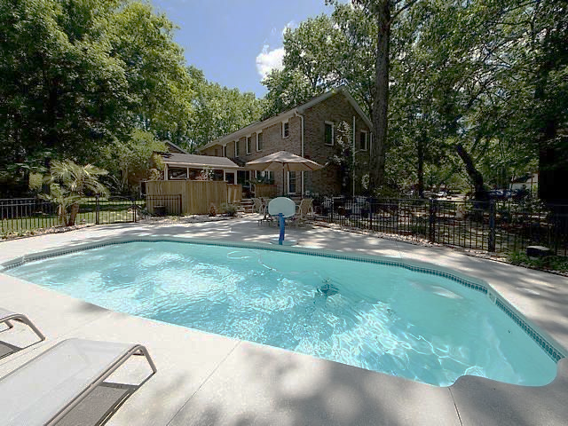

SNEE FARM HOME ~ UPDATED PRICE!
Moved to Saturday, 10/8 ~ 11:30 to 2:30
960 Charter Court
Mount Pleasant, SC 29464
MLS# 22024071
$1,199,999
4 Bedrooms
4½ Baths
4,415 Square Feet
All Brick Home
Half-Acre Lot on Cul-de-sac
Hardwood Floors
In-ground Pool
SCHEDULE A SHOWING!!
Jennifer Nipper-Crockett
REALTOR
843-478-1800
Jen@AgentOwned.com
AgentOwned.com
Notes:
DO NOT ALTER LAYOUT. YOUR FILE WILL BE RETURNED OR EDITED IF IT IS RECEIVED ALTERED.

