Slide 1
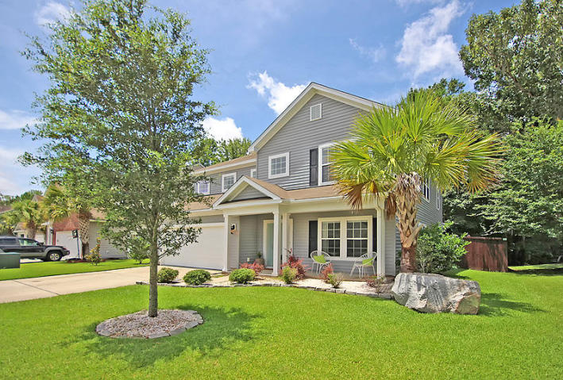
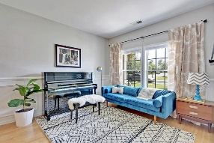
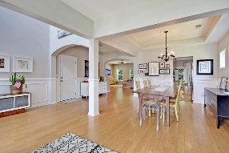
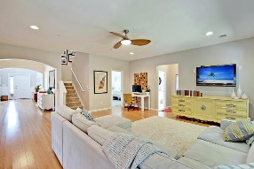
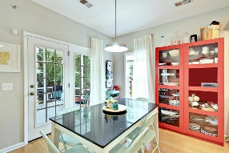
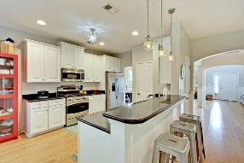
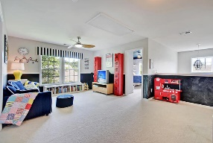
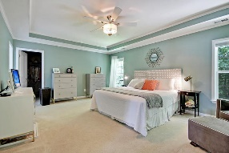
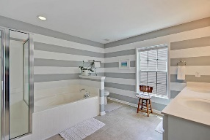
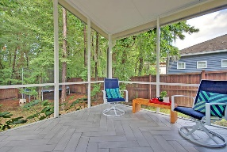
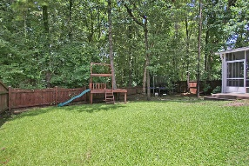
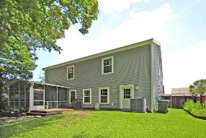
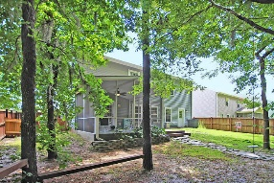


Wescott Wow House!!
9631 S Liberty Meadows Dr
Wescott Plantation
Summerville, SC 29485
MLS# 17019248
$299,900
5 Bedrooms | 3 Baths | 3,104 sf
Get ready to be Wowed with this beautiful home! Great floor plan with 5BR and 3 Full Baths! A great front porch welcomes you, then upon entering, get ready to be impressed!! Stunning bamboo floors create a warm welcoming! The formal living room, dining room combo is very large and perfect for entertaining! Step in to the kitchen and immediately notice the fantastic open flow of this home. The kitchen offers a gas stove, large pantry, ample cabinet space, large eat in kitchen area and a breakfast bar. The family room is a great size and offers tons of natural light. Also on the first floor is a bedroom with access to a full bathroom! Perfect for guests! The large laundry room has tons of storage and an access door to the backyard. No need to track dirt through the house!
Upstairs, you'll find a very large master bedroom and huge walk in closet! The master bath has dual vanities as well as a separate tub and shower. You'll also find three more good size bedrooms upstairs, all with big closets!! There's another full bath upstairs as well as a loft! This large area can be used many different ways - playroom, office, media area, workout space - the choice is yours! Back downstairs, head out to the newly tiled screened in porch. Look out over the wooded, private backyard which is completely fenced in! There's also a great patio perfect for grilling! Come see this home today and make it your own!!
Larry & Kathy Mazalatis
Larry Cell 843-693-0529
Kathy Cell 843-693-0159
Office 843-871-9133
AGENTOWNED PREMIERE GROUP | 1800 TROLLEY RD | SUMMERVILLE, SC 29485

