Slide 1
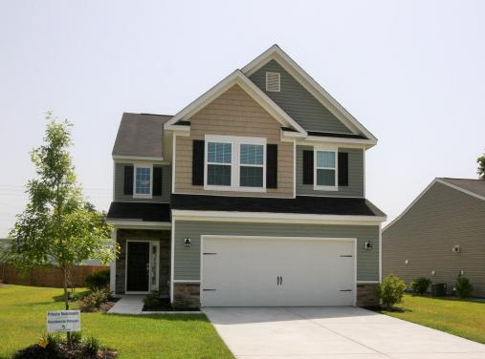
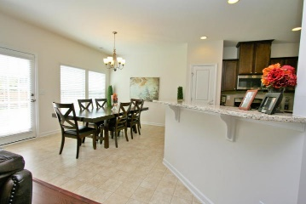
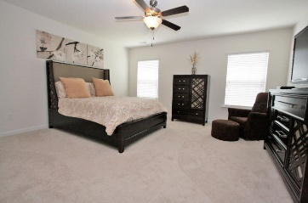
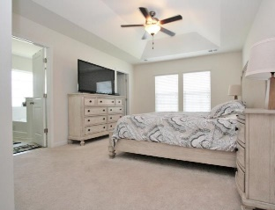
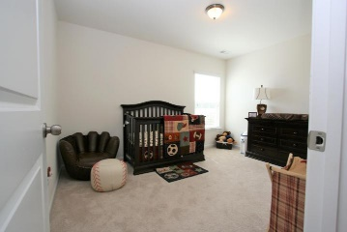
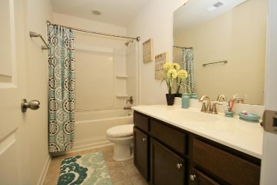


9637 Spencer Woods Road Spencer Creek Woods | Ladson, SC 29456 | MLS# 15016770 | $207,000
Motivated Seller
Motivated Seller
No Need to wait for new construction or paying more! This home The ''Dillon'' floor plan is grand with its breath taking 2-story foyer. This home was upgraded to add the HUGE 4th bedroom. This makes 4 beds, 2 full and 1 half bath! The covered porch leads into the open 2-story foyer with hardwood flooring, convenient coat closet for guests & storage closet under the staircase. The kitchen has a great triangular layout for the chef of the family, a perfect spot for bar stools at the breakfast bar that overlooks into the large family room, maple cabinets, recessed lights, a pantry & large eat-in-kitchen. The family room is spacious & perfect for entertaining with an open first floor. This home features 9 foot ceilings on the main level. From the 2 car garage you pass the separate laundry & first floor powder room. Through the family room you enter onto a patio perfect for entertaining outside. The Owners Suite has a decorative tray ceiling in the spacious bedroom, large walk-in closet and second closet, dual vanities w/ culture marble counter tops, upgraded maple cabinets, soaking tub & separate shower w/ culture marble & glass enclosure/door! In the hallway is a linen closet & the second bathroom featuring upgraded maple cabinets, cultured marble counter tops, elongated toilet & shower/tub combination. Large lot with a partial fenced back yard. This home also has a large upgraded screened in patio. Spencer Creek Woods is close to shopping, schools, Palmetto Parkway along with easy access to I-26.
Neil Schneider
(843) 200-8902
neil@charleston.info
AgentOwned Preferred Group of Mt Pleasant
824 Johnnie Dodds Blvd, Mt Pleasant, SC 29464
www.buycharlestonscrealestate.com

