Slide 1
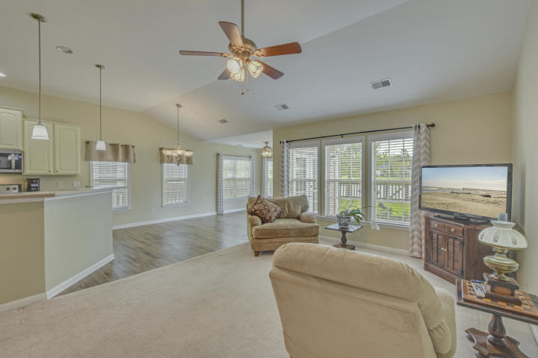
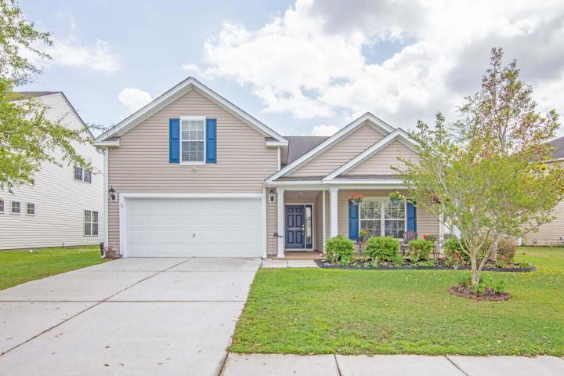
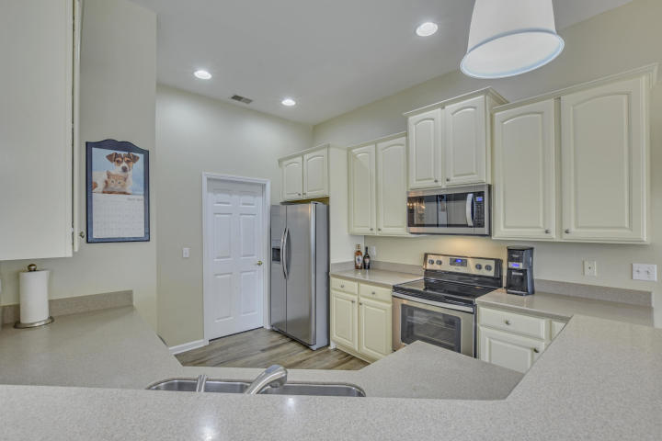
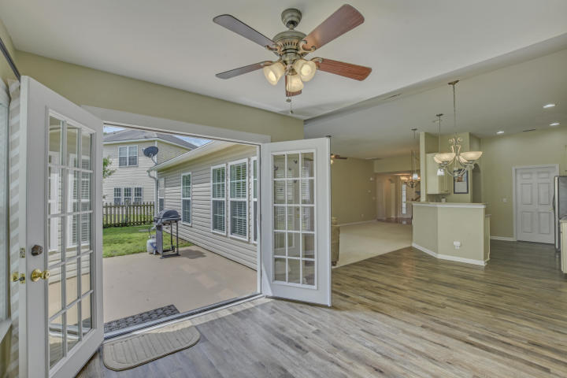
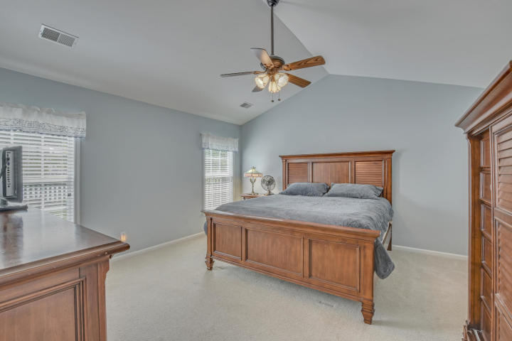
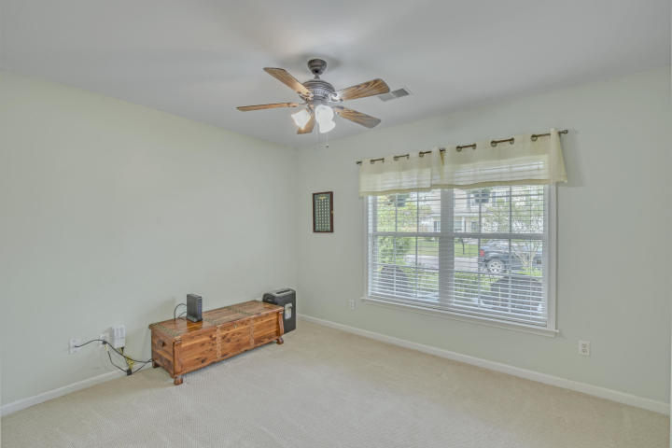
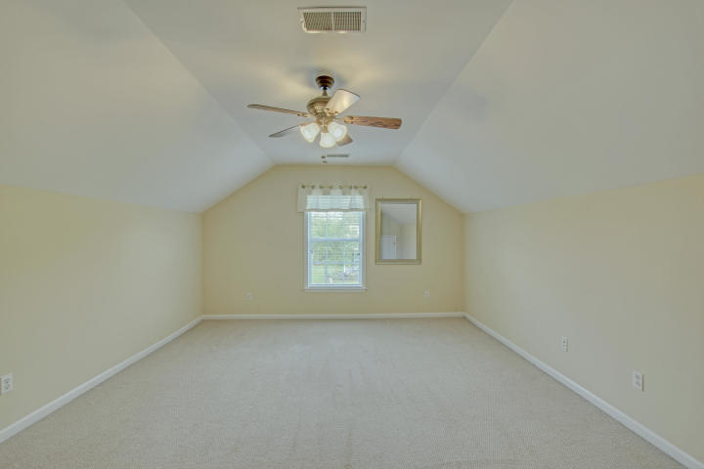
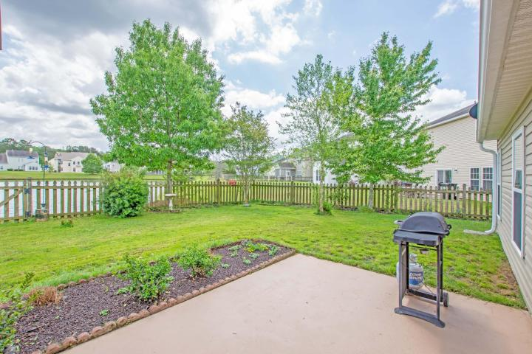
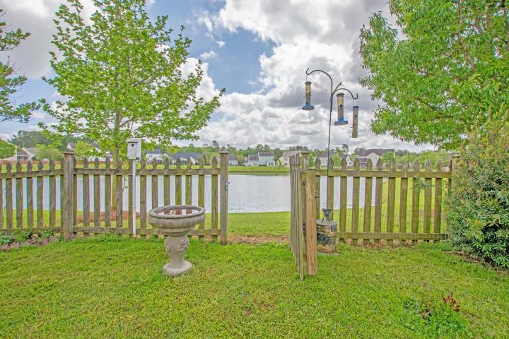


Local Agent Spring Special!
9647 S Carousel Circle
Wescott Plantation | Summerville, SC 29485
MLS# 19010734 | $279,999
$1,000 AGENT BONUS WITH RATIFIED CONTRACT
BY THE END OF MAY
Perfect 1-level Home
Meticulously Maintained
New HVAC
1 Year Old Matching Appliances That Convey - Including Washer And Dryer
Priced To Sell!
Click here for listing details!
Jamie Pfaffenbichler
843-460-7299
jamie.pfaffenbichler@gmail.com
Boykin Real Estate | 5401 Netherby Ln, Ste 301 | N Charleston, SC 29420

