Slide 1


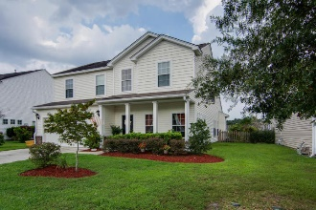
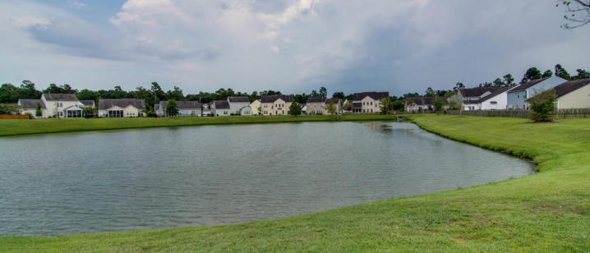
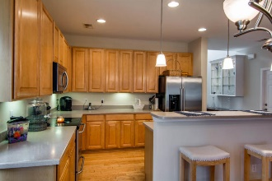
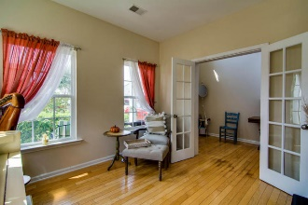
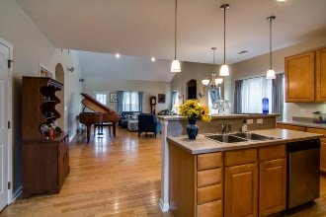
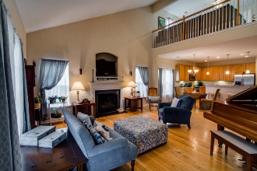
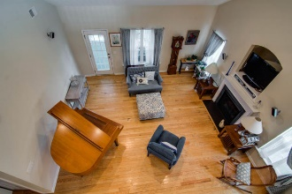
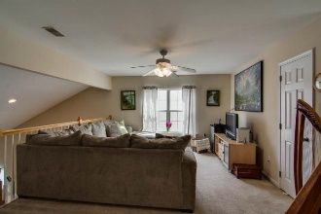
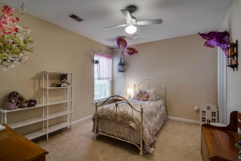
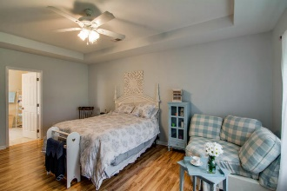
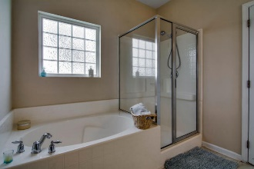
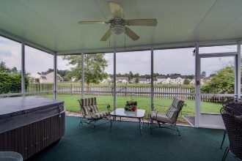
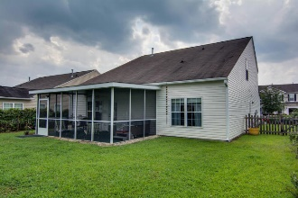

Seller needs to sell ASAP!! All reasonable offers considered!
9649 S Carousel Circle
Wescott Plantation ~ Summerville
MLS# 15023569 ~ $257,500
Just Reduced!
This is The One you have been waiting for!!
This well kept home has it all!! Open plan, first floor spacious master over looking serene pond in the backyard; two story family room-extra light and bright; kitchen with island; huge loft area, being used as second family room; 3 nice size bedrooms upstairs. This is the home for you! Enter the 2 story foyer with plenty of room for large pieces of furniture. To the right is the study with French doors. Continue to kitchen which opens to the family room so the cook is always included in the family fun. Master is off the family room and large enough for sitting area. Screened porch is over-sized and perfect for extended entertaining and includes hot tub. This is a peaceful area where you can sit and watch the ducks in the pond. Yard is fenced. HVAC was replaced in spring. Neighborhood includes neighborhood pool and play area. Close enough to shopping and restaurants that you can ride your bikes. This is a great place to raise your family. Dorchester II schools, close to Boeing and Airport.
Call to schedule your appointment today!!
Laurie A Loparo, ABR laurieloparo@gmail.com
lauriesellscharleston.com
Golden Bear Realty | 654 Coleman Blvd, Suite 100 | Mt Pleasant , SC 29464
Cell (843) 442-1290 | Office (855) 352-9088 | Fax (561) 721-3311

