Slide 1
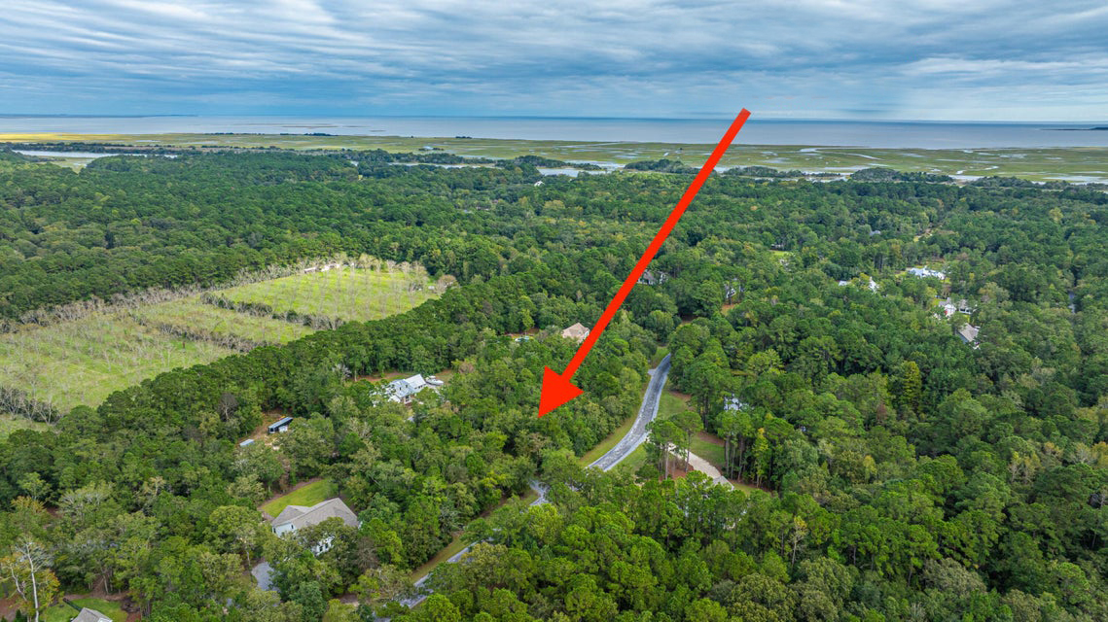
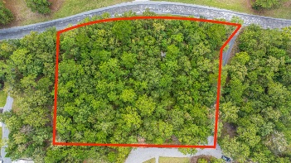

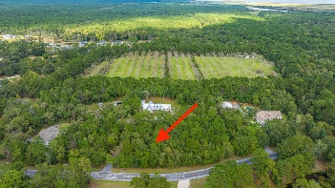
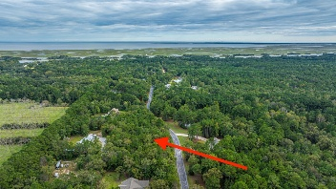
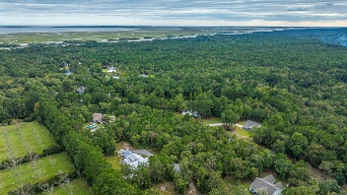


964 Awendaw Lakes Boulevard Awendaw, SC 29429 | MLS# 25028121 | $299,000
OPEN HOUSE SATURDAY 1-3
PRICE ADJUSTMENT!
If you've been looking for your own slice of serenity, this 1.39-acre wooded lot in Awendaw is it! Tucked back among tall pines and wild hardwoods, it's the kind of place where you can clear just what you need and leave the rest to nature. Only a short ride to Charleston and the coast, but far enough out where you can actually hear the wind instead of traffic. Spend your days casting a line from Buck Hall or Garris Landing, or hop the ferry to Bulls Island for some amazing fishing and wildlife. When hunting season rolls around, you're just minutes from the Francis Marion National Forest—thousands of acres of public land right at your fingertips. Got kids in sports? SC Youth Soccer Fields are nearby. Need some target practice? Twin Ponds Rifle Range is just down the road. Want live music and a cold drink? Wednesday evening Barn Jams at Awendaw Green has you covered.
Take a ride out and walk the property... one visit and you'll understand why this spot is special!
Scan for a virtual walkthrough!
Suzi Baldrick Mobile 843-442-3149
suzi.baldrick@carolinaone.com
Carolina One Real Estate
1503 Palm Blvd
Isle of Palms, SC 29451-2280

