Slide 1
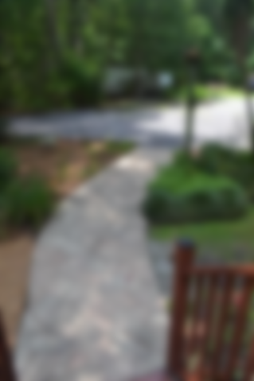
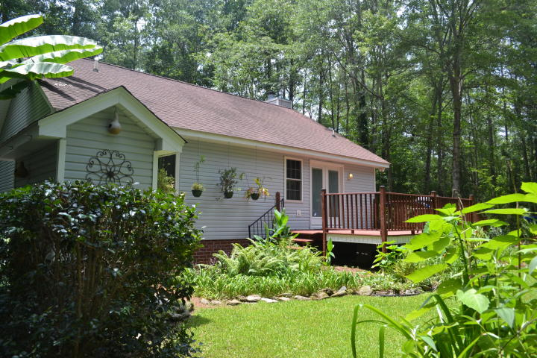
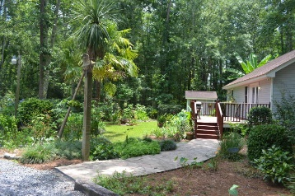
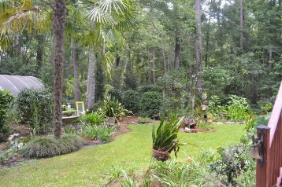
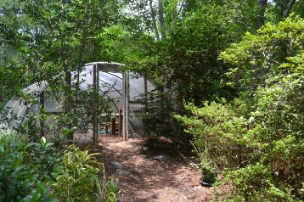
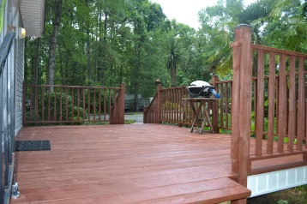
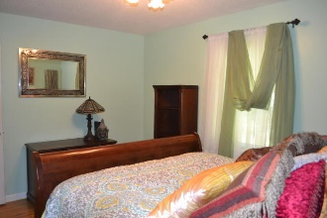
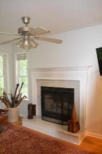
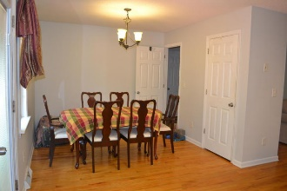
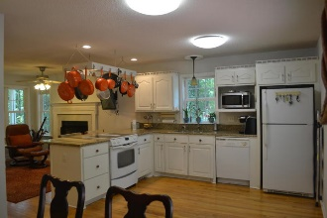
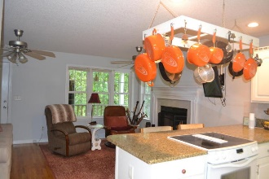
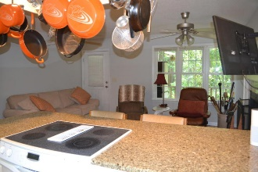
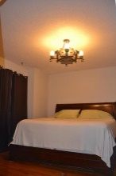


Wonderful Home on 3.8 Acres in Ladson, SC!
Just Reduced!
$20,000+ Below Tax Appraisal
9654 Hoot Owl Avenue
Pt Dowling Tract • Ladson, SC 29456 • MLS# 17018286 • $279,900
A rare find tucked away with 3.8 acres of privacy, yet conveniently located within minutes to restaurants and shopping. This one of a kind home has been meticulously maintained by the owners since home was originally built. As you drive up the gravel driveway, you will find home perfectly situated among hardwood trees and lush landscaping. Property has been cleared around the home and beautifully landscaped with walking garden trails, koi pond, small green space and irrigated greenhouse. Paver walkway leads to large back deck overlooking this incredibly landscaped yard... perfect for grilling and gatherings. As you enter the home from deck, you will walk into bright open kitchen complete with white cabinets and appliances, and granite countertops.
Kitchen has bar area for casual dining and opens up to living room. Living room has wood burning fireplace with marble surround and plenty of windows for natural light. Front door which leads to front porch is located in living room as well. A separate dining area is also located off of kitchen along with closet pantry. (Dining room could potentially be converted to a third bedroom if need be). Down the hall from living room are two bedrooms and two bathrooms. Master bedroom has walk-in closet and private bathroom with cultured marble vanity with bathtub/shower combo with multiple shower heads. Guest bathroom is located in hall and is complete with unique solid surface shower and vanity. Guest bedroom is across from master and has large closet. Hardwood flooring is throughout entire home including both bedrooms and bathrooms. In addition to greenhouse, this home offers storage shed and large cleared area with plenty of room for parking and boat or RV storage. Pride of ownership is quite evident both inside and outside of this wonderful home. Be sure to walk the trails around home to discover both the beauty and privacy this unique property has to offer. Seller offering one year AHS- ShieldPlus Home Warranty with acceptable offer.
For additional photos and information, text "17018286" to 1-855-880-6113.
Megan Schwerin
(843) 478-5867 | mkschwerin@gmail.com
Elaine Brabham and Associates, LLC • 1890 Sam Rittenberg Boulevard, Suite 217 • Charleston, SC 29407

