Slide 1
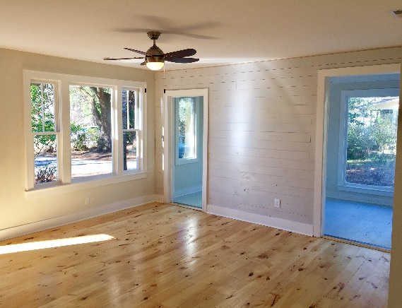
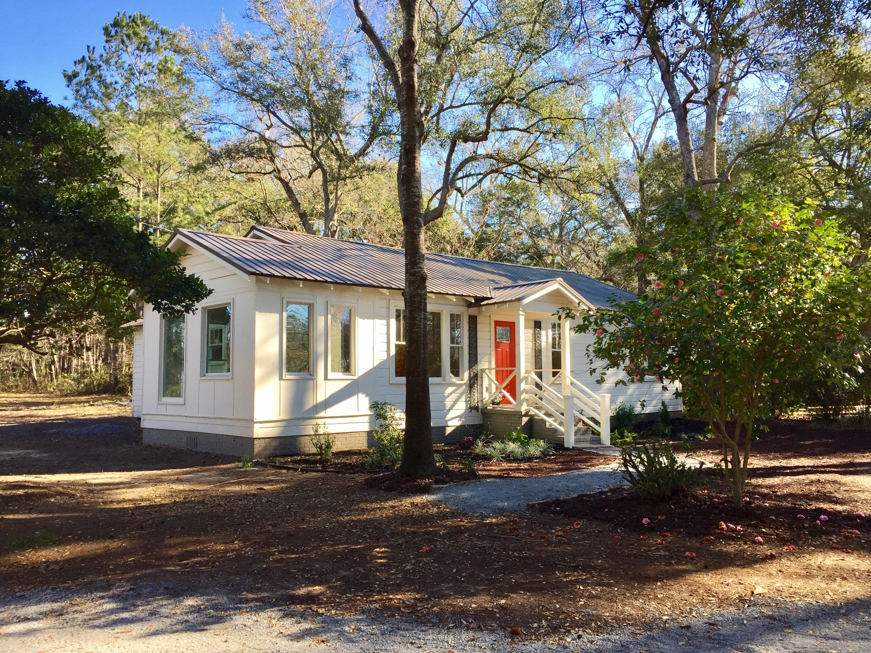
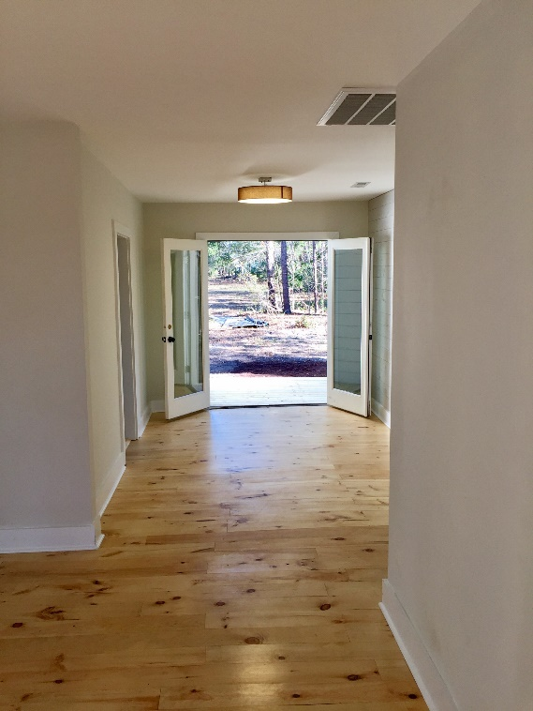


Gorgeous Business Property ~ Open House: April 28th 11:00-1:00
Dreaming of running a business? Here it is, a strikingly renovated 1940s mercantile home ready for your business! You can also live and run your business out of this spectacular property. It is on an acre lot that is almost like a park within the city. The road has become a major thoroughfare with lots of traffic for your business and it is very conveniently located. Come see this incredible property and start running your strategically placed business today!
9662 Jamison Road
Ladson, SC 29456
MLS# 17004413
CMLS#30040598
$377,000
Sherri Seymour
843-303-3495
Seymour.Sherri@gmail.com
CCBG Real Estate Group PO Box 1440
Mount Pleasant, SC 29465

