Slide 1
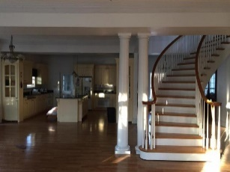
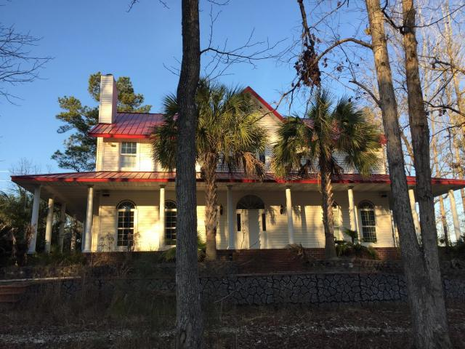
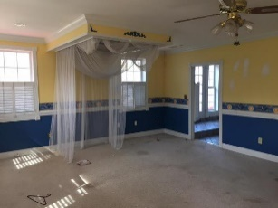
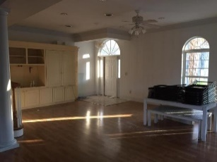
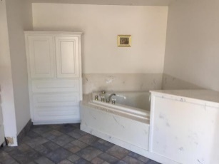
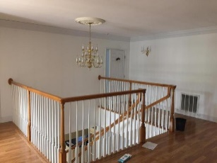
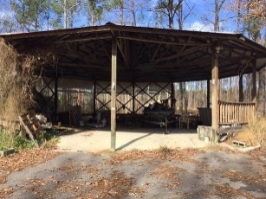
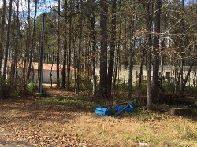
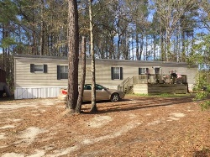
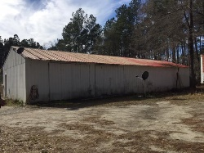

966 Hardwood Lane Summerville, SC 29486 ~ MLS# 17003380 ~ $650,000
Gorgeous Custom Home … Country Living At Its Finest
Open floor plan with a grand staircase. Crown molding, smooth ceilings, recessed lighting and surround sound throughout. Dual master suites. Jetted tubs. Mother-in law suite on the main level. Huge kitchen with plenty of custom cabinetry & granite counters. Wood burning fireplace in the great room. Heating and cooling system is a geothermal heat pump which operates off underground water. Perfect space for a home office. Commercial quality construction with a BASEMENT!
Note: there is an adjacent 2.2 Acre Parcel that can be purchased, that consists of Workshop/Garage & an income producing mobile home with tenant. Additional 1,522 SF metal warehouse. Constructed with iron framing, poured concrete floors and insulated metal roof.
Steven Olson
(843) 412-9848
solson1071@aol.com
Fred McCutcheon
(843) 608-8490
fred.mccutcheon@agentownedrealty.com
AgentOwned Charleston Group | 902 Savannah Hwy | Charleston, SC 29407 | www.agentowned.com | (843) 769-5100

