Slide 1
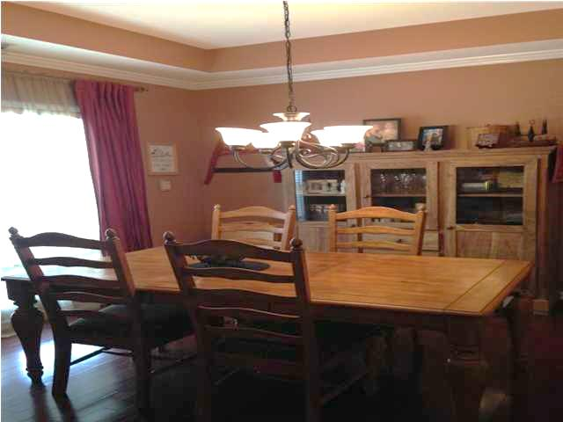
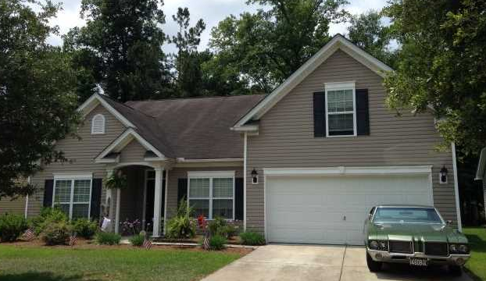
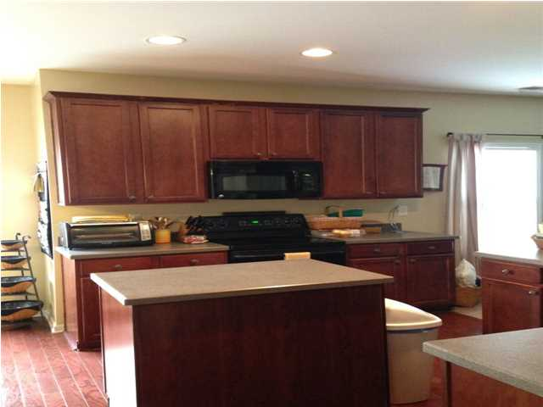
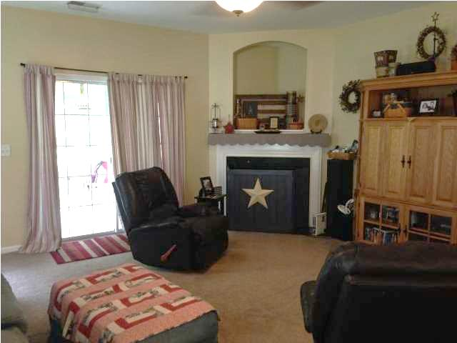
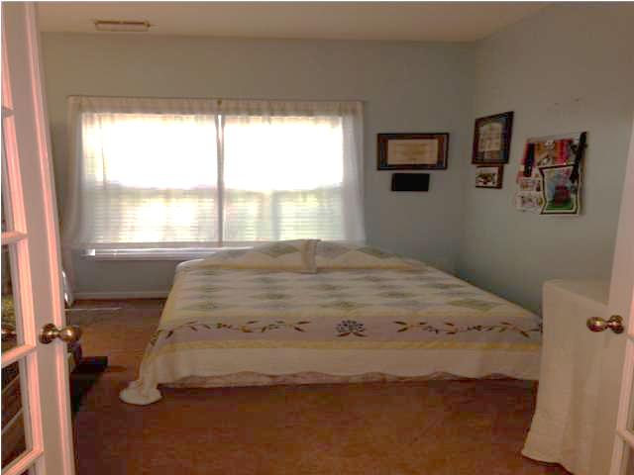
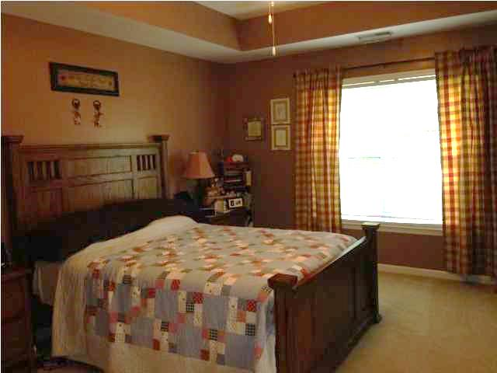
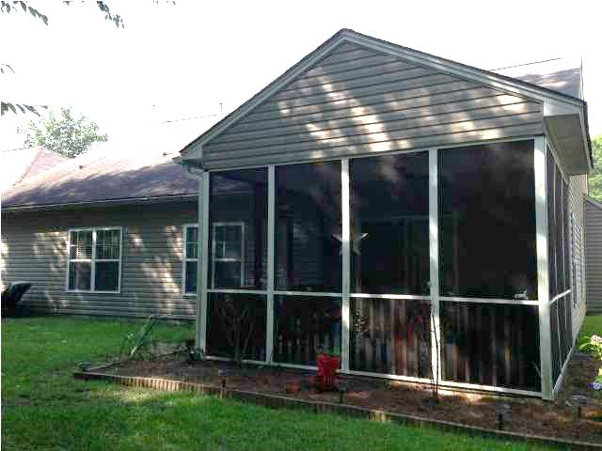
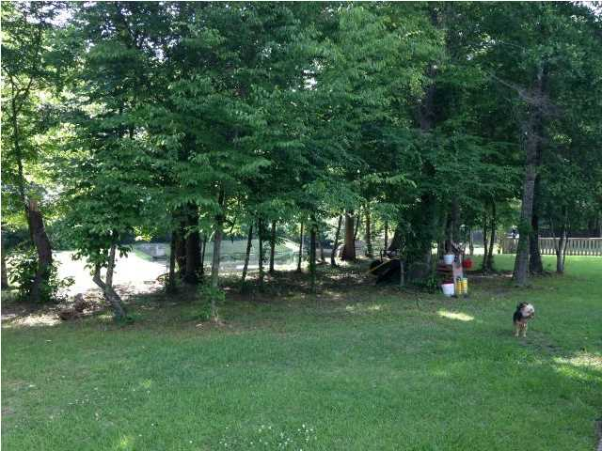
Amazing single story in Wescott Plantation!
9671 Pebble Creek Blvd
Summerville | MLS# 1414098 | $219,900
Amazing Ranch Style home located in the convenient Wescott Plantation Golf Course Community. Open floor plan offers a bright foyer with hardwood floors. Formal Dining room also offers hardwood floors, tray ceiling and beautiful crown molding. Enjoy cooking in your large kitchen with Corian counter tops, an island and black appliances. Kitchen and Eat in offer hardwood floors and an area to place bar stools. Living room is very large and open to kitchen. You won't be cold this winter while enjoying your fireplace. Split floor plan offers privacy for the Master bedroom from the second and third bedrooms. Home offers a study off of the living room, great for a at home office. The study is currently being used as a guest bedroom. Master bedroom is tucked away in the back of the home. It offers tray ceilings, ceiling fan, and walk in closet. Master Bathroom offers dual his and her sinks, stand up shower and garden tub. Second and Third bedrooms are located on the front and side of home. Both offer excellent space and wonderful outdoor lighting. Hall bathroom is located in the middle of the home and can be accessed from both hallways. Hall bathroom offer dual sinks. Large laundry room gives you plenty of extra space for storage. Get away from it all and escape to your room over the garage. The FROG offers plenty of space to use as an entertainment room or children's playroom! Relax on your wonderful quiet screen porch after a hard day's work. Very private backyard backs up to wetlands and small pond.
Jennifer Laffey-Foster, MRP
Real Estate Agent
Miler Properties
Office: 843-821-1111
Cell: 843-708-1582
jlfoster86@gmail.com www.milerproperties.com

