Slide 1
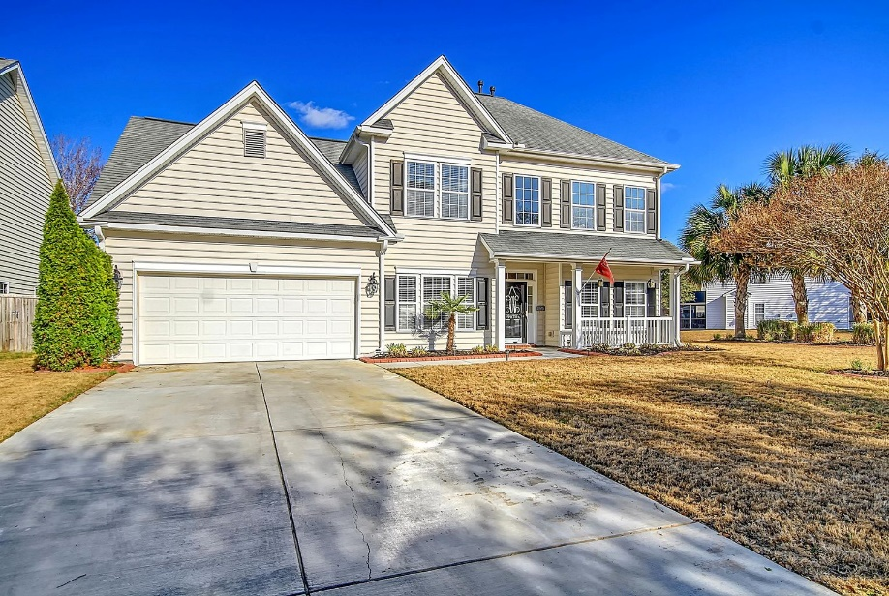
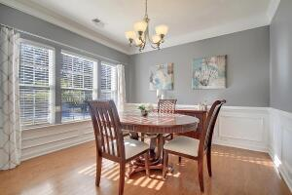
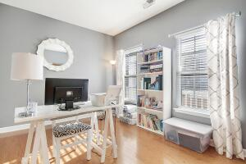
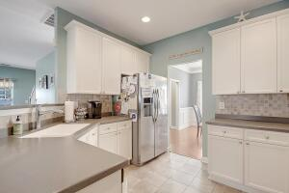
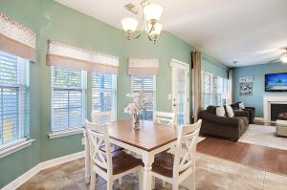
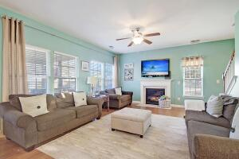
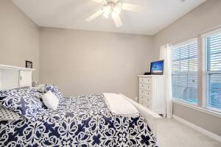
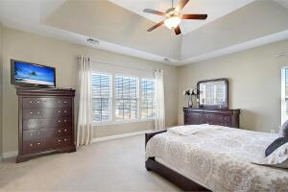
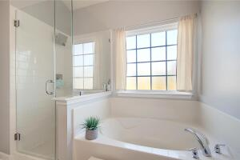
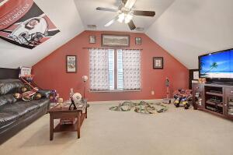
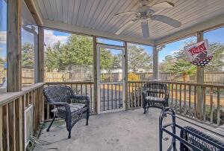
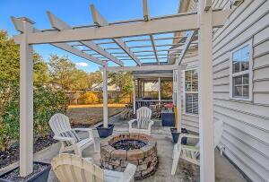
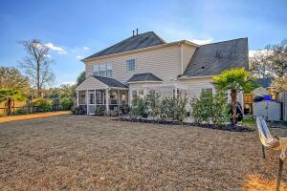
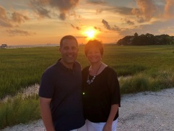

5 Bed/3 Bath Beauty in Summerville!
9678 Pebble Creek Boulevard
Wescott Plantation
Summerville, SC 29485
MLS# 23000766
$399,900
5 Bedrooms | 3 Baths | 2,704 sf
Welcome home to 9678 Pebble Creek Blvd! This lovely home is ready for you to move in! Located in the golf course community of Wescott Plantation, this sidewalk lined neighborhood is walking to distance to a variety of shopping and restaurants and centrally located for a short drive to the airport, Bosch, Boeing, Mercedes and right down the road from Palmetto Commerce Park! This home is located across from a large pond and sits on a corner lot with a fenced in backyard creating a beautiful setting. At the end of the street is a cul de sac, so limited traffic passing by! Upon entering, to your right is a home office or formal living room with french doors for added privacy. To your left is the large dining room, perfect for entertaining! The back of the house has a great open feel.
The kitchen overlooks the family room and eat in kitchen area, all with views of the nicely landscaped backyard. A great addition to the first floor is a bedroom with a full bath right outside. This can be a second main bedroom, guest room or mother in law suite. Head upstairs to the main bedroom which has a separate tub and shower and large walk in closet. Three additional bedrooms, all a great size with large closets, a full bath as well as the laundry room complete the second floor. Bedroom five can be a media room, game room, exercise room, you name it! Now head back downstairs outside to relax in your large screened in porch or out on the patio under your pergola. This backyard is your own little piece of paradise! This home has so much to offer and is a must see! Schedule your appointment today!
Larry & Kathy Mazalatis
Larry Cell 843-693-0529
Kathy Cell 843-693-0159
Office 843-871-9133
AGENTOWNED PREMIERE GROUP | 1800 TROLLEY RD | SUMMERVILLE, SC 29485

