Slide 1
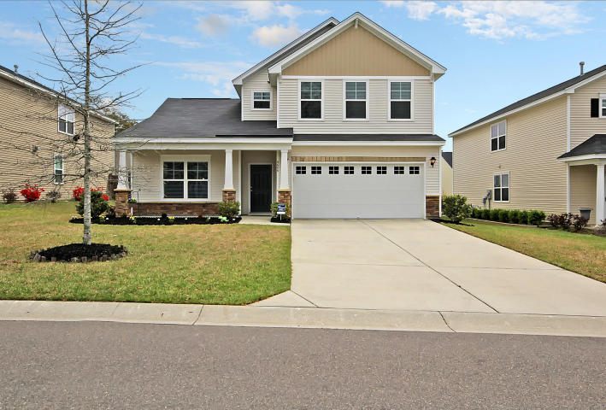
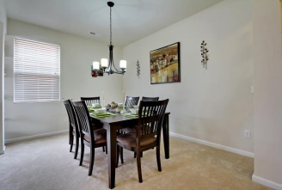
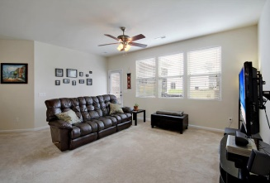
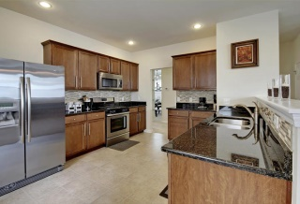
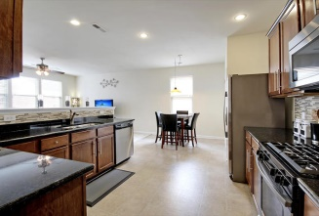
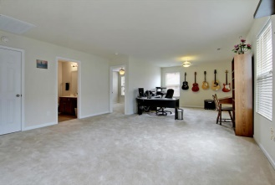
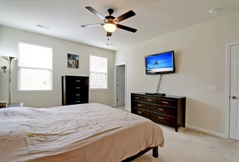
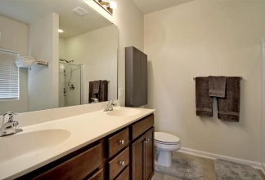
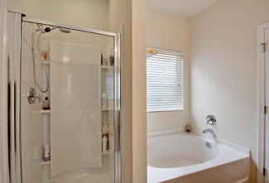
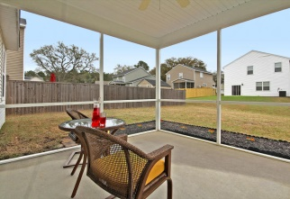
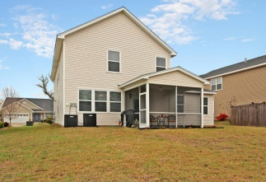

9686 Godwin Street
Mckewn
Ladson, SC 29456
MLS# 15007752
$227,900
4 Bedrooms | 2½ Baths | 2,554 sf
Open House Lunch ~ Friday, Oct 3 from 11 - 1
Handyman Special… Bring your hard hats!
Shows like a model!
This beautiful, pristine home offers so much more than expected! The floor plan boasts of spaciousness; including over 2500 sqft., 4 bedrooms, 2.5 baths gourmet kitchen, pantry, family room, oversized loft, utility/laundry room and separate/open dining and living rooms. The gourmet eat-in kitchen has everything for family dining to informal and formal get-togethers! Stainless steel appliances, gas stove, granite counter tops, and gorgeous 36'' maple cabinets. The breakfast area and entire home is light and bright. When you enter the home you are greeted with airy tall ceilings that spread from the open living room to the dining room. The family room is open to the kitchen and overlooks the welcoming screen porch, which is perfect for relaxing and enjoying a cup of coffee or reveling in the reading of a good book. The master bedroom is on the main floor and offers an attached bath with garden tub and separate shower and a walk-in closet. There are three additional bedrooms on the second floor that share a bath. The loft is expansive and could easily be a media room or game room, and still has enough room for a separate office. The home sits on an interior lot and has a wonderful yard with room for kids to play and parents to bbq and entertain at the same time. The clean and spacious garage offers an abundance of room and for additional storage the spacious walk-in attic is very easy to access-no fold down stairs or climbing up! The home features a MANABLOC water distribution system that allows the owner to turn water on/off to every fixture separately, Taexx built-in pest control system, and is dual zone climate controlled. McKewn is a wonderfully landscaped community that is walking distance to the elementary school and close to local shopping and grocery stores. The neighborhood is a short drive to downtown Charleston with 5-star restaurants, world class shopping and iconic history as well as a short drive to the beaches, the airport, Boeing and Daniel Island. This house supersedes all expectations!
Jill Marcacci
843-297-5590
jill@agentowned.com
www.agentownedrealty.com
AgentOwned Realty Co. Preferred Group, Inc. | 824 Johnnie Dodds Blvd | Mt Pleasant, SC 29464

