Slide 1
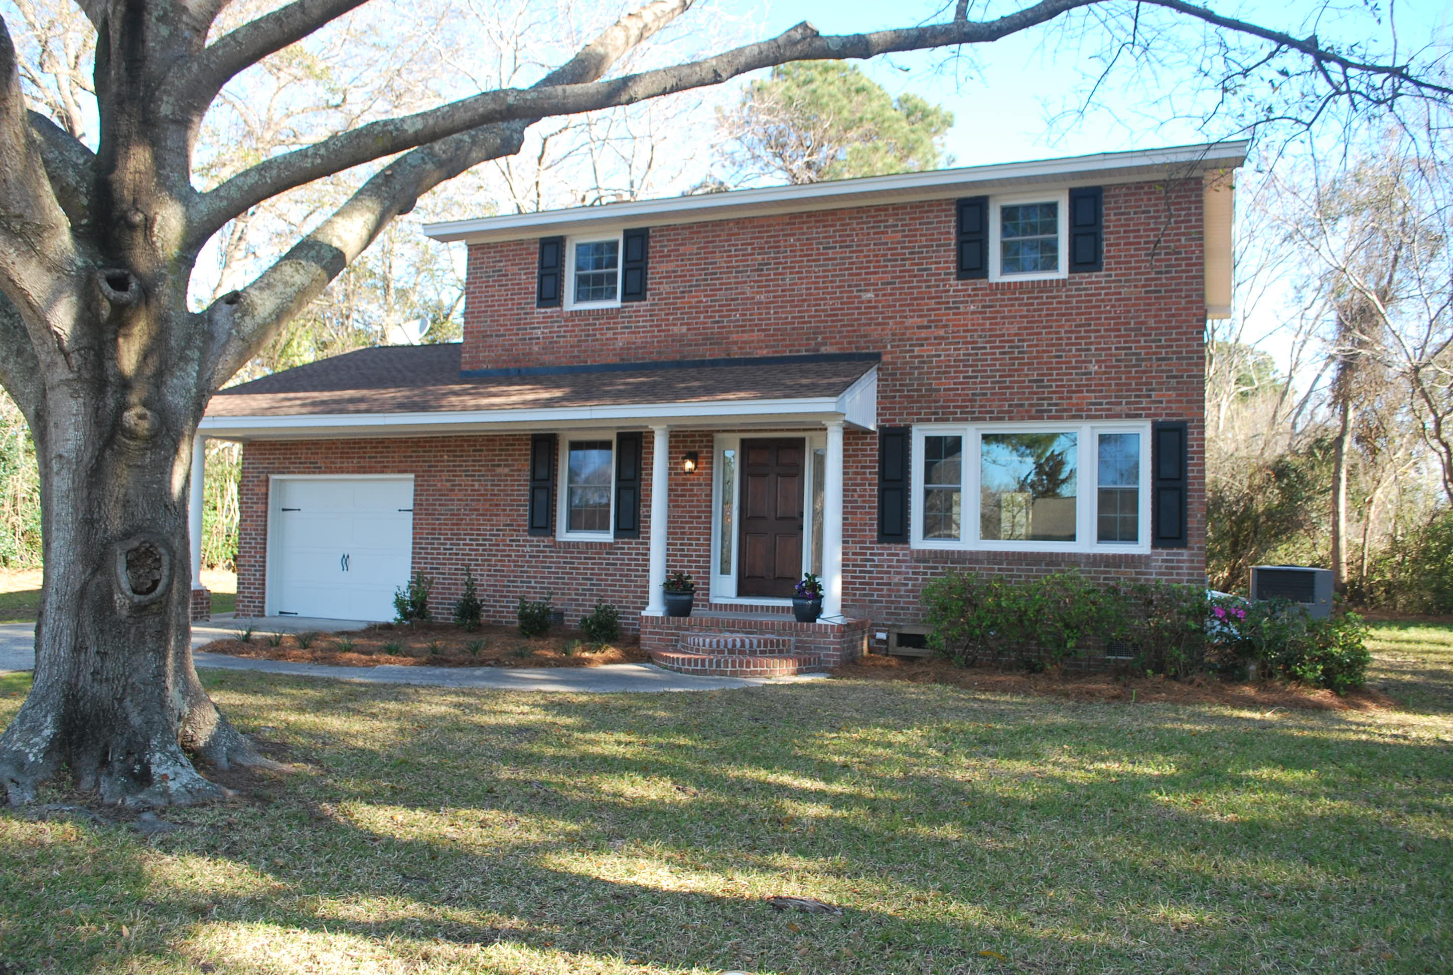
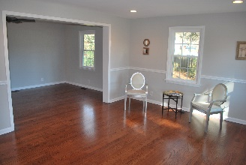
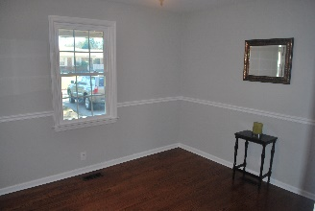
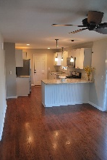
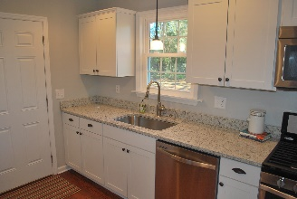
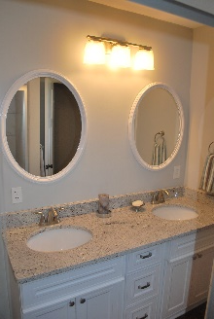
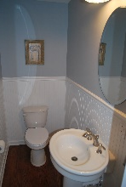
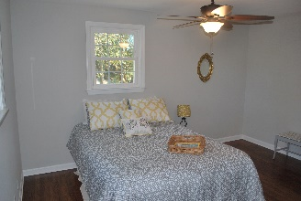
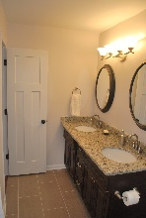
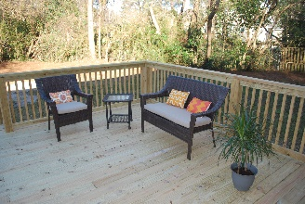


Stunning Renovation on James Island ~ New Listing
968 Travers Dr ~ Charleston
MLS# 16004972 ~ $419,900
Just-renovated!! Classic brick home located walking distance to the harbor, where you can take-in gorgeous marsh-views. Inside, you're greeted with an open floor-plan, new hardwood floors, solid craftsman 3-panel doors, and oil-rubbed bronze knobs. The new kitchen features shaker-style cabinets, granite counters, recessed-lighting, and stainless appliances, including a gas range. The two full baths and powder room are remodeled, with beadboard, ceramic tile, granite-top vanities, and brushed-nickel fixtures. The master bedroom has a spacious walk-in closet. Other upgrades include: Pella thermal windows, plumbing, electrical, HVAC ductwork, huge 20x16 deck, garage door & more. Zoned for the new Harborview Elementary School!
Jeff Irvine
Mobile - (843) 619-9930
irvine.jeff1@gmail.com | www.theblvdcompany.com
The Boulevard Company, LLC | 35 Broad Street | Charleston, SC 29401

