Slide 1
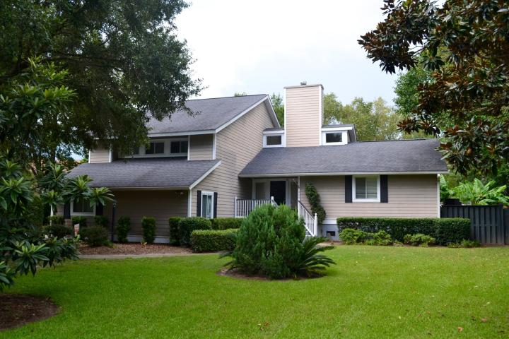
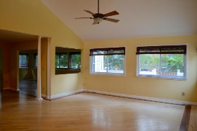
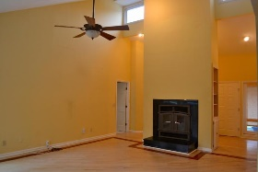
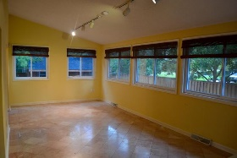
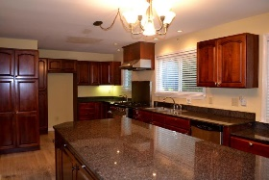
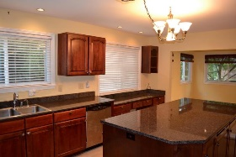
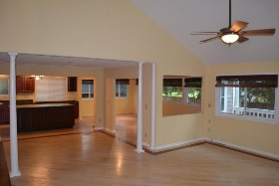
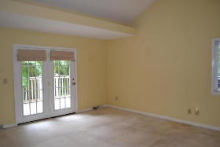
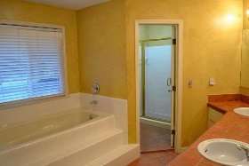
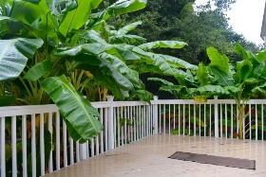
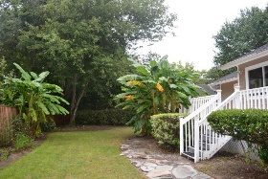
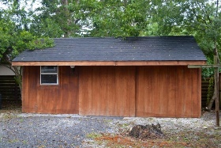
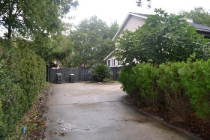

968 White Point Blvd White Point Charleston, SC 29412 MLS# 15023526 $599,000 4 Bedrooms | 2½ Baths | 2,750 sf
Rare James Island Hideaway ~ Big Price Drop!
REDUCED! REDUCED! REDUCED! MAKE US AN OFFER TODAY!
Not many homes come on the market in this sought after James Island neighborhood! A private hideaway tucked one block from the Charleston Harbor with a beautiful view of the Ravenel Bridge. Many improvements have been made in the last 16 years by this owner including: 36 sliding windows in 2006, new roof 2002, AC unit downstairs 2013, AC unit upstairs 2005, and hardy plank siding 2006. Oak whitewashed floors with a cherry Brazilian inlaid border (need to be reconditioned) are found in the living room. Dinner? Let's head to a kitchen anyone would love to create a meal. Solid cherry cabinets, large island, granite counter tops, double sink for cleaning up, vegetable sink to prepare for the professional chef’s six-burner gas Vulcan stove! This beautiful kitchen overlooks the living room with a large wood burning fireplace and the enclosed sun-room with marble floors. The large windows look into the well-manicured backyard. Having breakfast or an ice cream sundae? Grab a banana from the banana trees off the back deck! There's also a large barn shed on the property with power for any handy man's cave! A half bath off the living room has also been redone. The master bedroom is located off the living room with a beautiful large bathroom, shower, a whirlpool bathtub and custom-made closet storage (see pictures). Now, that's the first floor! Head upstairs to the three additional bedrooms, also with custom made closet systems (carpet needs to be replaced).
Susan & Greg Day
843-900-0477 | 732-757-2904 charlestonbyday@gmail.com
www.charlestonbyday.com
AgentOwned Realty Co. Premier Group, Inc. | 824 Johnnie Dodds Blvd | Mt Pleasant, SC 29464

