Slide 1
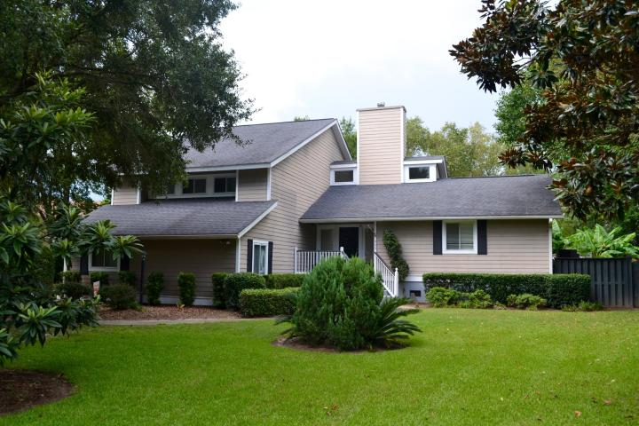
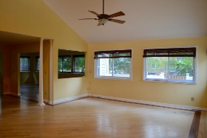
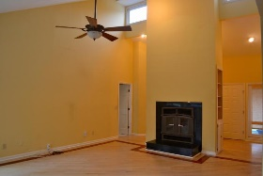
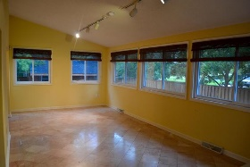
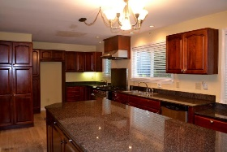
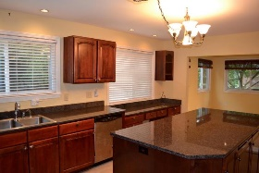
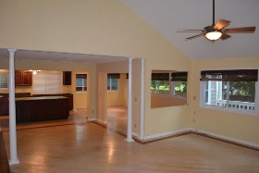
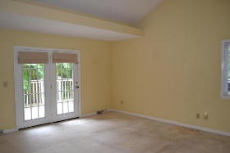
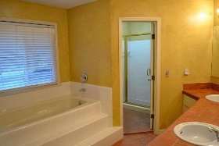
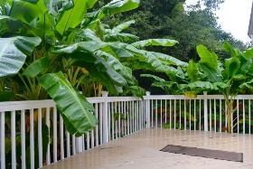
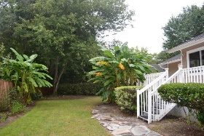
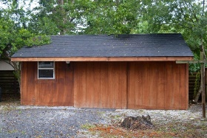
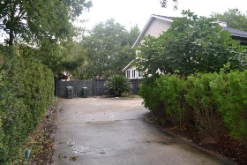

968 White Point Blvd White Point Charleston, SC 29412 MLS# 15023526 $499,000 4 Bedrooms | 2½ Baths | 2,750 sf
Short Sale Approved ~ BIG Price Drop!
REDUCED! REDUCED! REDUCED!
Not many homes come on the market in this sought after James Island neighborhood! A private hideaway tucked one block from the Charleston Harbor with a beautiful view of the Ravenel Bridge. Many improvements have been made in the last 16 years by this owner including: 36 sliding windows in 2006, new roof 2002, AC unit downstairs 2013, AC unit upstairs 2005, and hardy plank siding 2006. Oak whitewashed floors with a cherry Brazilian inlaid border (need to be reconditioned) are found in the living room. Dinner? Let's head to a kitchen anyone would love to create a meal. Solid cherry cabinets, large island, granite counter tops, double sink for cleaning up, vegetable sink to prepare for the professional chef's six-burner gas Vulcan stove! This beautiful kitchen overlooks the living room with a large wood burning fireplace and the enclosed sun-room with marble floors. The large windows look into the well-manicured backyard. Having breakfast or an ice cream sundae? Grab a banana from the banana trees off the back deck! There's also a large barn shed on the property with power for any handy man's cave! A half bath off the living room has also been redone. The master bedroom is located off the living room with a beautiful large bathroom, shower, a whirlpool bathtub and custom-made closet storage (see pictures). Now, that's the first floor! Head upstairs to the three additional bedrooms, also with custom made closet systems (carpet needs to be replaced).
MAKE US AN OFFER TODAY!
Susan & Greg Day
843-900-0477 | 732-757-2904 charlestonbyday@gmail.com
www.charlestonbyday.com
AgentOwned Realty Co. Premier Group, Inc. | 824 Johnnie Dodds Blvd | Mt Pleasant, SC 29464

