Slide 1
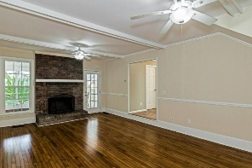
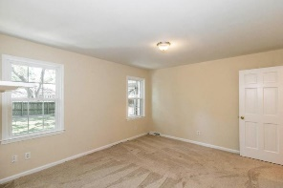
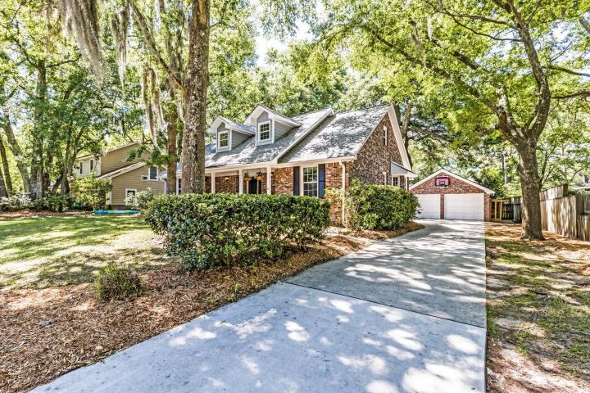
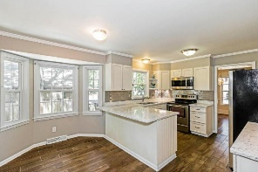
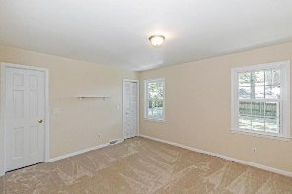
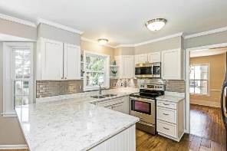
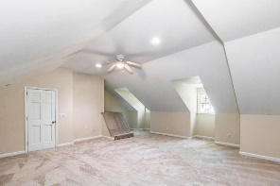
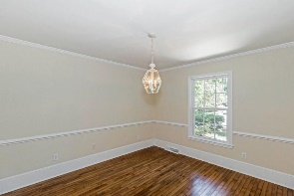
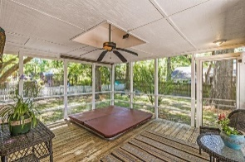
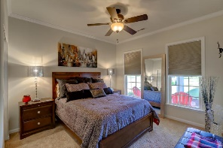
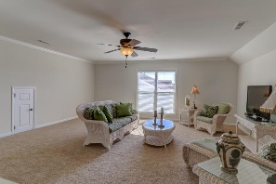
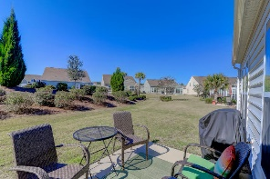
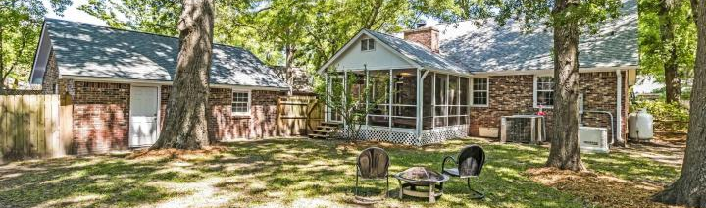



Shemwood II ~ Open House
Friday May 11th 12-3
969 Sea Gull Drive
Mount Pleasant, SC 29464
MLS# 18012278 ~ $675,000
Terrific two story cottage style brick home located in the highly sought after Shemwood ll neighborhood. Freshly painted interior, new bedroom carpeting throughout, recently refinished antique maple flooring, and renovated custom kitchen featuring quartz countertops make this a magnificent move-in ready family home. 4/5 bedrooms, Master Down and a huge Master Suite upstairs, if you so choose, with a sitting room, office, or 5th bedroom just across the hall. Separate formal dining, a Family Room featuring maple wood flooring reclaimed from a Pawley's Island beach home, and a wood burning fireplace for those cool winter nights. Step outside and enjoy the comfort of a screened in porch with jacuzzi, large fenced in back yard for the kids and the pets to play, plus a 2 car detached garage. Owner recently installed a propane fueled Generator just in case the lights were to go down during Hurricane Season! This is one of the great locations in all of Mt. Pleasant, close to Coleman Blvd, 526, and 17. Don't let this one get away!
Elaine Nugent
(843) 330-7044
enugent@carolinaone.com
John Nugent
(843) 304-2061
john.nugent@carolinaone.com
nugentknowsrealestate.com
Carolina One Real Estate | 628 Long Point Rd | Mt Pleasant, SC 29464

