Slide 1
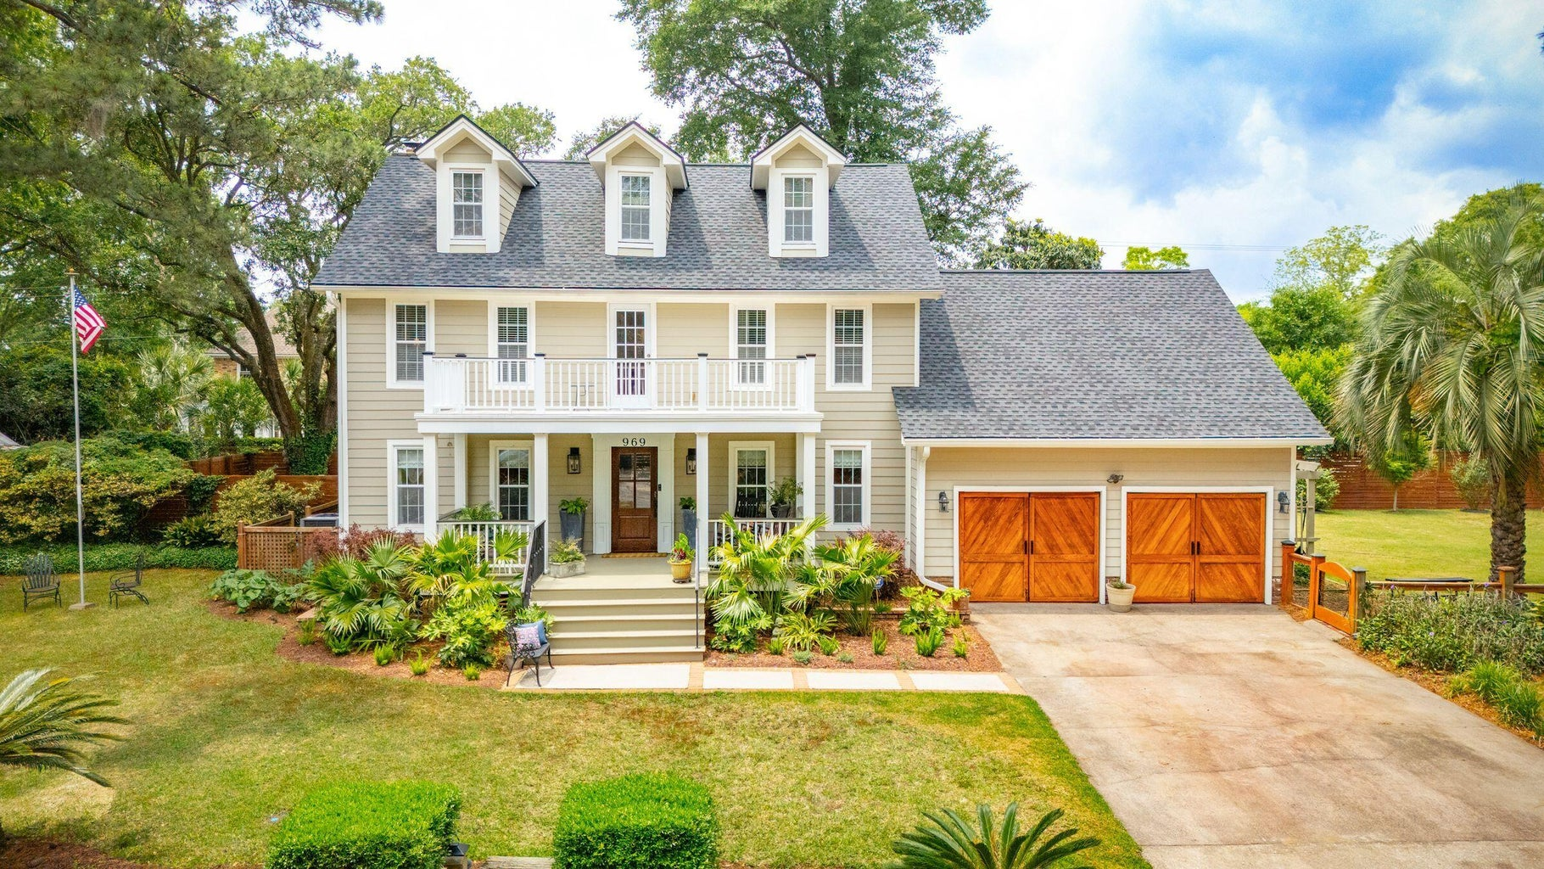
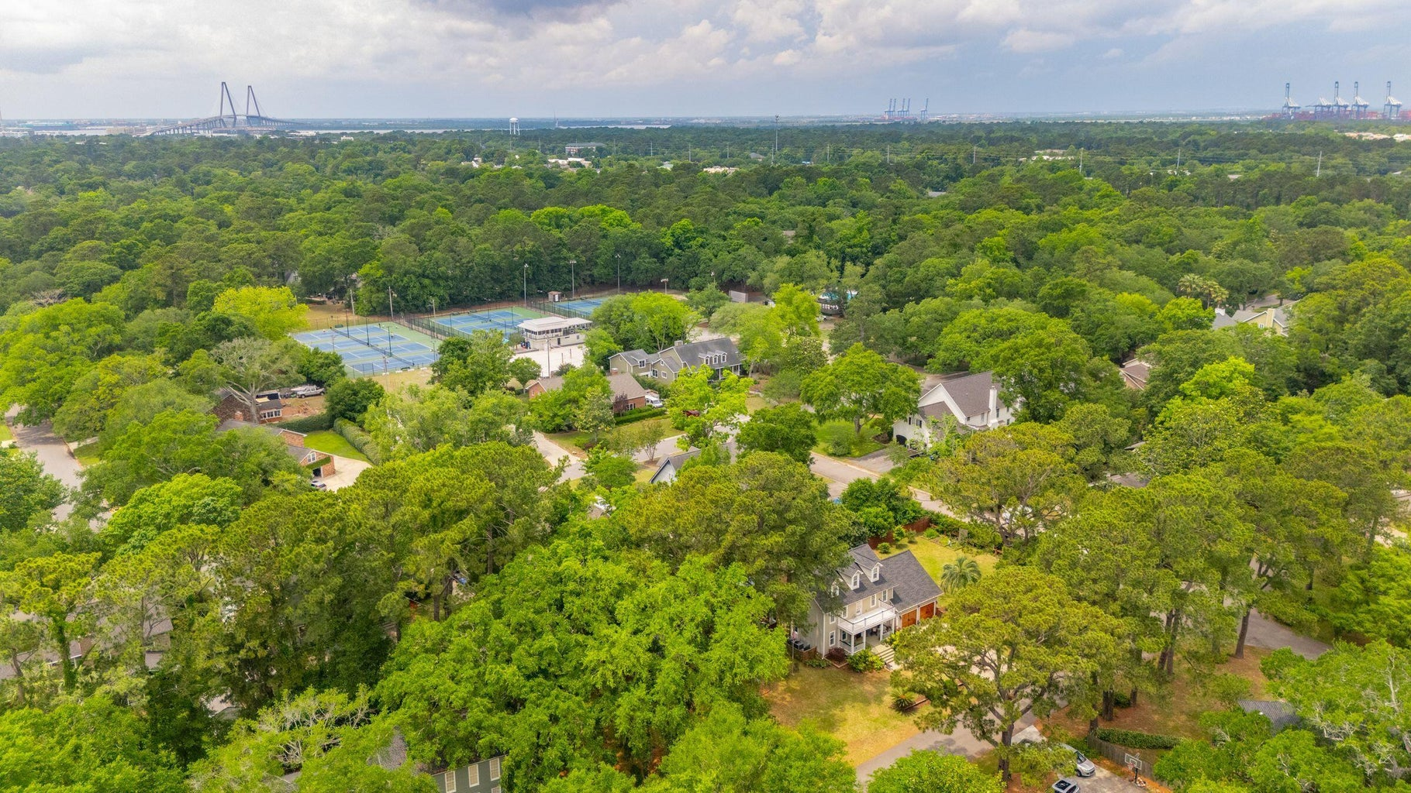
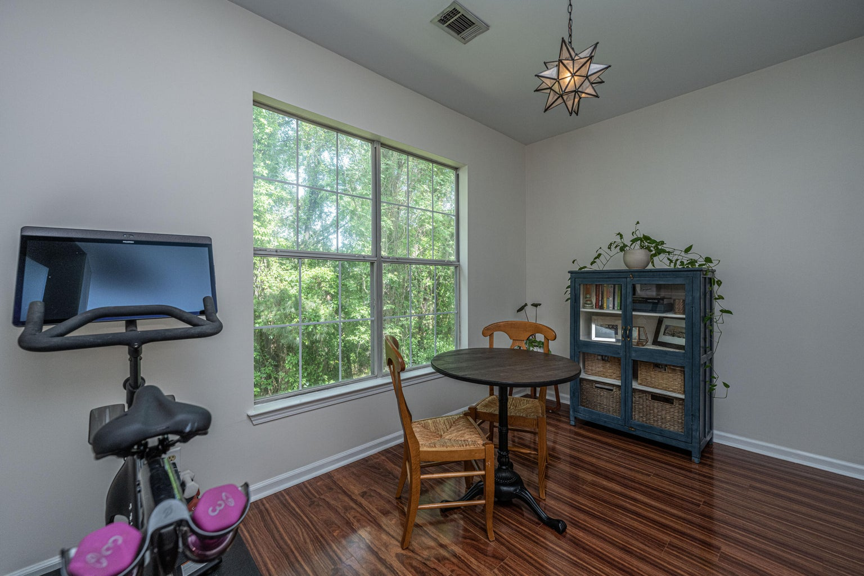
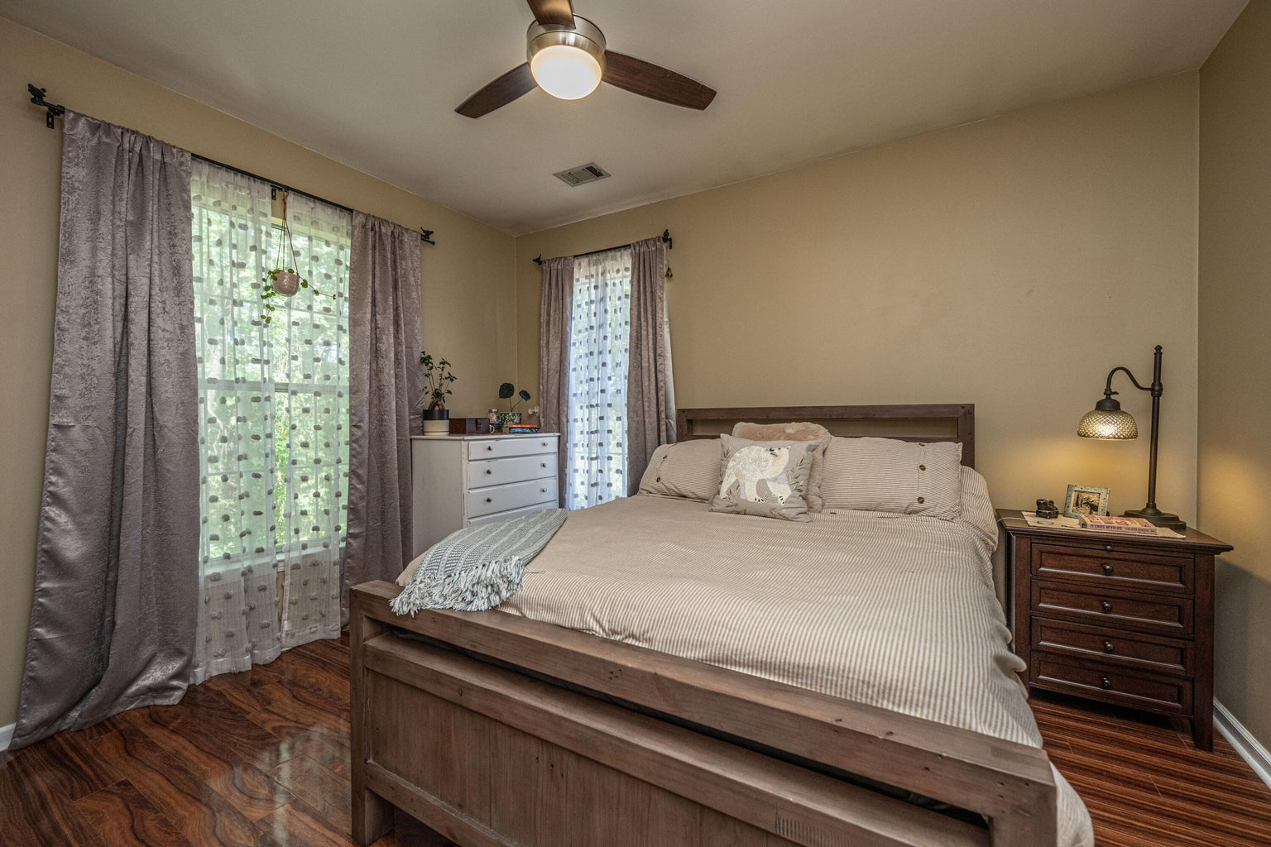



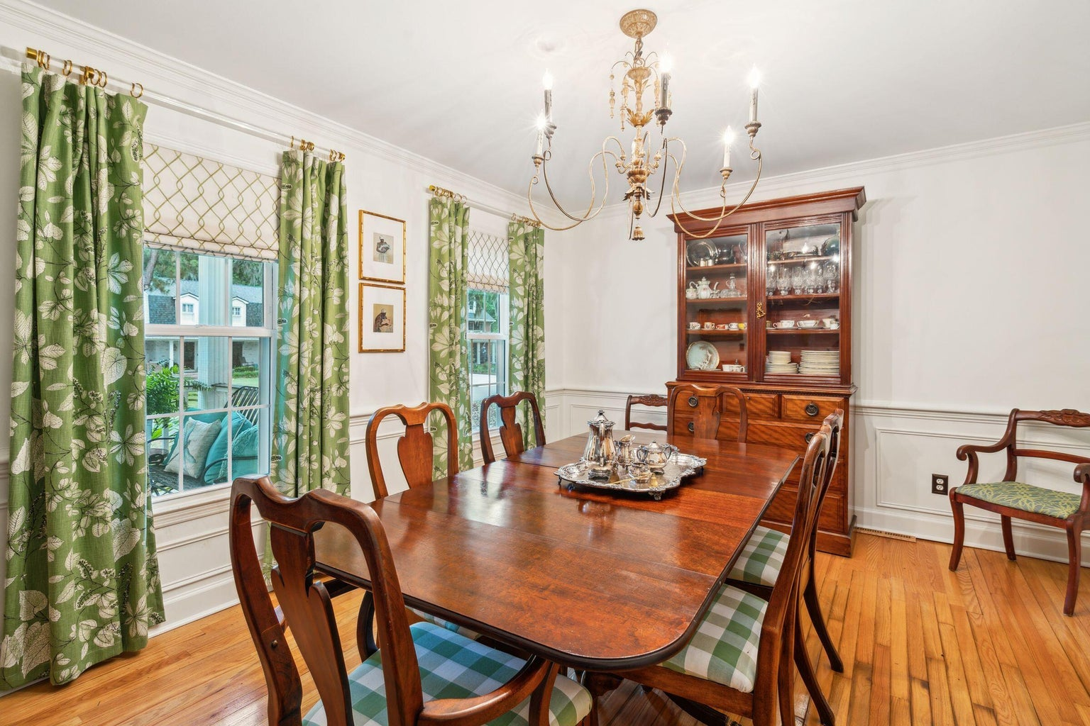
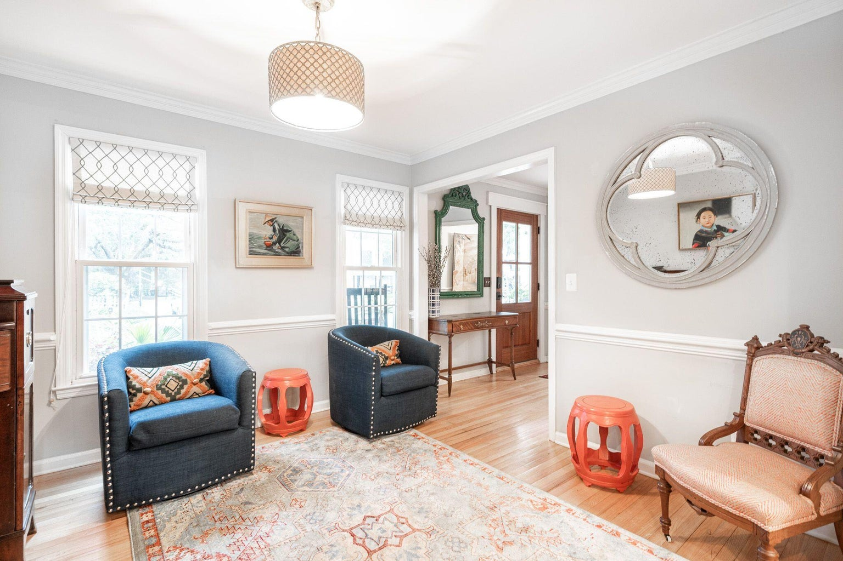
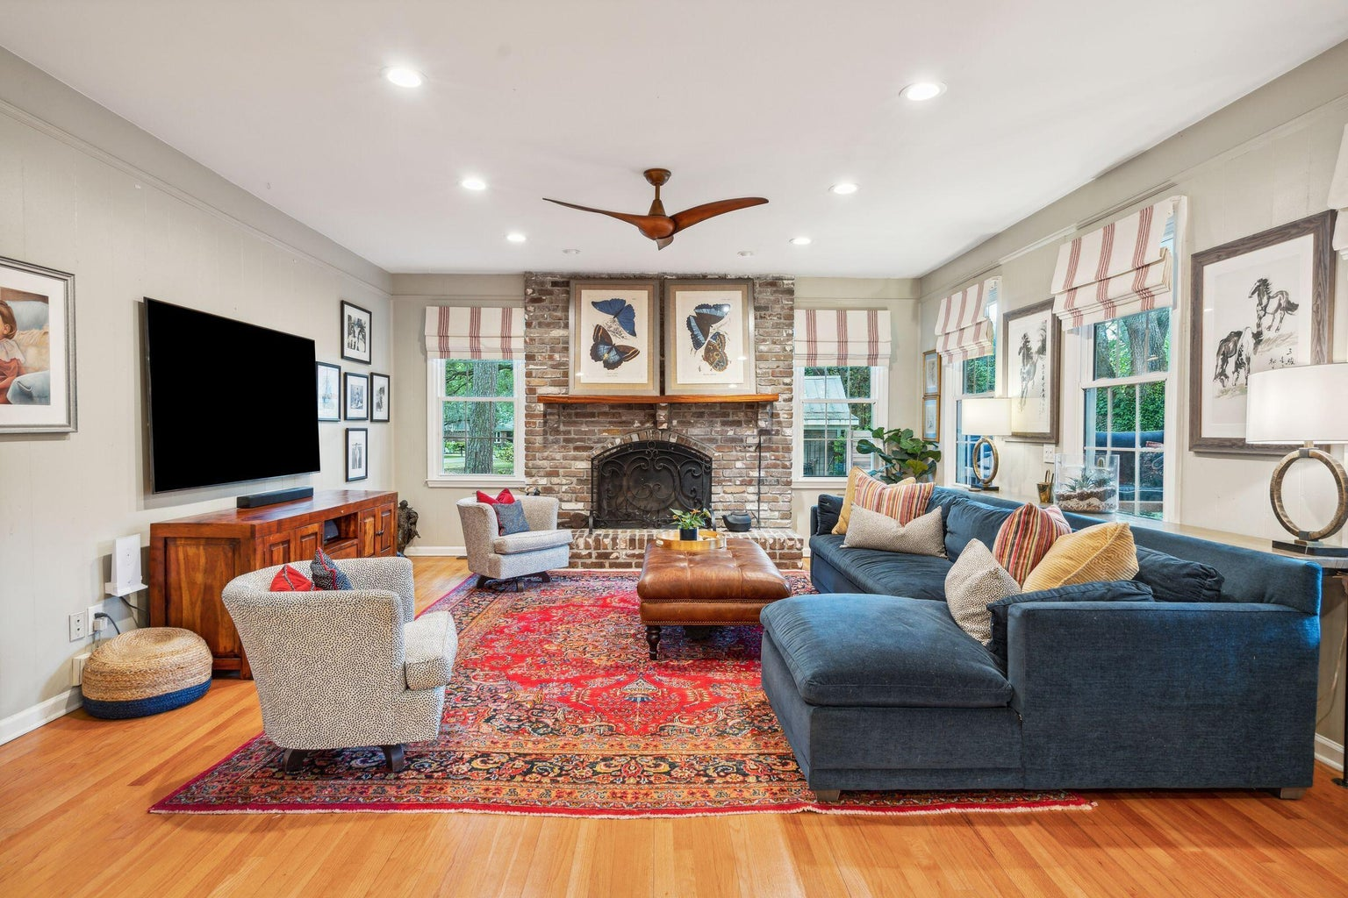
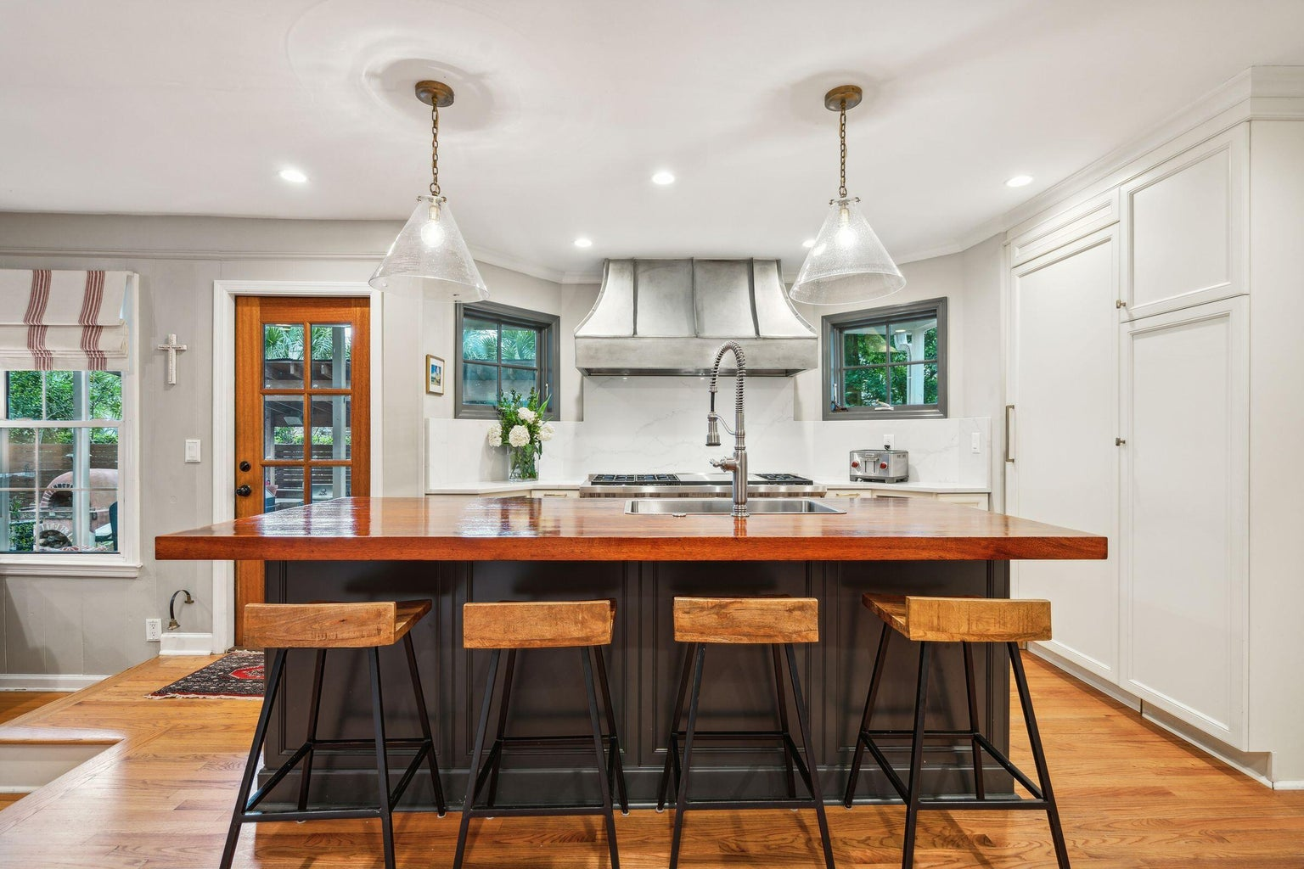
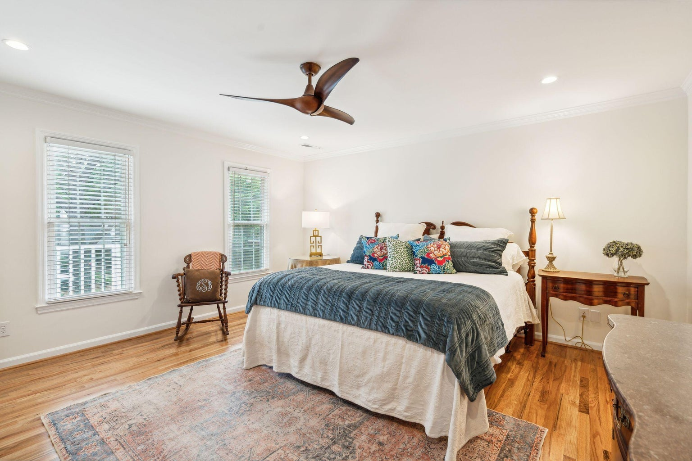
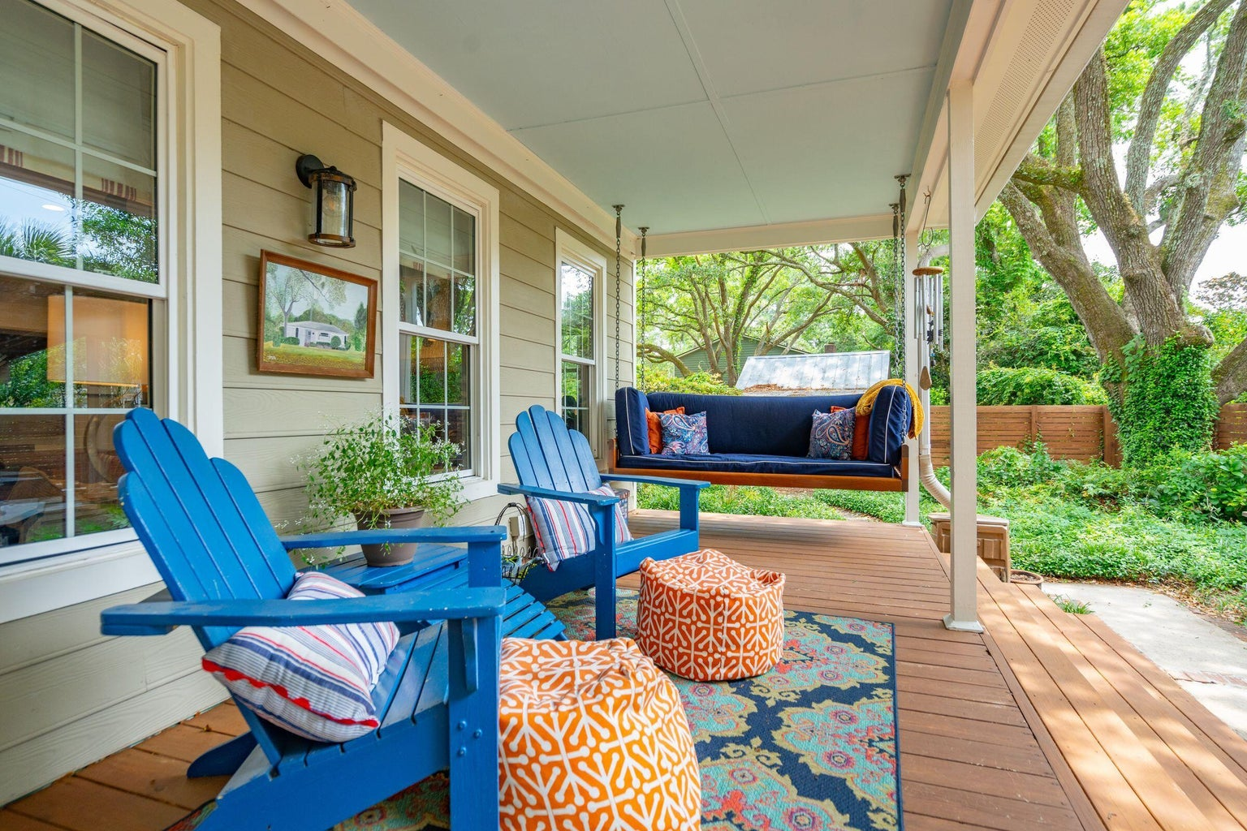
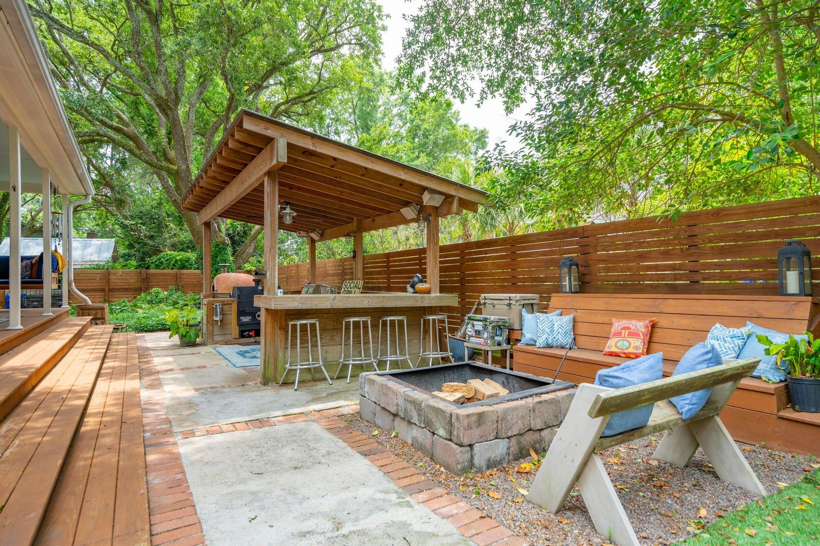
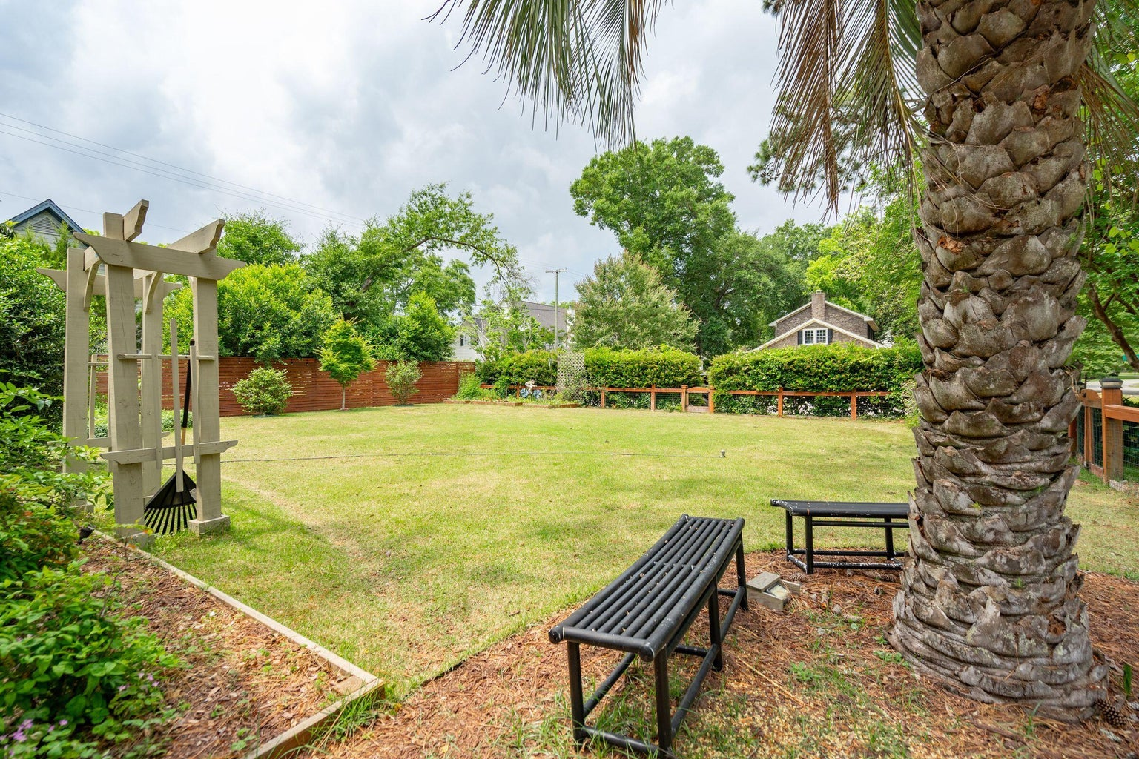



Gorgeous Home on Almost Half Acre Lot
969 Equestrian Drive
Hermitage | Mount Pleasant, SC 29464 | MLS# 24012009 | $1,850,000
Embrace comfort and style in this captivating home nestled within one of Mount Pleasant's most sought-after neighborhoods. Spanning over 3,000 square feet across nearly half an acre of lush surroundings, this home offers a spacious retreat infused with charm. Step inside to discover four generously sized bedrooms, including a recently updated primary suite, accompanied by three full bathrooms and one convenient half bathroom. The heart of the home is the gourmet kitchen, boasting an oversized Wolff range with a custom vent and Sub-Zero refrigerator, ideal for both culinary enthusiasts and everyday living.
Perfect for entertaining, the expansive living room and wet bar seamlessly flow to the outdoor living space, where Lowcountry living awaits with an inviting outdoor kitchen and serene surroundings.
Home features beautiful hardwood floors, a versatile bonus room and access to membership at the Creekside Tennis and Swim Club.
This is a rare opportunity to own a home situated in the heart of Mount Pleasant conveniently located near restaurants, shops and only minutes from island beaches and Historic Downtown Charleston.
Video Tour
4
3
1,844
Noah Moore 843-412-0263
nmoore@carolinaoneplus.com
www.pressonmooregroup.com
Carolina One Real Estate
1503 Palm Blvd
Isle of Palms, SC 29451-2280

