Slide 1
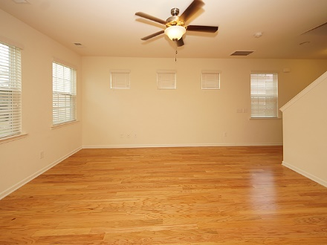
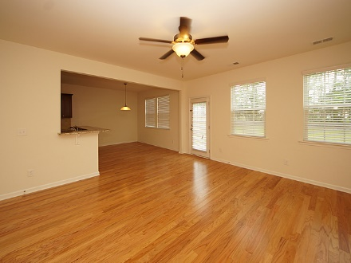
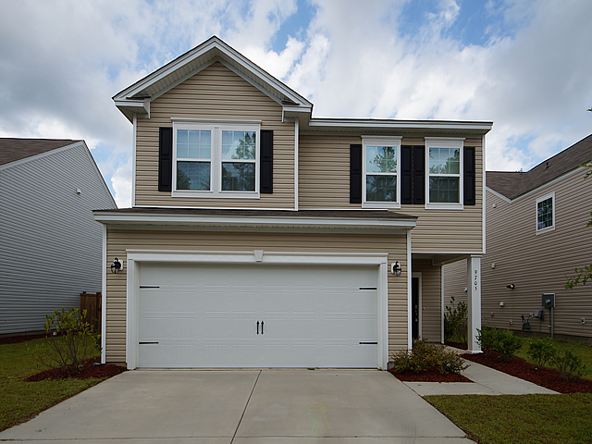
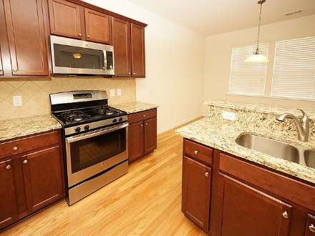
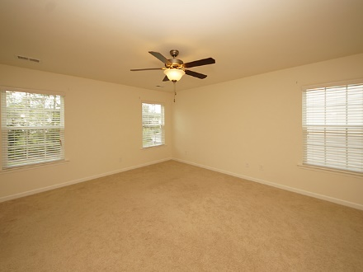
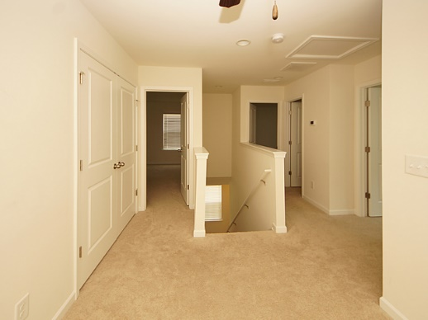
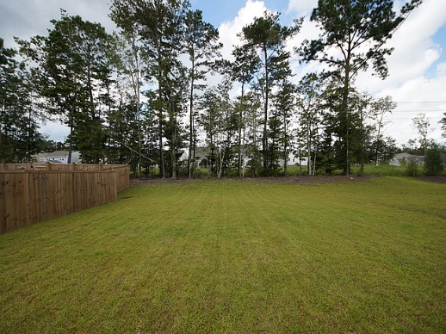
Seller willing to pay $4000 of buyers closings costs with acceptable offer
9705 Cherrybark Ct
Coosaw Preserve
Ladson, SC 29456
MLS# 17024450
$229,500
3 Bedroom ~ 2½ Baths
1,645 Square Feet
Welcome Home to 9705 Cherrybark Ct. This beautiful 2 story home offers plenty of space and tons of natural light. Both Front and back yards overlook the beautifully preserved green spaces Coosaw Preserve offers. Hardwoods throughout the first floor. Upgraded kitchen with granite countertops, stainless steel gas stove, dishwasher, microwave and refrigerator, beautiful dark cabinets and a large pantry. Upstairs you will find three bedrooms and a loft. The 2 secondary bedrooms are great size and both offer WALK IN closets. Storage is not lacking here. The large master bedroom has tons of natural light and WALK IN closet. Master bathroom has a stand up shower and garden tub along with his and her sinks and ceramic tile. Hall bathroom is conveniently located between the two secondary bedrooms. It offers an oversized vanity with tons of counter space and ceramic tiled floors. Laundry room is located on the second floor making it super easy to get laundry done. This home offers a large backyard and can easily be fenced in. Enjoy these hot summer days at Coosaw Preserves beautiful amenity center. Your family can enjoy the summer sun rays in the community pool and allow the kids to blow off some energy at the neighborhood playground. Enjoy the clubhouse and BBQ area with family and friends. Sidewalks throughout make it convenient to enjoy an afternoon stroll.
Jennifer Laffey-Foster, MRP
Real Estate Agent
Miler Properties
Office: 843-821-1111
Cell: 843-708-1582
jlfoster86@gmail.com www.milerproperties.com

